Slide 1

Marketing Strategy with focus on twitter spaces

Slide 2
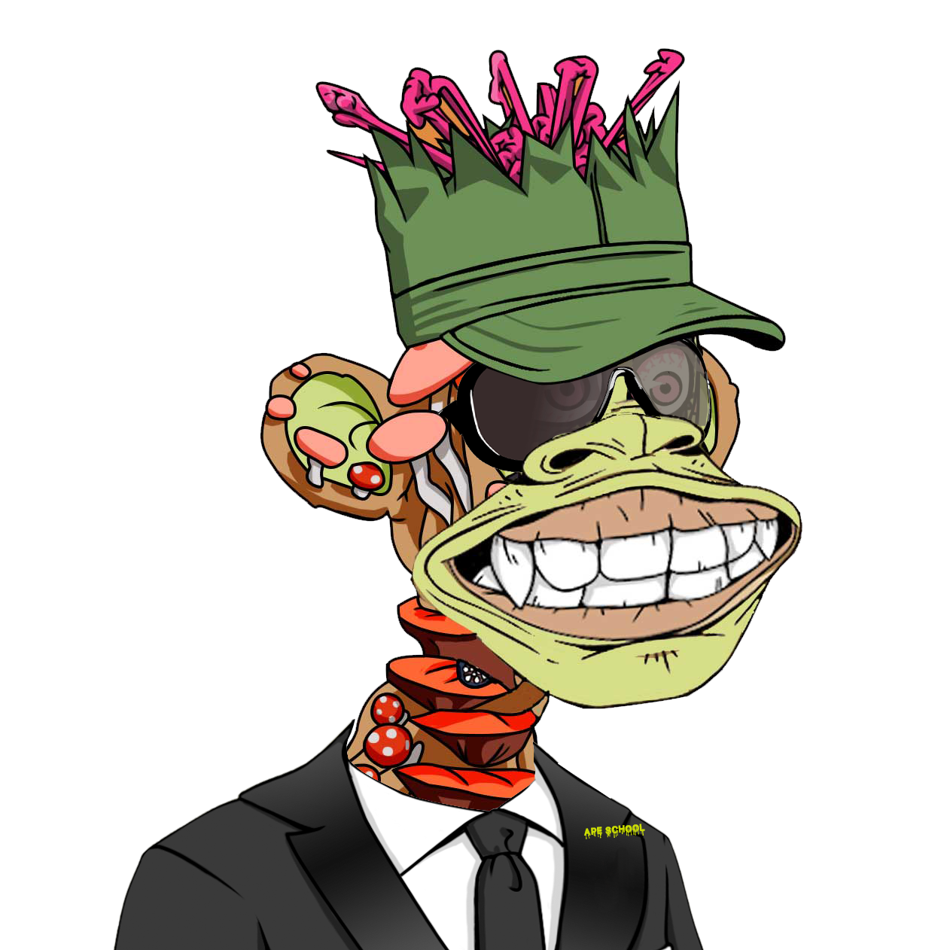

It’s an art to say a lot with only a few words.

Slide 3
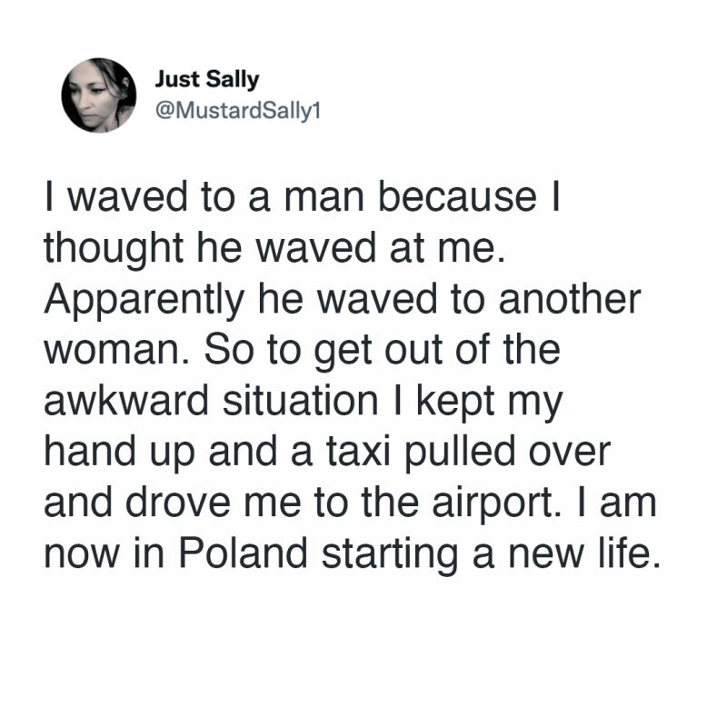

Slide 4
Marketing strategy
We identified 4 major keys for success of NFT projects
  Concept of the NFT project → business plan
    Is there a value for users?
    Why your NFT and not some others’?
    Will you be there in 3 years?
    How will you finance the following before and after mint?
    How will you create needed hypes?
  Network of right people
  Brand (and trust) → storytelling
  Hype
marketing

Slide 5
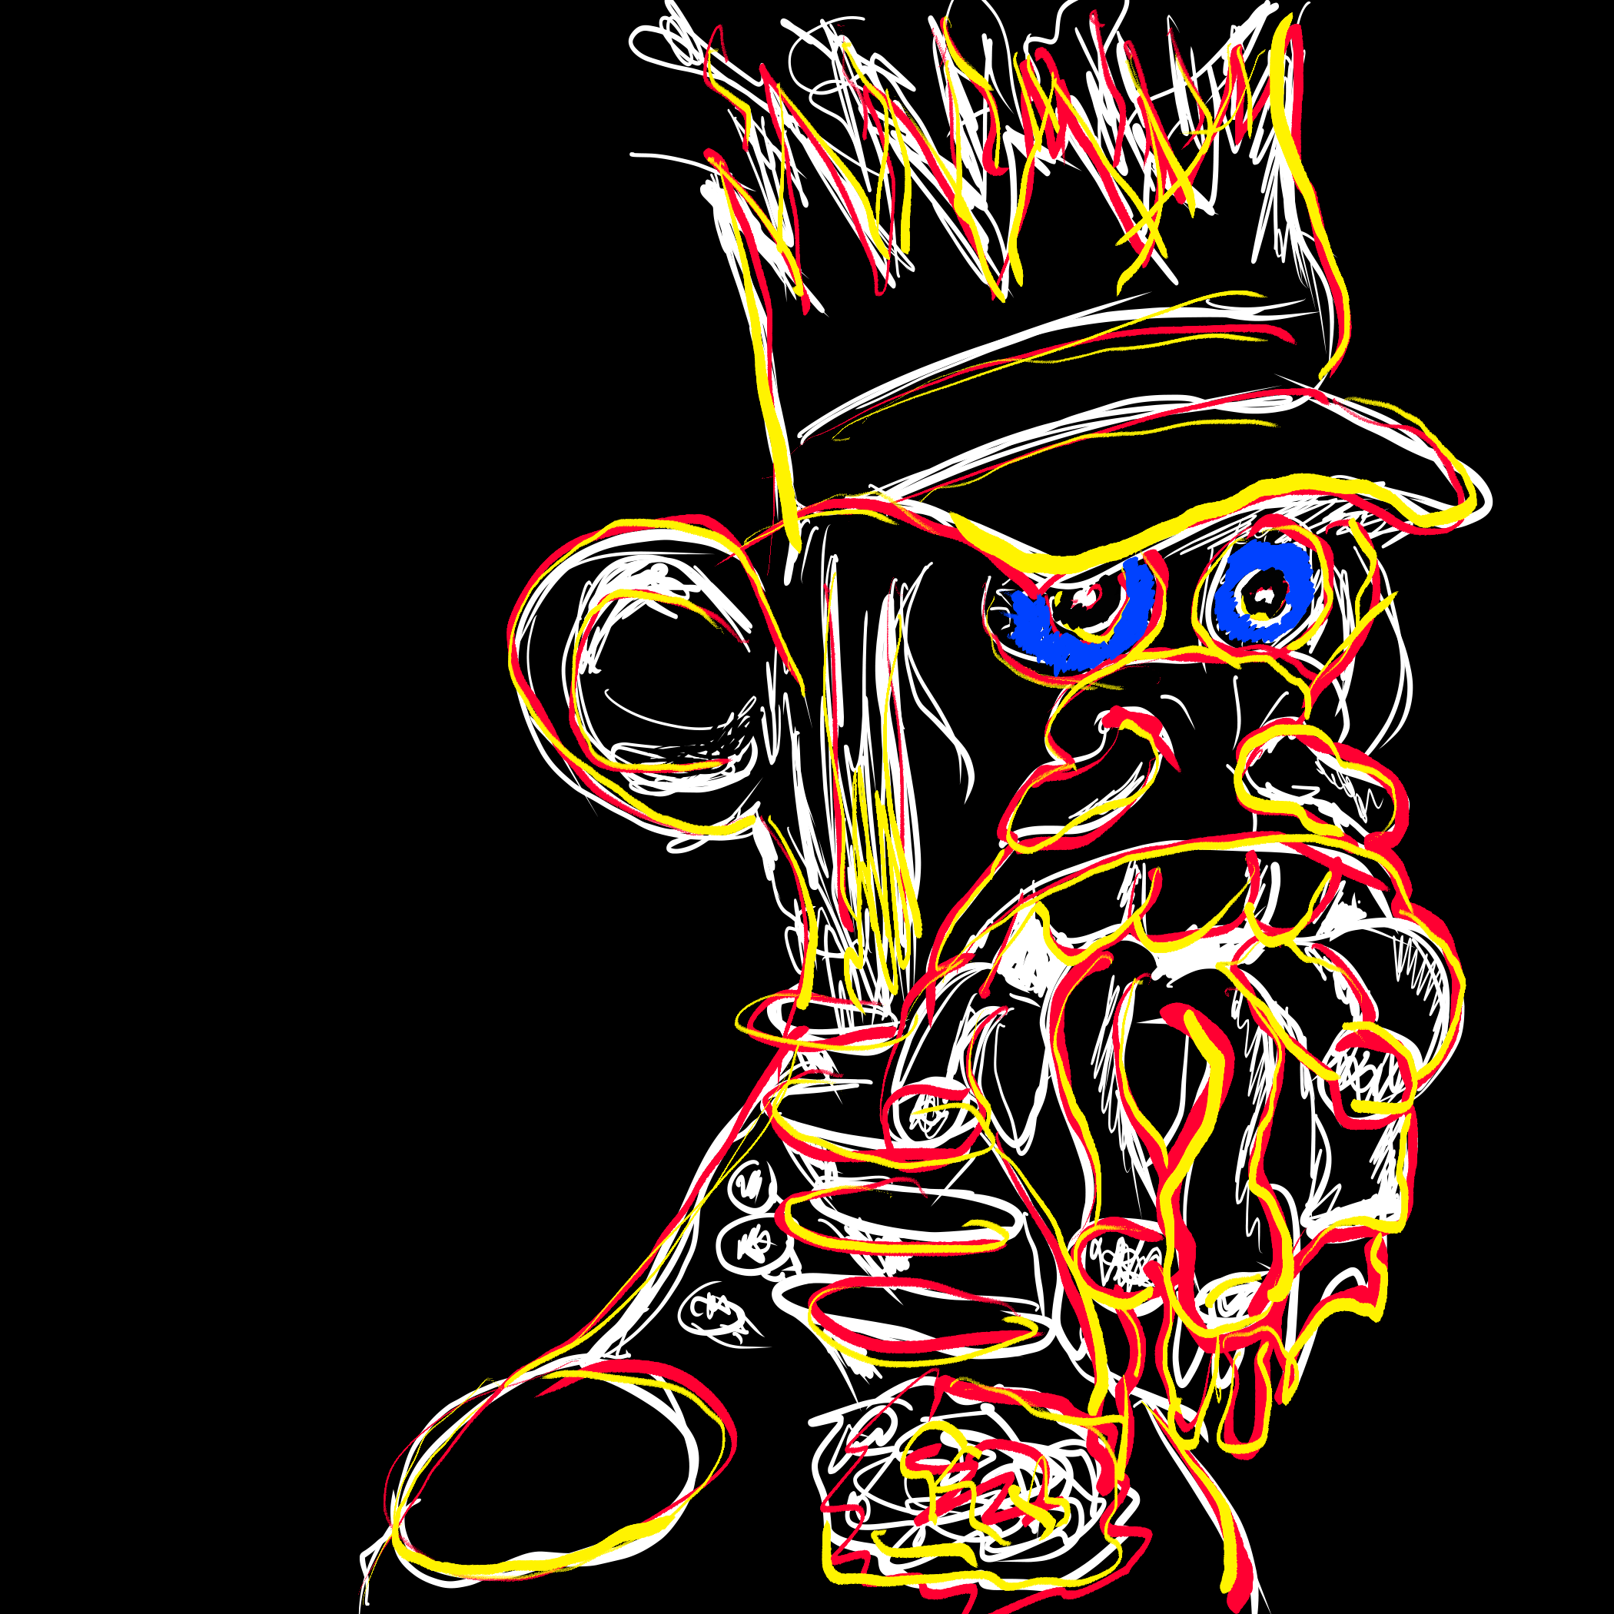
Marketing in web3 projects
There is no successful web3 project without good (web3) marketing.

Slide 6
web2 vs. web3 marketing
Web3 is working like a big social network
  Content and storytelling
  Viral posts, trends, and hype
  Engagement as communication
  Presence and high frequency of interactions/engagement
  Algorithm-driven and controlled
brand and trust

Slide 7
Web3 marketing tools
Most common
Twitter
Discord
Activities in different communities e.g. NFT communities
Whitelist
Cooperations with other projects
Giveaways e.g. NFTs, whitelist spots, crypto, etc.
Influencers
Etc.
Traditional tools e.g. advertisements are mostly not used and not effective

Slide 8
Twitter
The most important marketing tool is Twitter
Why Twitter and not Instagram or any other social network?
  Not 100% clear
  Probably due to Twitter‘s algorithm
    Segmentation of people according to their interest
    Visibility of your interactions → Twitter algorithm is reacting very fast to your behavior.
    Publicity of Twitter communications and interactions → you can interact very easily even with unknown accounts, and everybody can see it and join easily.

Slide 9
Twitter
The key to the success of your web3 project is your Twitter strategy.
Followers | Content | Brand | Persistency | Network | Influencers

Slide 10
Most important elements
Twitter strategy
Amount of followers
  You need enough followers to execute the rest of the strategy
  Strategy to grow followers
    Organically
    Buying followers
    Working with influencers

Slide 11
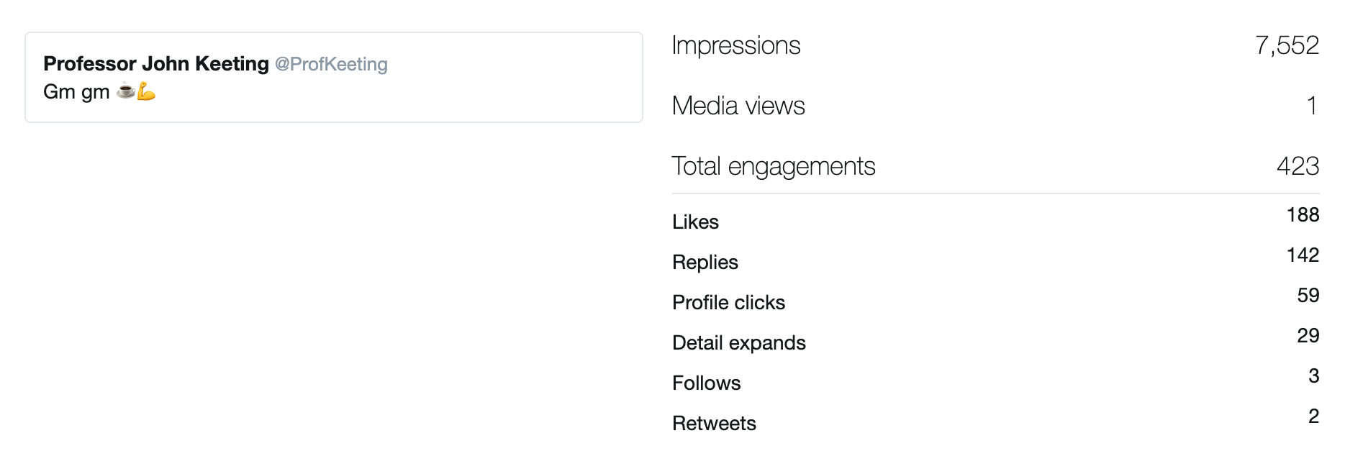
Most important elements
Twitter strategy
Content strategy
  Inline with your story
  Inline with your brand
  “GM” culture

Slide 12
Most important elements
Twitter strategy
Persistency
Network
  Focus on the right accounts (e.g. use lists)
Brand
  Your Twitter account is your identity, and your identity is your brand.
  Imagine that your Twitter account is a person,
    define which characteristic and the way of thinking this person should have and apply that to everything
Influencers
  Give-a-way influencers
  Special area influencers
  Twitter Space influencers
  Celebrities
  Fake influencers

Slide 13
Twitter Spaces
What is it?
Twitter Spaces are public, live audio conversations
A 10% rise in the conversation has led up to a 3% increase in sales volume (source https://business.twitter.com/)
Through Twitter Space you can:
  Engage authentically with fans and followers
  Connect in real-time as something is happening e.g. mint party
  Get inspired in real-time
  Create and deliver value (content) in real-time
  Tell the stories on a natural, engaging way

Slide 14
Twitter Spaces
Equipment that you need
Twitter Spaces are made for mobile phones.
Interaction is not possible on a desktop.
You can use external microphones.
Professional equipment does exist, too.
RodeCaster

Slide 15
Twitter Spaces
Different types in web3 Space
Shill Spaces
Chill Spaces
Educational Spaces
Informative Spaces
Your marketing strategy should be
To cover all of them
To run and join

Slide 16
Twitter Spaces
How to join the space?
As a listener or as a speaker
How to join as a speaker:
  It‘s depending on the host
    By invitation before the space
    By invitation during the space
    By requesting to speak during the space

Slide 17
Twitter Spaces
Strategy if you are joining the space
Shill only in Shill Space or upon request
Prepare what you want to say and learn it
Don‘t read – but you can use notes
Use „Hand“ to request the word
Be polite

Slide 18
Twitter spaces
Strategy if you are runing the space
Finding good topics can be challenging
  For example, you could discuss the web3 news
For moderators: It’s not about you
Prepare a green room for your guests
Screen speaker requests
Be prepared for the app to be glitchy
  Always have a co-host
Stay consistent
Use Spaces before an event to build awareness and reach
Create a Space afterward to keep the conversation going

Slide 19
Twitter Space
Strategy if you are runing the space
Schedule your Space in advance,
Remind your attendees that your Space is happening with push and in-app notifications.
Promote the link for your upcoming space e.g. on your TL.
Ask friends to share
Invite the audience and speakers one by one
Once your Space begins, a “Live Now” card will generate and can also be promoted and shared.

Slide 20
Twitter Spaces
Shill your project
Challenges
The time that you have is very short.
You don’t see your audience and you can‘t react.
You can’t use visual tools.
Your audience is mostly made of usual people not investment institutions but
You don’t know who is sitting in the audience.
Pressure is similar to any other public speaking event.
Don‘t read!

Slide 21
Every pitch is just a story

Slide 25
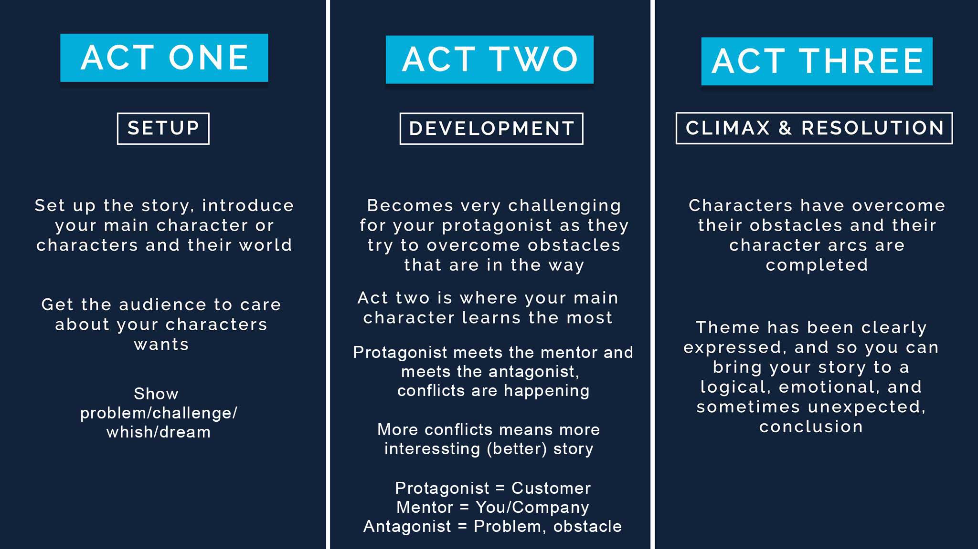
Every pitch is just a story!
Make it dramatically, create conflicts and an emotional end.

Slide 26
Every pitch is just a short story ☺
90s

Slide 27
Twitter Spaces
Tips for your pitch
Introduce your self (only your name and maybe something most important)
Start with a hook
Create a setup → describe the environment, and describe the problem
Describe “conflict“
  What is happening if you don‘t solve the problem?
Make a conclusion
  Use only USPs (unique selling points)
Include call to action
Act one
Act two
Act three
Take care to answer W-questions
  W-hat is your product?
  W-ho should use it?
  W-hy should they use it?
  W-hy is it better than competitor products?
  W-hat are the benefits if somebody used it?

Slide 28
Twitter Spaces
Pitch examples
Let‘s hear and analyze some pitches

Slide 29
Excercize
Select the project, analyze it and create a pitch
  Act like an owner of the project
https://artgobblers.com/
https://www.venturecapitalx.io/
https://bugatticollectionsnft.com/
https://www.fiendz.io/
https://pokeworld.game/
https://thelittles.io/
https://www.mega404.net/
https://www.averagebob.co/
https://freaks.club/
https://twitter.com/NakedPunksNFT
https://nonfungibleknowledge.webflow.io/
https://www.metabrewsociety.com/
https://eloop.app/en/
https://stayopen.com/stay-pass/

