Slide 1
BLOCKCHAIN ART, ART ABOUT BLOCKCHAIN & BLOCKCHAIN FACILITATED ART MARKETS
MARKO SUVAJDZIC
Associate Director
Digital Worlds Institute, University of Florida
Marko Suvajdzic is a diverse thinker working on projects ranging from artificial Intelligence-intensive video game titles for major industry publishers, to co-founding five of his own startups. His research focuses on emerging technologies and their applications in every day life. He has lectured internationally at schools and conferences in USA, UK, India, UAE, Serbia, China, Australia, Norway, and Japan.
marko@digitalworlds.ufl.edu

Slide 2
BLOCKCHAIN LAB
University of Florida
BLOCKCHAIN LAB is a consortium of blockchain companies, industry professionals, and academic researchers.
Our goal is to inspire and develop the next generation of blockchain engineers, entrepreneurs and visionaries. To provide the wider population with the skills and knowledge to be successful in a new digital economy.

Slide 3
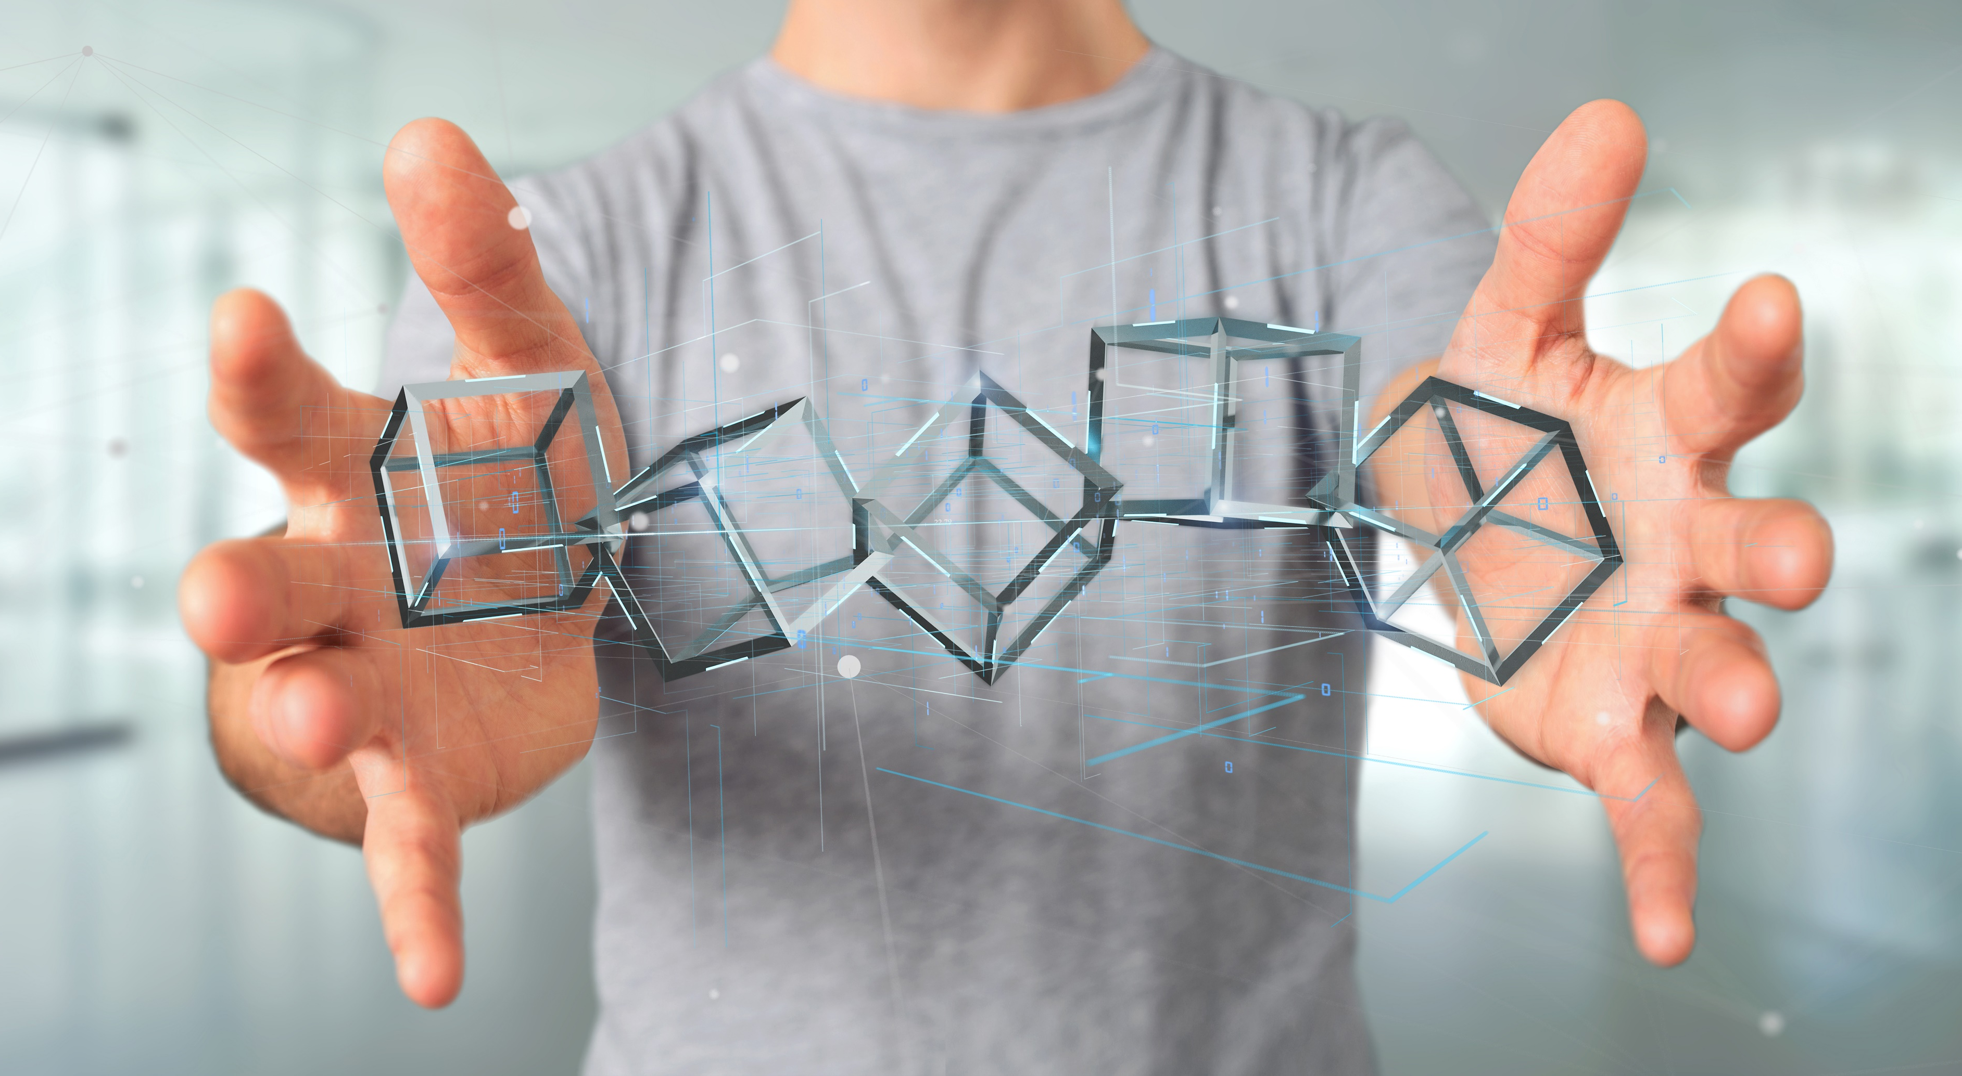
Blockchain Art
“The ideology and technology of the blockchain and the materials of art history—especially the history of conceptual art—can provide useful resources for mutual experiment and technique.”
(Rob Myers, one of the early adopters of blockchain as an artistic tool)

Slide 4
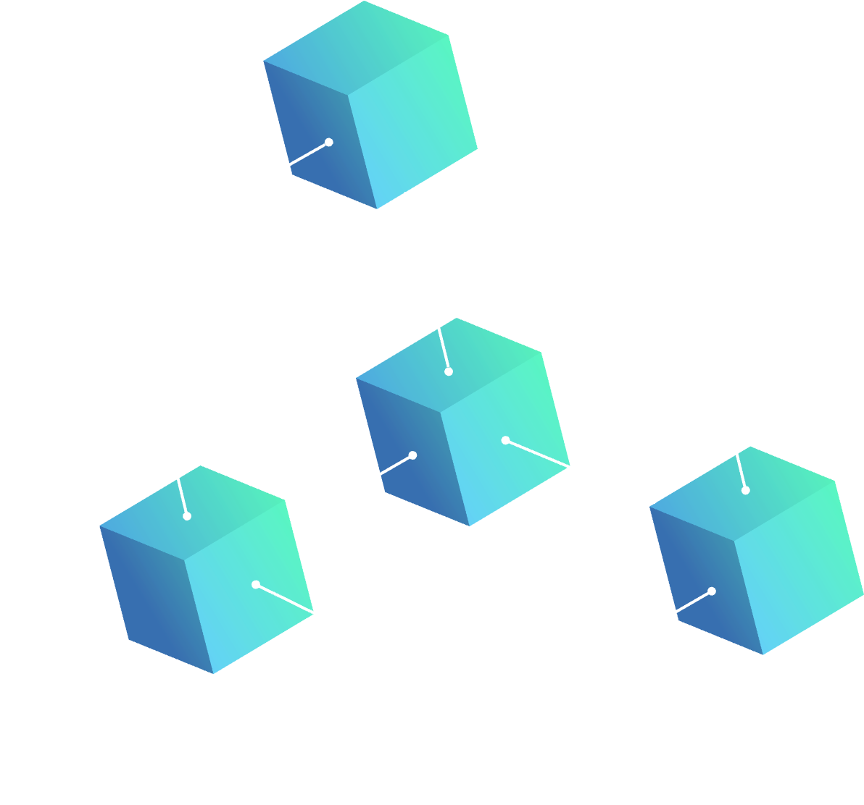
Blockchain Art
Blockchain as means of PAYMENT AND
PURCHASE tracking, crowdfinancing art
ART
about blockchain
BLOCKCHAIN
art
Marko Suvajdzic (msuvajdzic@live.com)

Slide 5
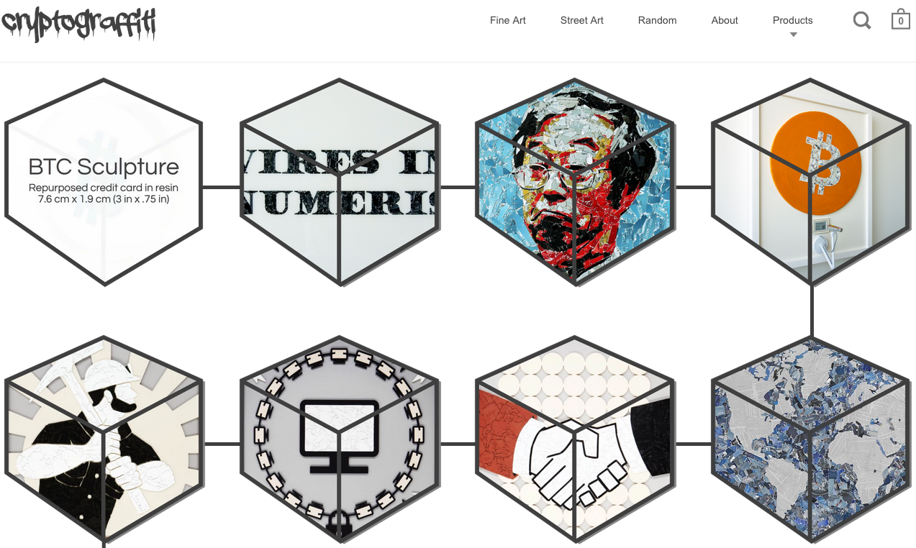

Slide 6
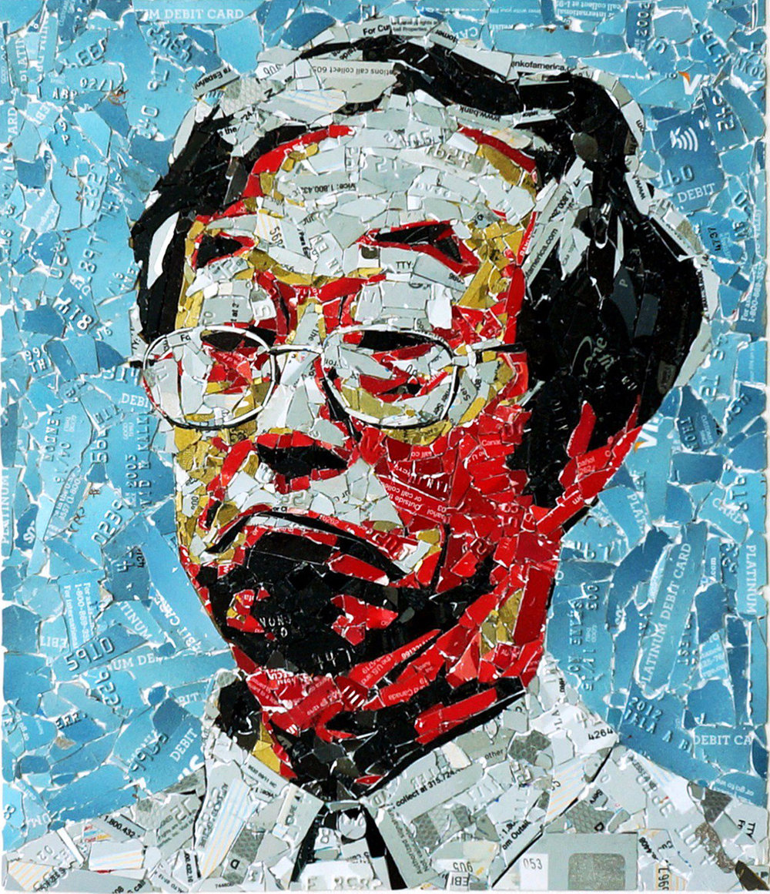
Art About Blockchain
CRYPTOGRAFFITI’S current work repurposes materials from industries being disrupted by the blockchain. These materials will shortly become scarce even though the monetary systems from which they were derived are not.
By incorporating these soon-to-be extinct artifacts in his work, he teaches others about the advantages of cryptocurrencies vs the status quo banking sector.

Slide 7
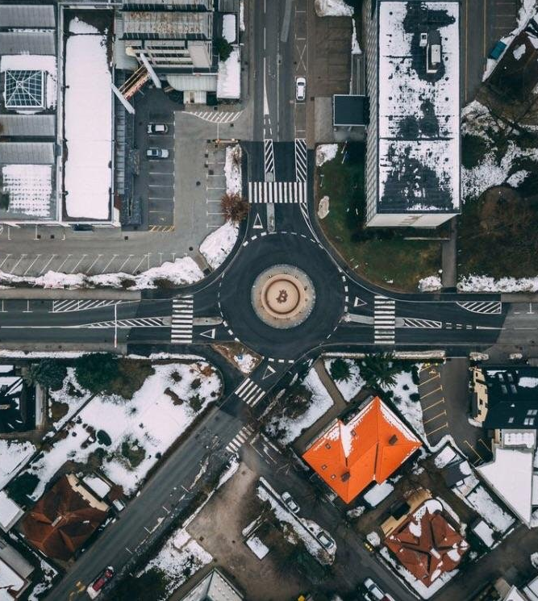
Art About Blockchain
BITCOIN MONUMENT - The Slovenian city of Kranj recently unveiled a public monument to bitcoin and blockchain technology, of which it claims is the first in the world. The monument was financed by major bitcoin exchange Bitstamp, and blockchain software company 3fs.
The three-tonne metal sculpture is situated near Kranj’s courthouse. The circle surrounding the bitcoin ‘B’ has a diameter of roughly seven meters. The statue was created by artists Selman Čorović and Aleksander Frančeškin.

Slide 8
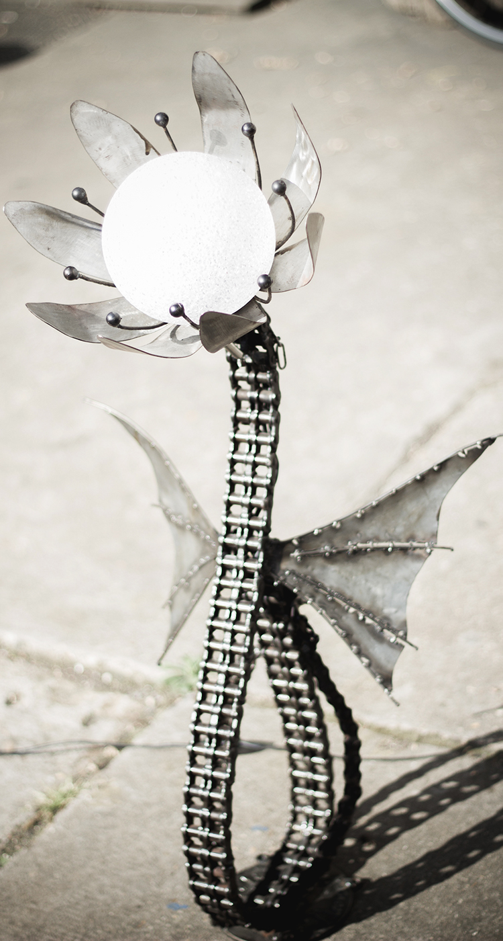
Blockchain Art
Plantoid (2016)
The Plantoid was created by Primavera De Filippi to ‘illustrate the ability to create ‘blockchain-based life forms’’; it’s purpose to educate the world on the inner workings and potential challenges of this emergent technology, by merging familiar concepts from the natural world with blockchain.

Slide 9
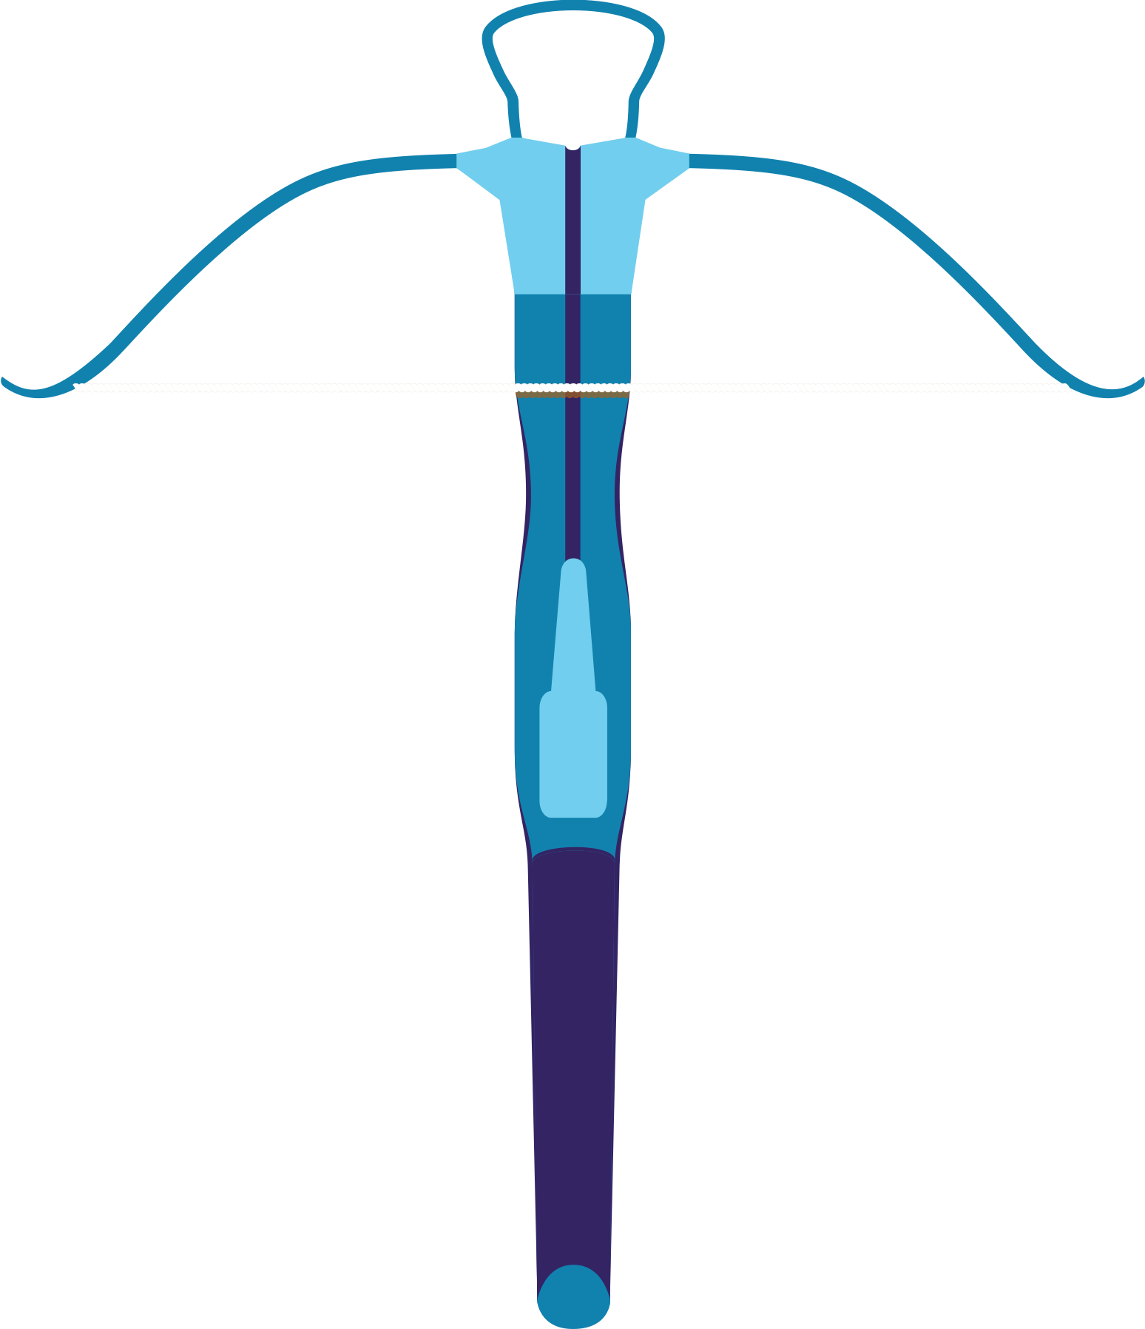
Blockchain Art
Discover Da Vinci
(Digital Worlds, UF, 2019)
Using a novel combination of Augmented and Virtual Reality (AR/VR), blockchain, and spatial computing technologies, the custom “Discover Da Vinci” mobile app will allow users to explore holographic images of da Vinci’s devices.

Slide 10
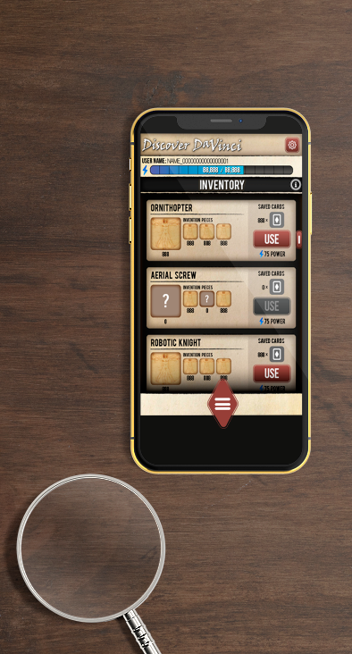
Blockchain Art
Discover Da Vinci
(Digital Worlds, UF, 2019)
Using a novel combination of Augmented and Virtual Reality (AR/VR), blockchain, and spatial computing technologies, the custom “Discover Da Vinci” mobile app will allow users to explore holographic images of da Vinci’s devices.

Slide 11
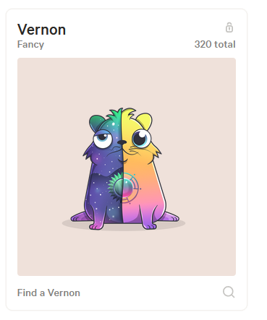
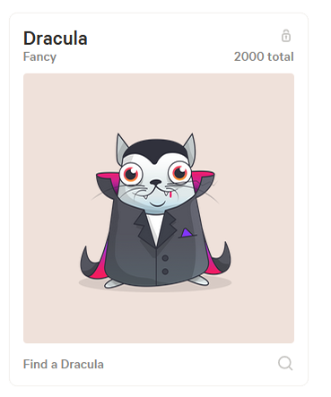
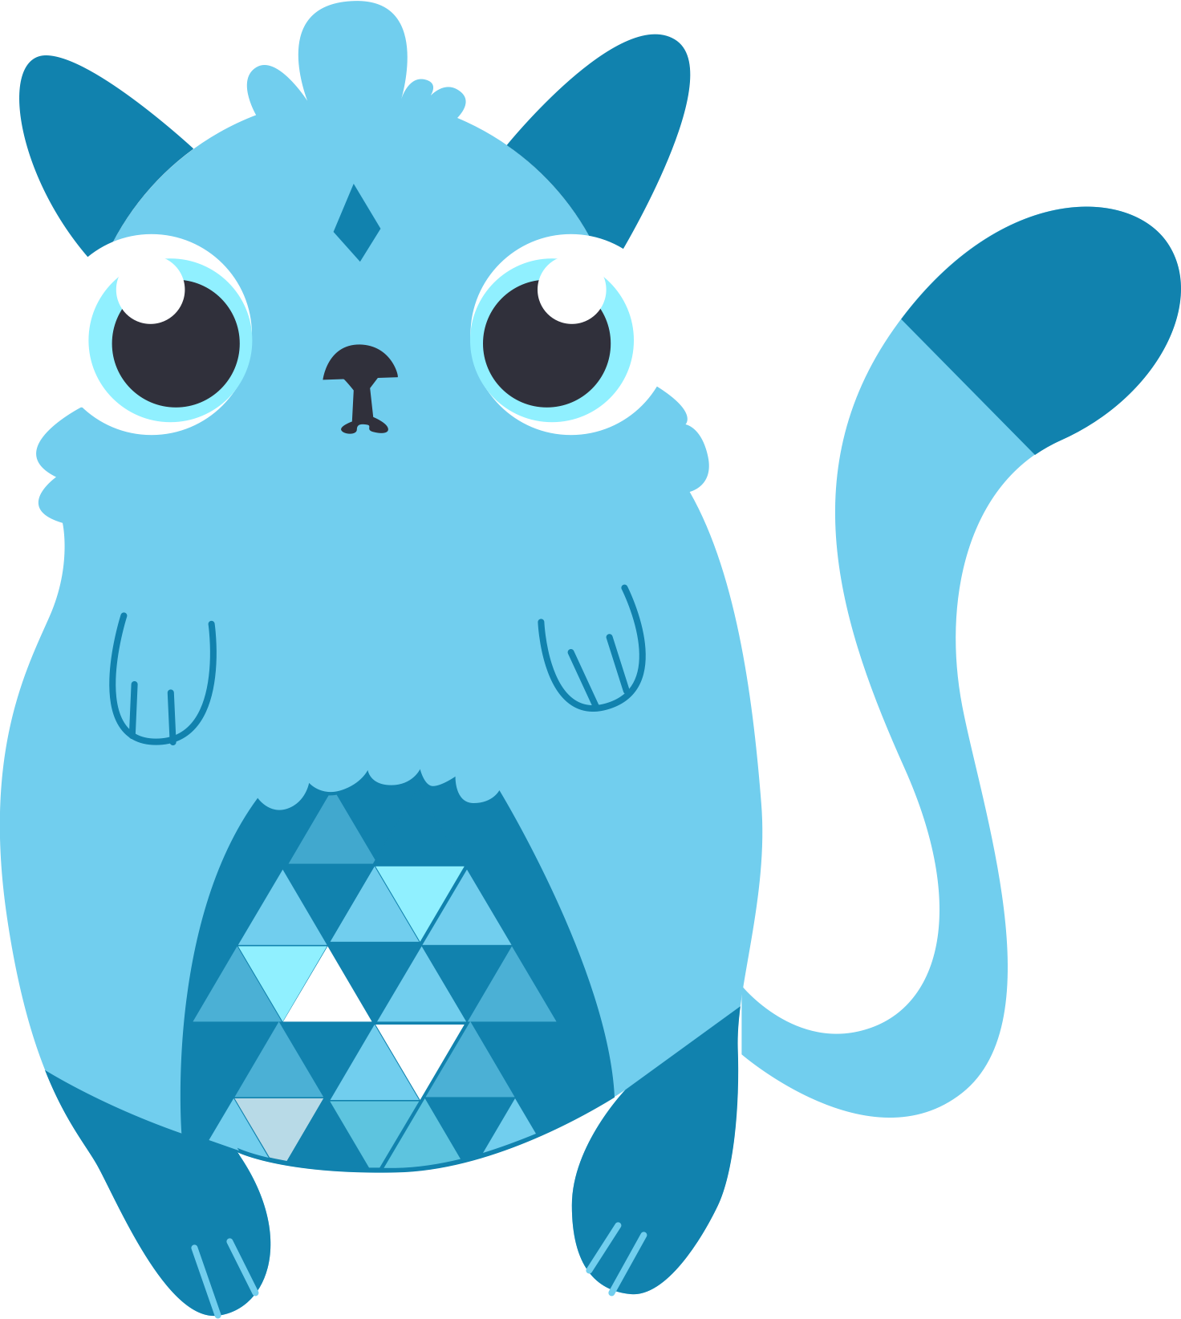
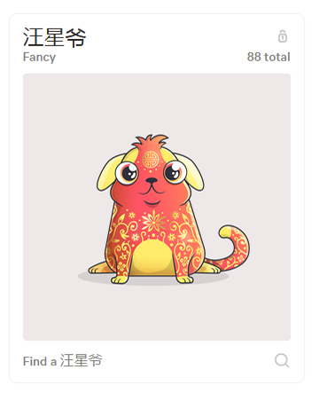
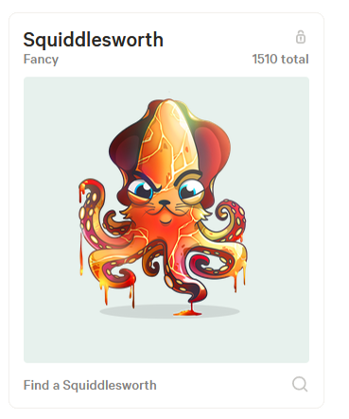
Blockchain Art
CryptoKitties
(2017)
The very first CryptoKitty, Genesis, sold for 250 ether (approximately $115,000 at the time)
Each CryptoKitty is made up of two key pieces: text-based “DNA” stored in an Ethereum transaction, and graphic elements created by Axiom Zen, the company behind CryptoKitties.

Slide 12
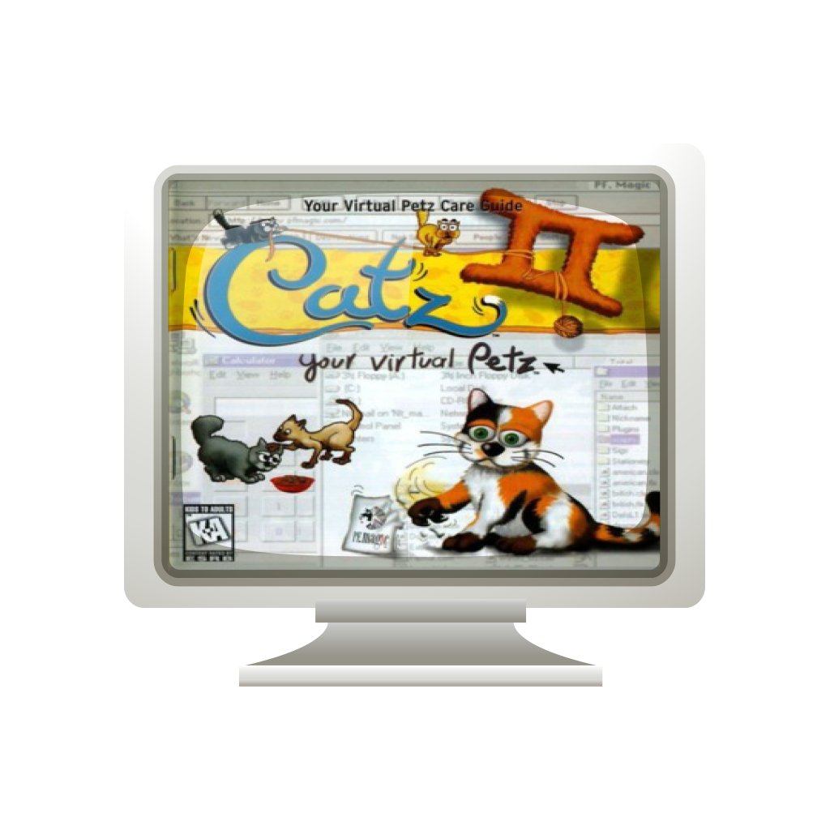
Virtual Petz Art
Virtual Catz
(1997)
Petz (Dogz and Catz) is a series of single-player video games dating back to 1995, in which the player can adopt, raise, care for and breed their own virtual pets.
The original Petz games were developed by P.F. Magic., later acquired by The Learning Company in 1998.

Slide 13
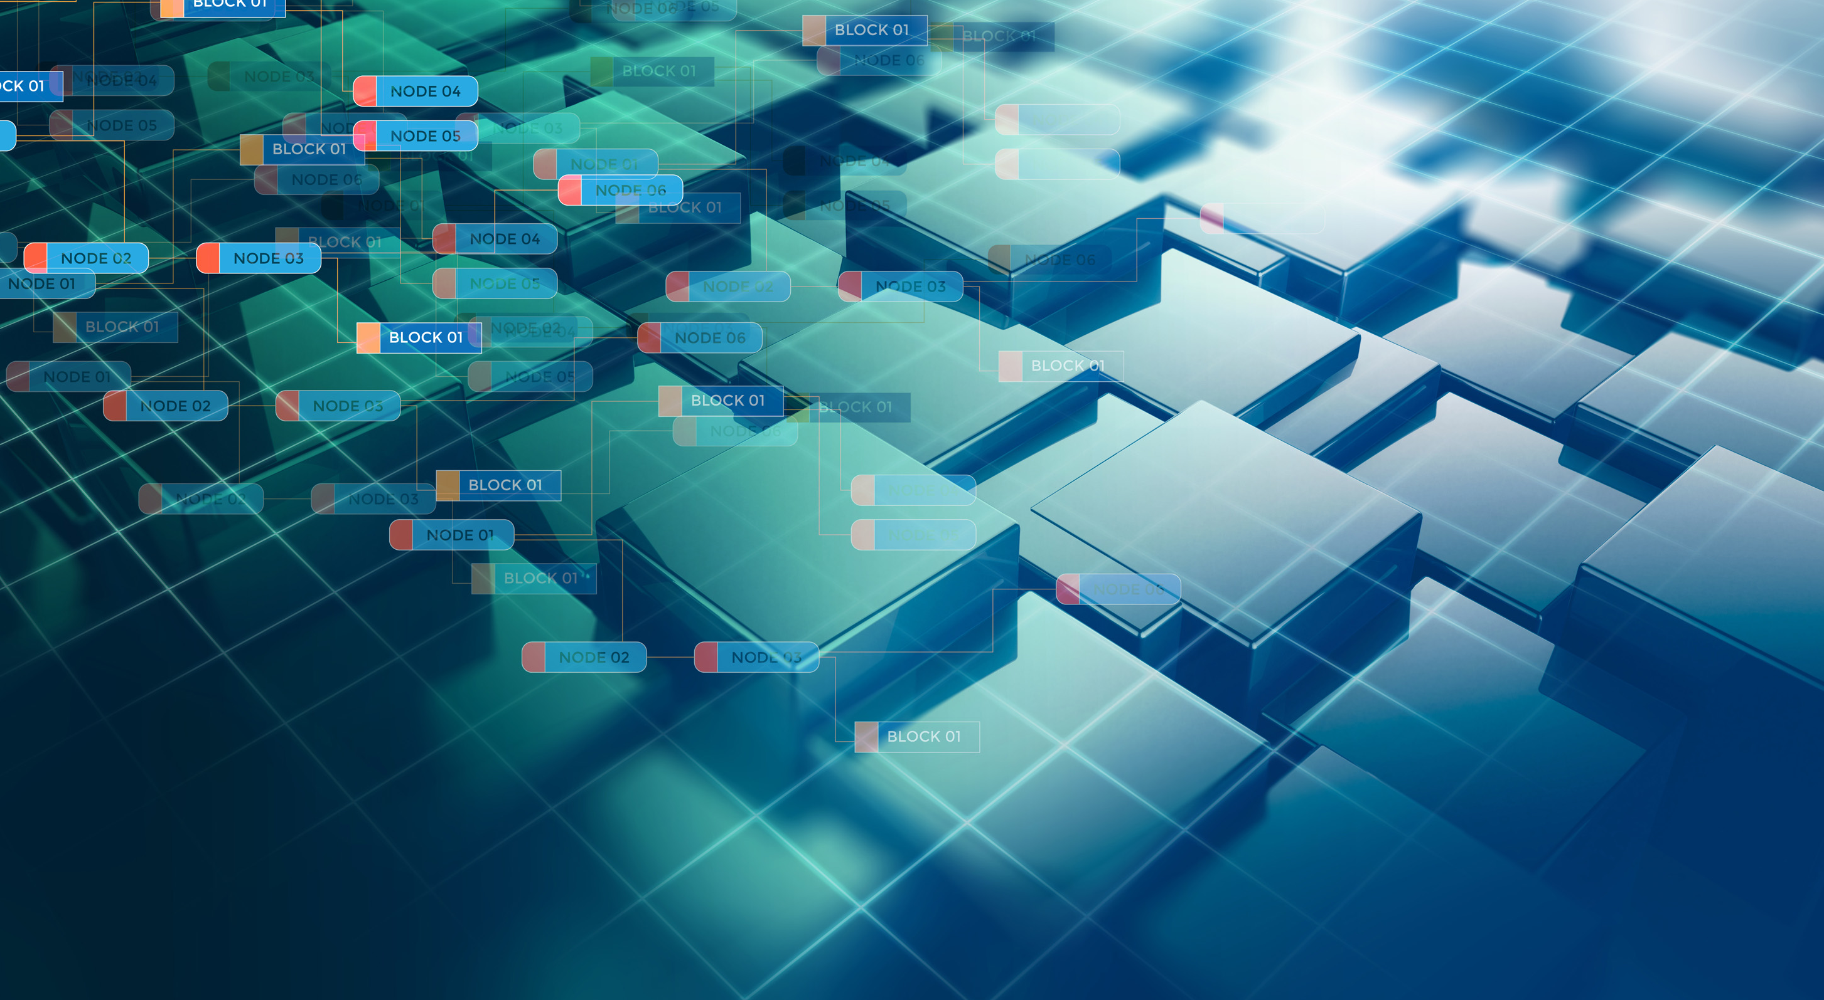
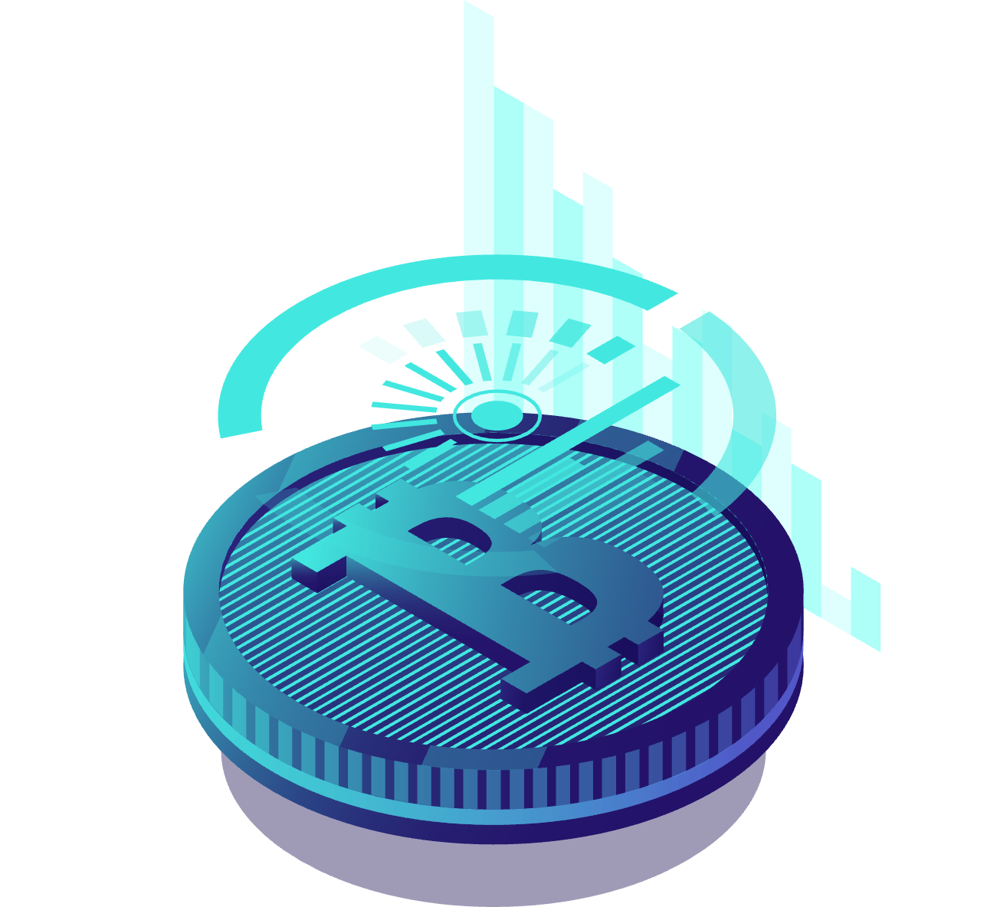
BLOCKCHAIN FACILITATED
ART ECONOMY
There are at least three major areas where blockchain is expected to disrupt the art market:
Driving digital art sales up through digital scarcity
Democratizing fine art investments
Improving provenance and reducing art forgery.

Slide 14
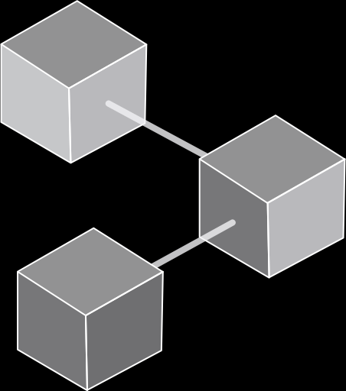
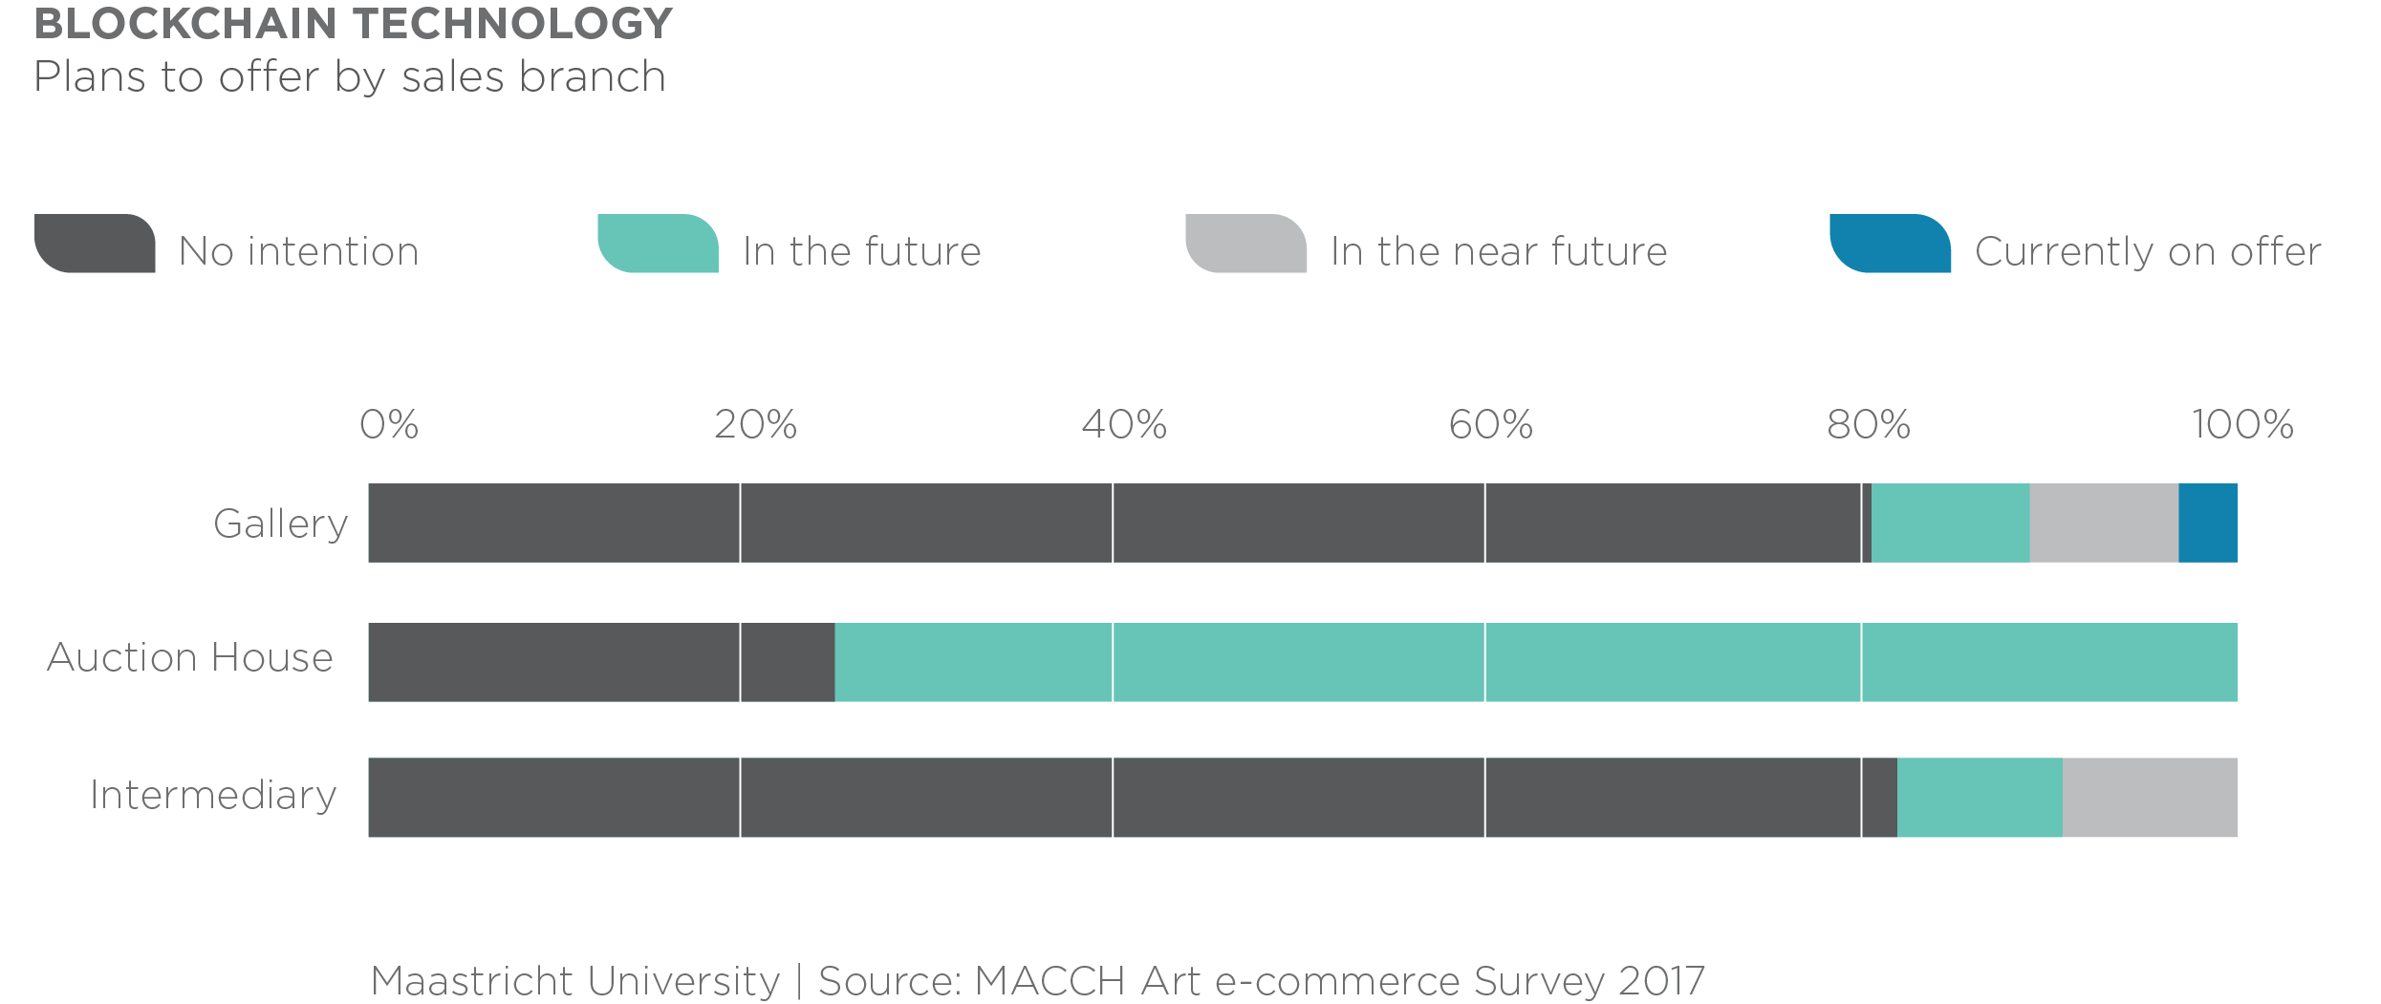
Marko Suvajdzic (msuvajdzic@live.com)

Slide 15
DIGITAL SCARCITY
Issuing a limited number of copies and tying them back to unique blocks proving ownership

Slide 16
DEMOCRATIZING FINE ART INVESTMENT
Blockchain and smart contracts allow for a seamless process of partial art ownership. Art has become a commodity, and the prices of art objects can reach millions, if not hundreds of millions of dollars. The introduction of fractional stakes will have the effect of a profound democratization of fine art ownership.

Slide 17
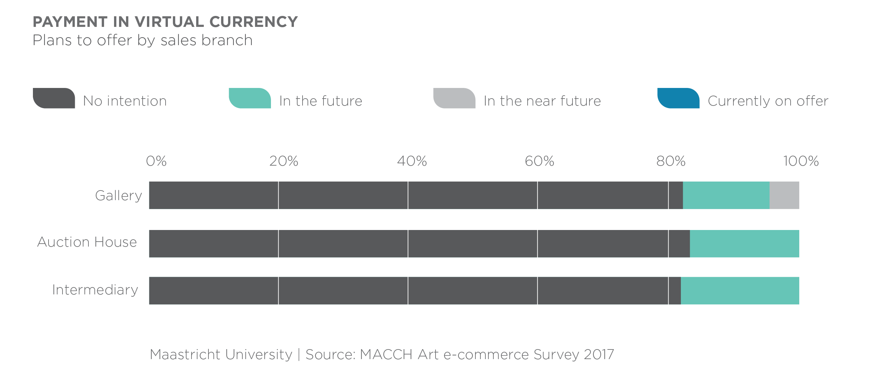
Marko Suvajdzic (msuvajdzic@live.com)

Slide 18
ART PROVENANCE
The concepts of immutability and trustless consensus are important aspects to explore in the art world. Perhaps the most obvious implementation of blockchain is to fight art forgery, through the establishment of better authentication and provenance. Since at its core the blockchain is a distributed ledger, it can provide an unalterable record of provenance starting with authentication and ending with the current owner of an artwork.

Slide 19
THANK YOU
marko@digitalworlds.ufl.com

