Slide 1
DIGITAL WORLDS FOR WELL-BEING
Interactive VR/biofeedback meditation system for ICU patients and staff
MARKO SUVAJDZIC
Associate Director
Digital Worlds Institute, University of Florida
Marko Suvajdzic is a diverse thinker working on projects ranging from artificial Intelligence-intensive video game titles for major industry publishers, to co-founding five of his own startups. His research focuses on emerging technologies and their applications in healthcare. He is an avid practitioner of mindfulness meditation, and has worked with psychologists, medical doctors, and spiritual masters from around the world. He has lectured internationally at schools and conferences in USA, UK, India, UAE, Serbia, China, Australia, Norway, and Japan.

Slide 2
D.R.E.A.M.S.
(acronym)
DIGITAL REHABILITATION ENVIRONMENT AUGMENTING SYSTEM The aim of our study is to develop and assess the feasibility of a novel, immersive, intelligent system to humanize the hospital stay by improving the quality of sleep, reducing pain, lowering the usage of sedatives, and stimulating cognition.
marko@digitalworlds.ufl.edu

Slide 3
VALIDATED
VIRTUAL
"PRESENCE"
Our research focuses on the intersection of VIRTUAL reality and VALIDATED reality.
In collaboration with my team, I explore the multi-dimensionality of consciousness by leveraging the phenomenon of "Presence". In our research, we utilize this phenomenon as the means of medical therapy, creating a sense of well-being among the hospital patients.
marko@digitalworlds.ufl.edu

Slide 4
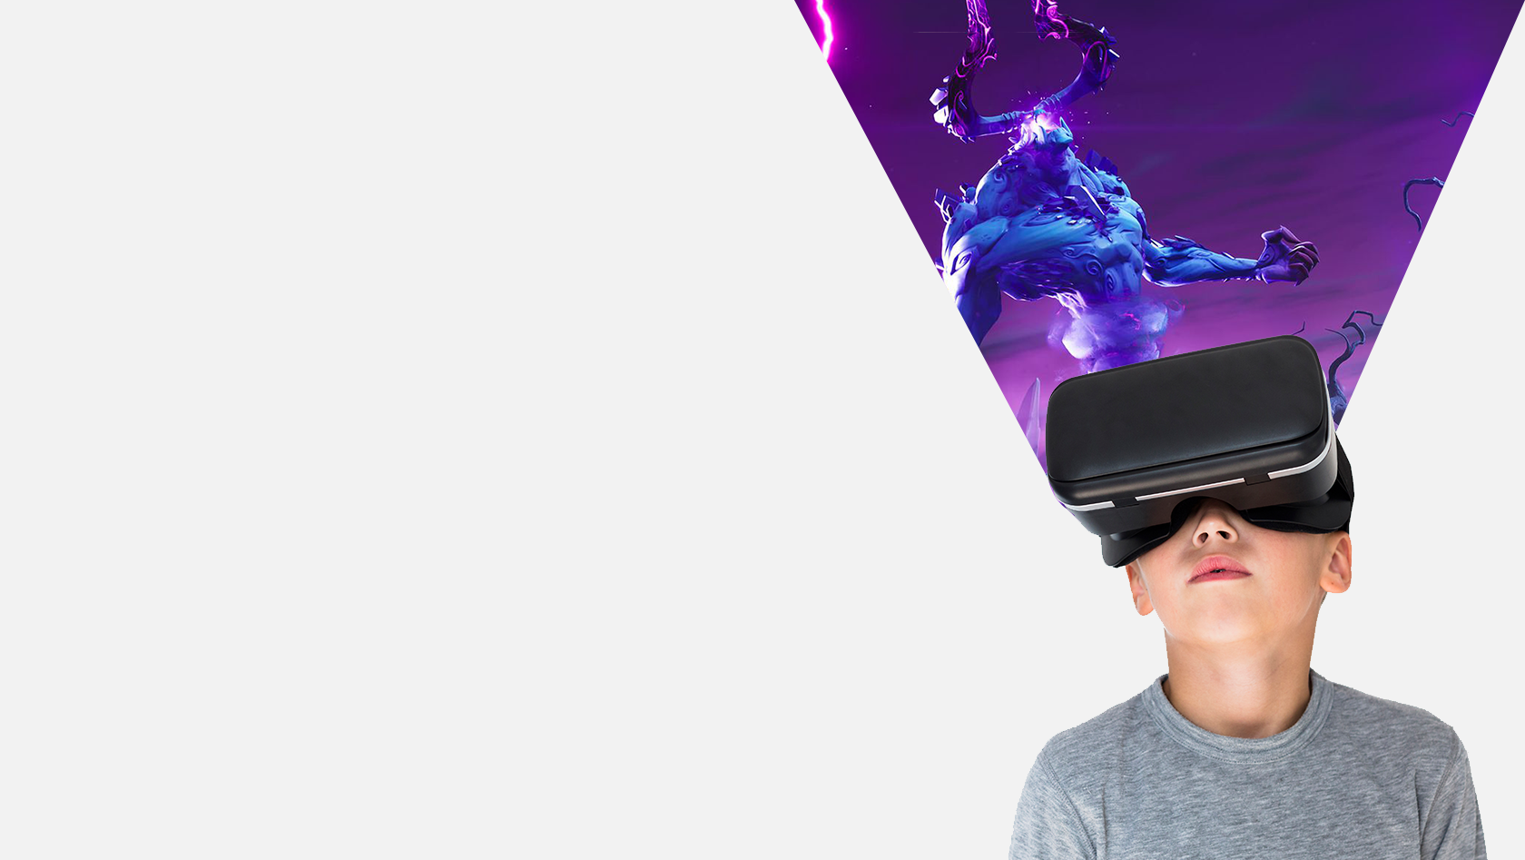
D.R.E.A.M.S.
The idea of presence in a virtual environment is rooted in the concept of transferring - transferring our consciousness from where our body physically is to a space where we believe we are. An immersive virtual environment is capable of fully engaging our mind so it no longer relates to the actual location of the body, but its totally engaged with the virtual reality that is being experienced.
marko@digitalworlds.ufl.edu

Slide 5
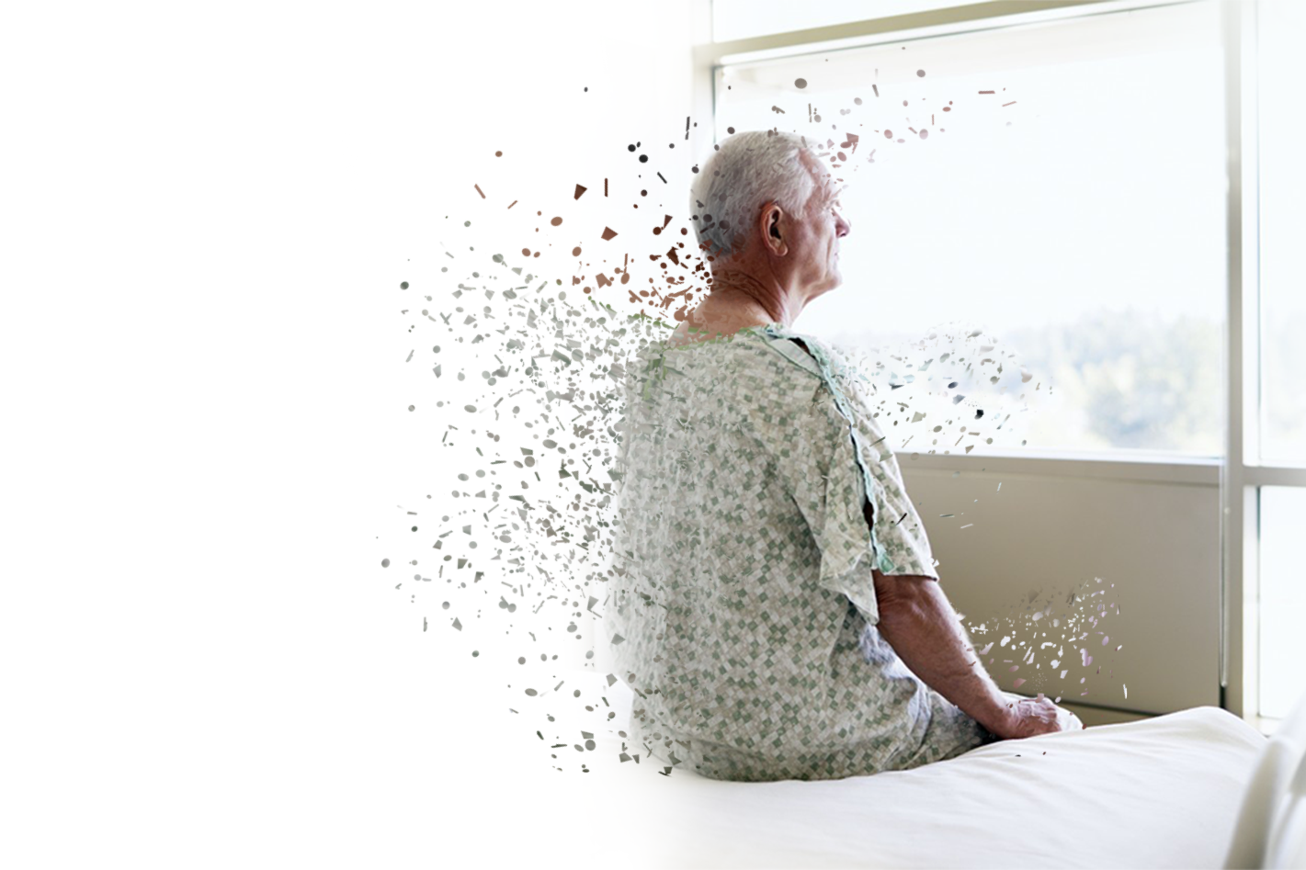
THERAPY
As our awareness can be affected in a controlled manner within a virtual environment, it means that “presence” can be exploited to scientifically affect our consciousness. This phenomenon facilitates the application of virtual environments to various branches of psychotherapy.
marko@digitalworlds.ufl.edu

Slide 6
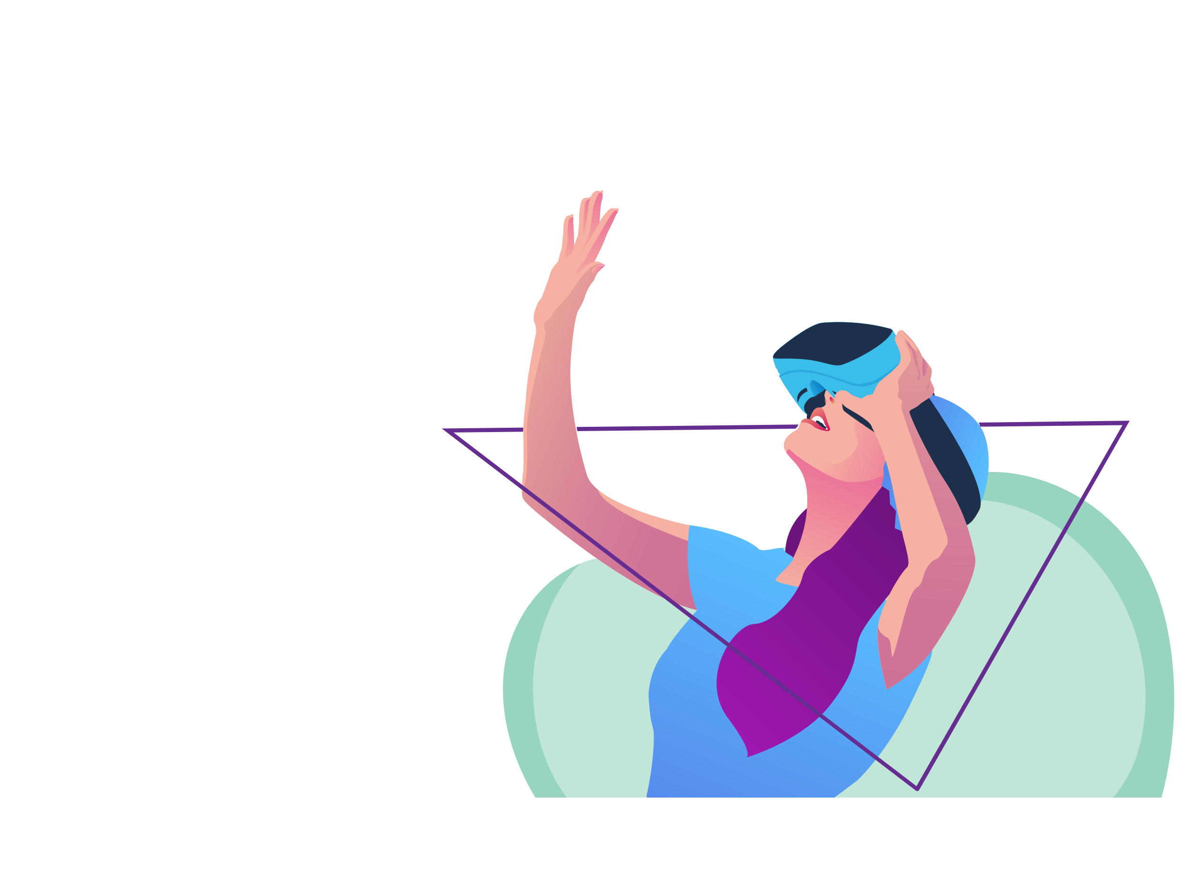
VR AS HEALTHCARE THERAPY
Virtual reality (VR) is a promising application for patient care and rehabilitation. Interventions using VR have produced feasible and effective therapies for pain perception in sufferers of traumatic injury, treatment compliance in burn victims, and cognitive deterioration in the elderly. Applications for VR continue to expand towards improving patient care and comfort for serious medical conditions.
marko@digitalworlds.ufl.edu

Slide 7
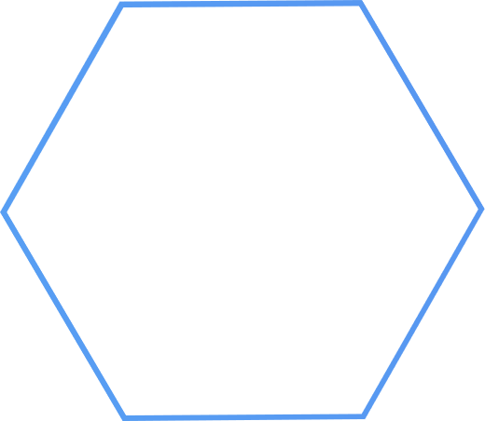
WHY VR APPS IN HEALTH THERAPY
ARGUMENT 1:
Apps as an Observational
(Data Collection) Tool
ARGUMENT 2:
Scaling
ARGUMENT 3:
Immersion +
Sense of Presence in VR
marko@digitalworlds.ufl.edu

Slide 8
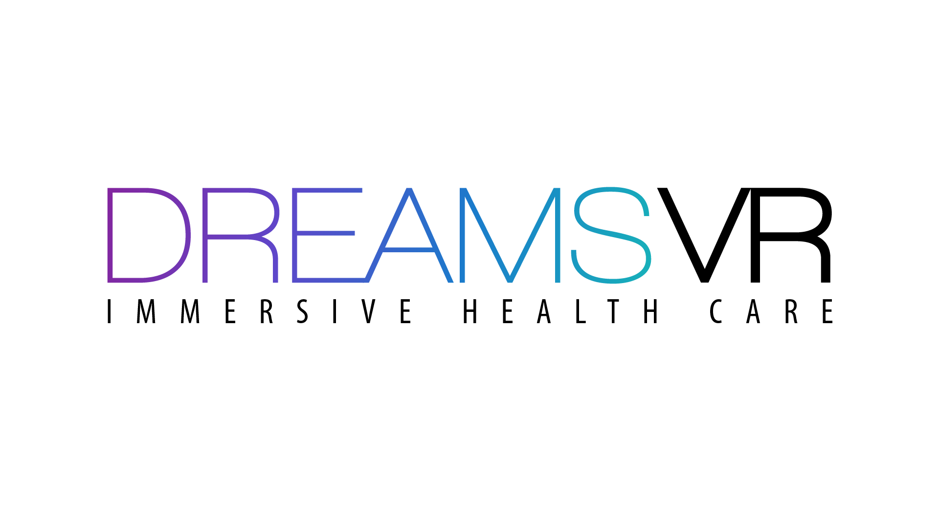

Slide 9
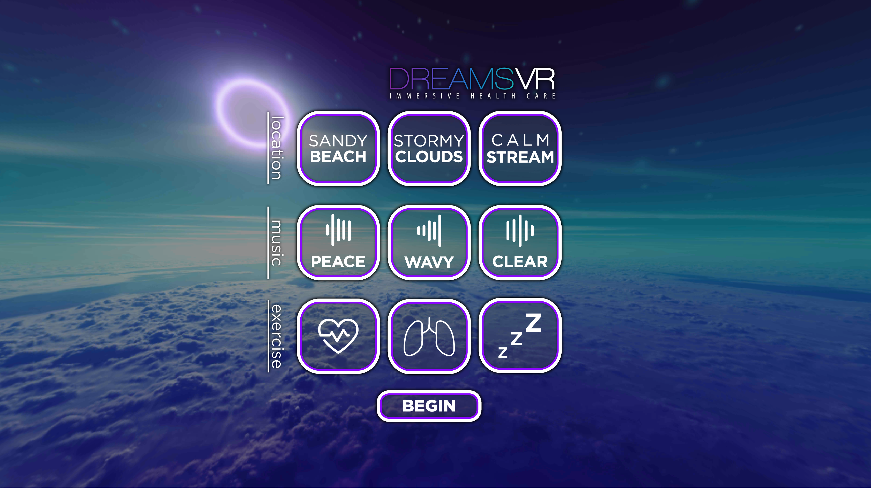

Slide 10
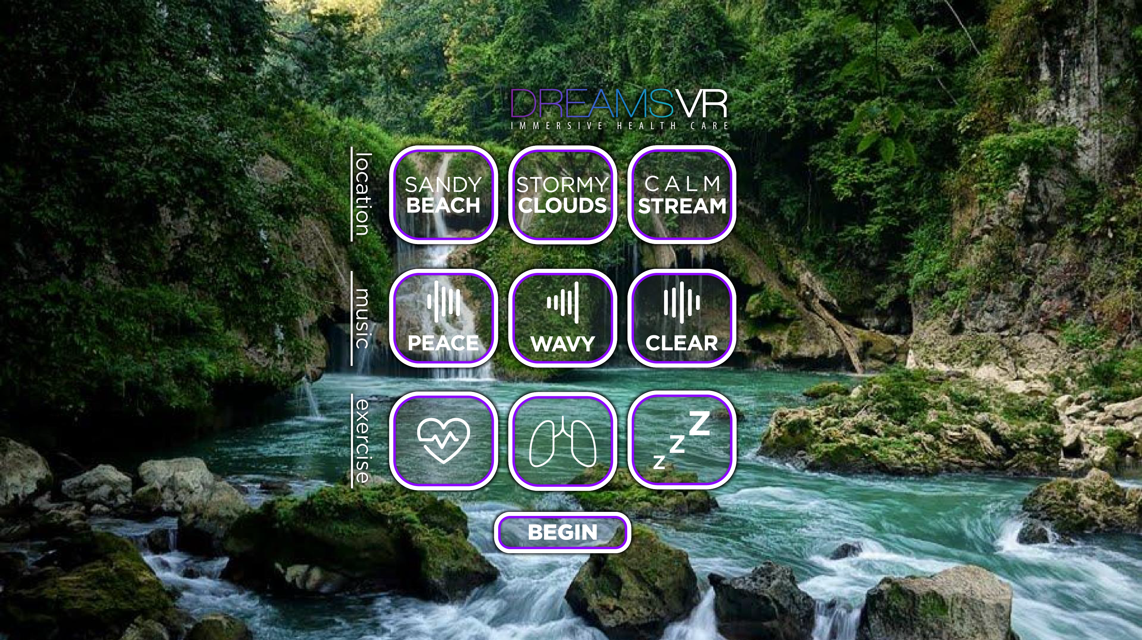

Slide 11
SCOPE
The study was conducted in the general ICU of a university-affiliated hospital in the southeast United States. Data from the first 10 completed patients are presented here.
At recruitment, patients were of adult age (+18 years), tested negative for delirium, were not in isolation (e.g., high risk of infection), were likely to stay in the ICU for several days, were not intubated, and did not have conditions which might limit face, head, or neck movement.
All procedures were approved by the university institutional review board and were supervised by members of the ICU healthcare team.

Slide 12
RESULTS & DISCUSSION
We enrolled 37 patients in the study. Of the total number of patients enrolled, a subset of 10 patients completed the full set of sessions. The 27 patients who did not complete sessions were either moved to other hospital wards before we could finish data collection or no longer wanted to participate due to changes in their medical status (e.g., change in medication, surgery). Participants’ average age was 56.9 years (ranged 20-76) and consisted of 6 females and 4 males.

Slide 13
Results & Discussion

Slide 14
Results & Discussion

Slide 15
FINAL REMARKS
The participants exposed to VR experienced benefits to their pain management and sleep quality, enjoyed and promoted the DREAMS VR platform, and remained CAM-ICU-negative throughout their stay in the ICU. The DREAMS was low-cost, simple to administer, and welcomed by participants.

Slide 16
FINAL REMARKS
Patients in the ICU have little tolerance for frustration
Patients in the ICU can be in emotionally sensitive states
Patients in the ICU are quickly immersed into VR

Slide 17
INTERACTIVE VR/EEG MEDITATION
DREAMS-ICU uses biofeedback to measure the user’s physiological response and visualizes in real-time to guide the user.
Coupling biofeedback with responsive immersive environment allows us to directly attend to physical correspondents of meditation in real-time.
EEG:
Using EEG as real time input device for the VR experience

Slide 18
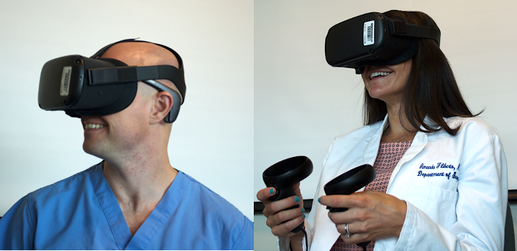
INTERACTIVE VR/EEG MEDITATION
Pilot study, with ICU physicians
EEG:
Using EEG as real time input device for the VR experience

Slide 19
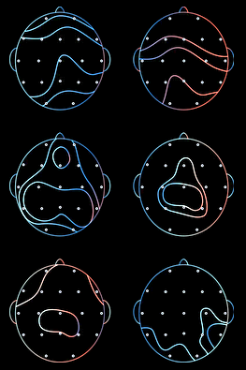
INTERACTIVE VR/EEG MEDITATION
Brain wave technology may seem futuristic, but it’s backed by decades of scientific research.
EEG:
Using EEG as real time input device for the VR experience

Slide 20
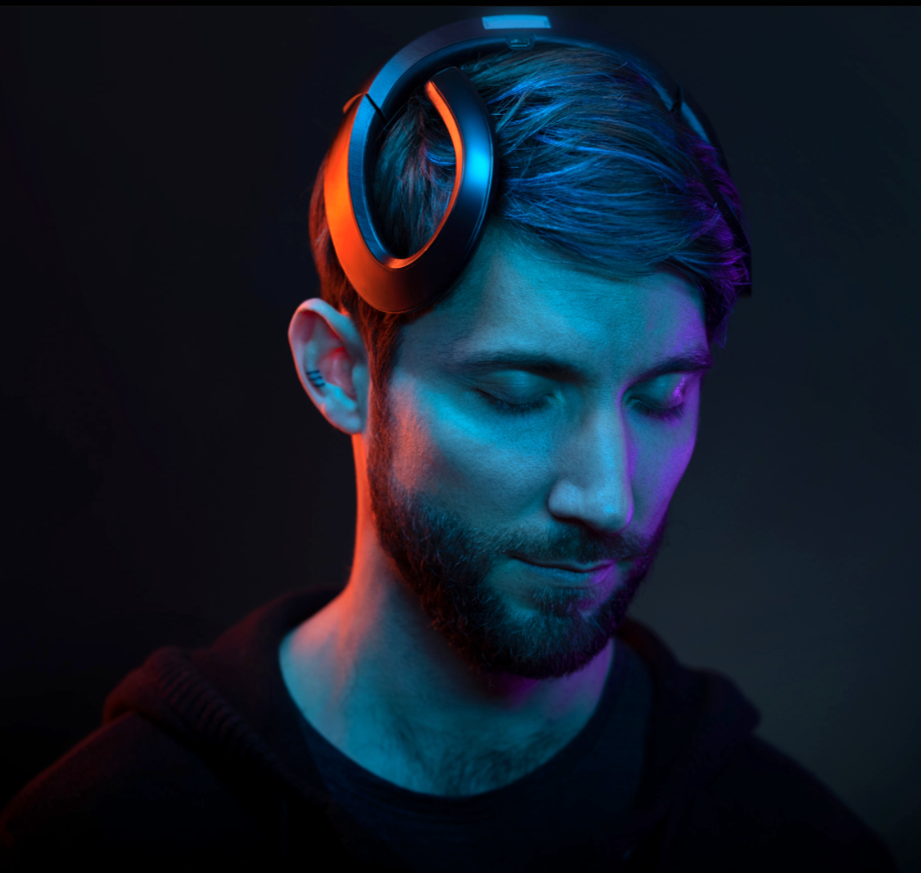
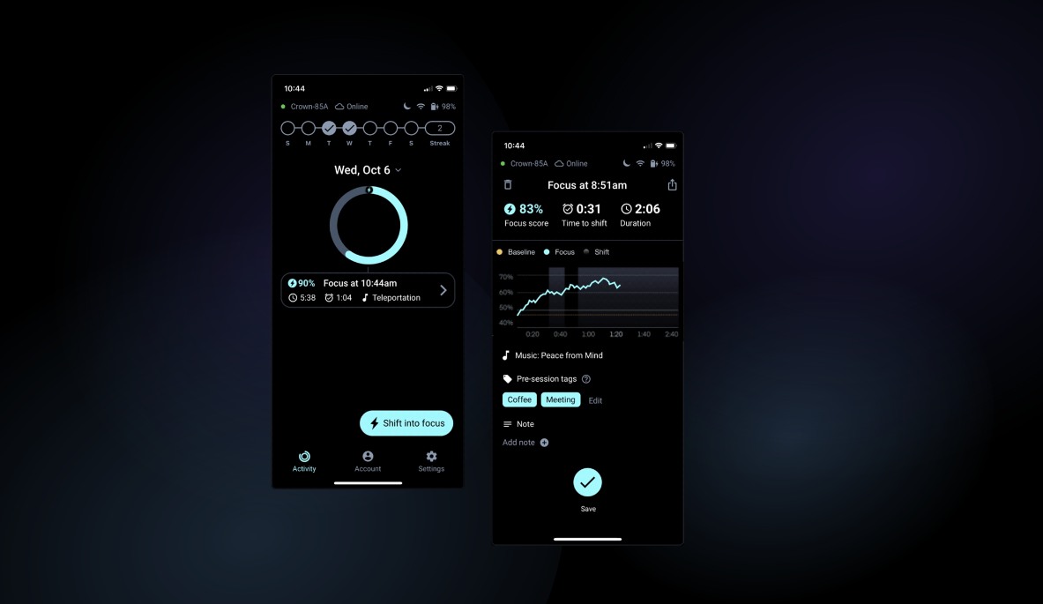
INTERACTIVE VR/EEG MEDITATION
EEG:
Using EEG as real time input device for the VR experience

Slide 21
INTERACTIVE VR/EEG MEDITATION
A mandala is a geometric configuration of symbols. In various spiritual traditions, mandalas may be employed for focusing attention of practitioners and adepts as an aid to meditation and trance induction.
EEG:
Using EEG as real time input device for the VR experience

Slide 22
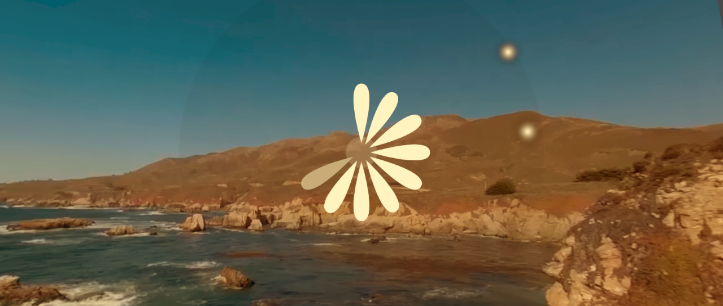
INTERACTIVE VR/EEG MEDITATION
EEG:
Using EEG as real time input device for the VR experience

Slide 23
INTERACTIVE VR/EEG MEDITATION
EEG:
Using EEG as real time input device for the VR experience

Slide 24
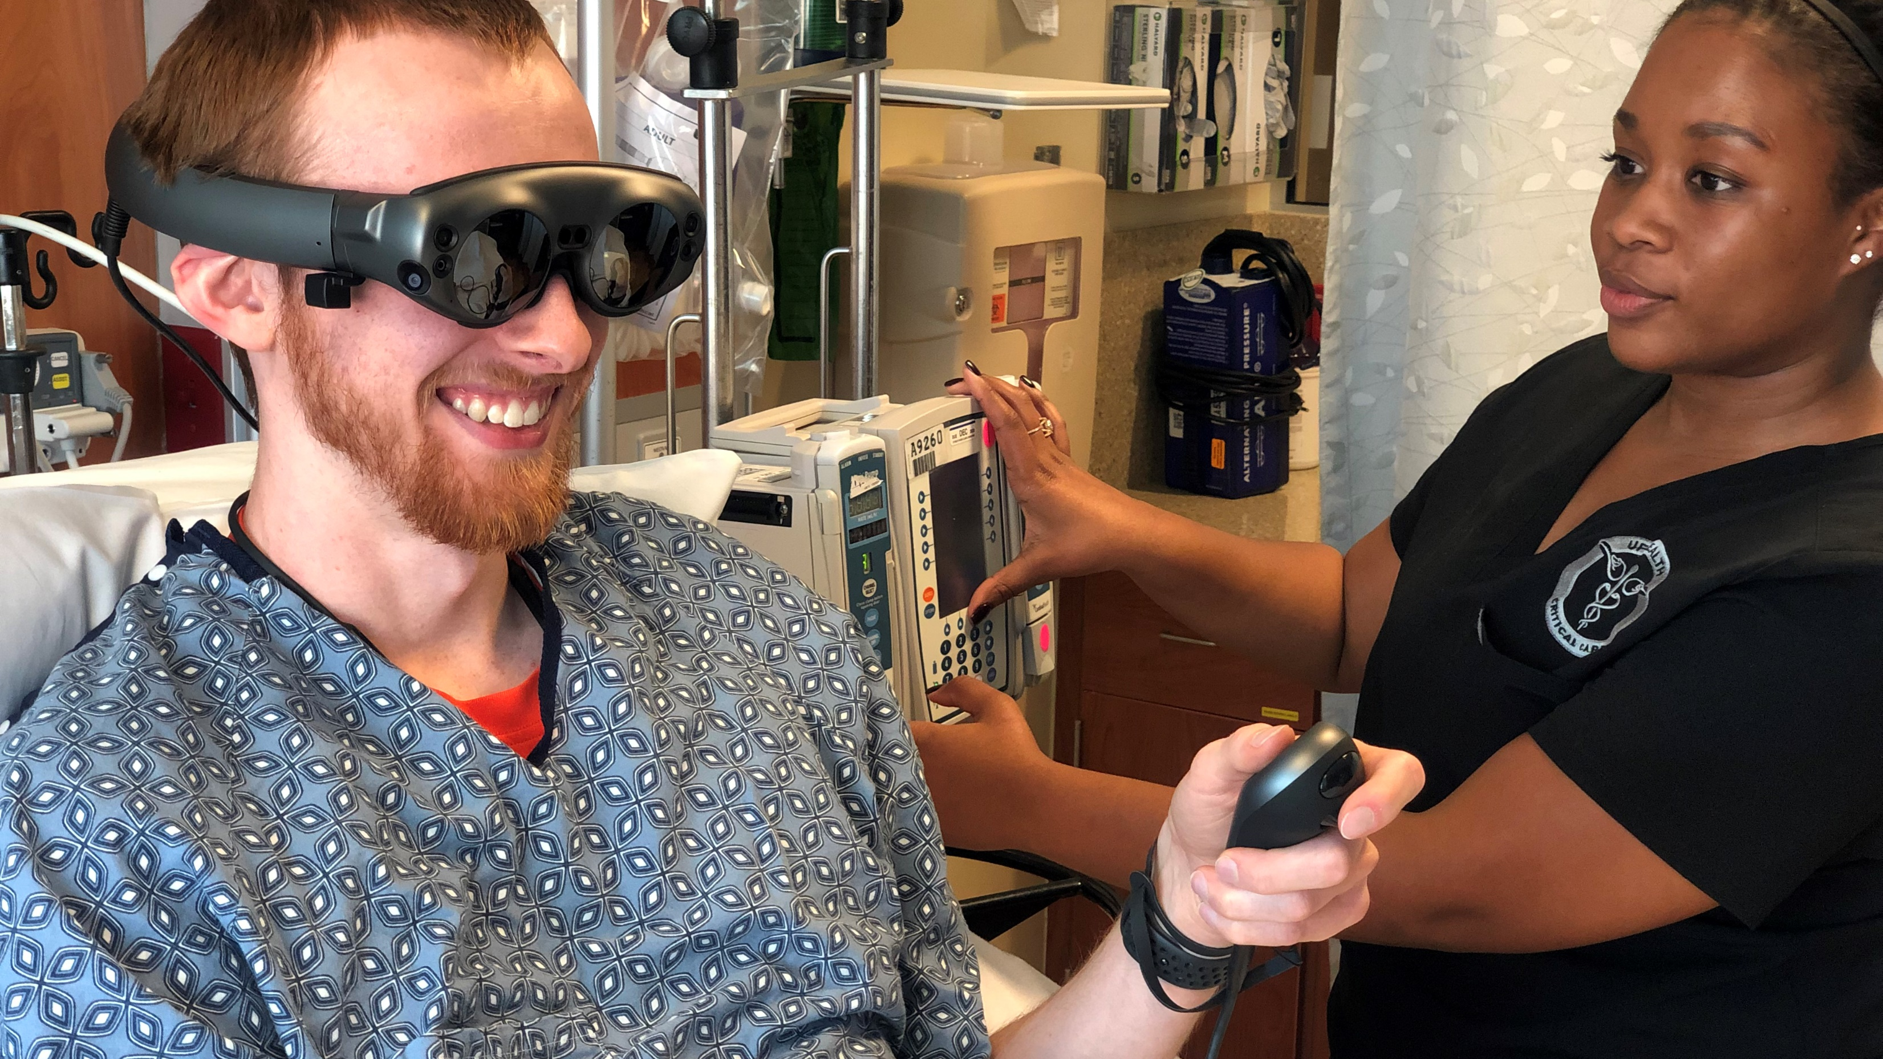
LOOK INTO THE FUTURE
AUGMENTED REALITY
marko@digitalworlds.ufl.edu

Slide 25
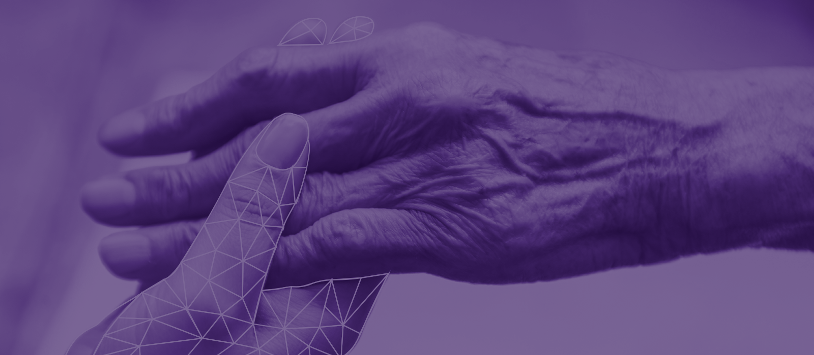
LOOK INTO THE FUTURE – END OF LIFE CARE
marko@digitalworlds.ufl.edu

Slide 26
THANK YOU!
marko@digitalworlds.ufl.edu

