Slide 1
NFTs and how to create your own collection

Slide 2
Content
Structure of an account on Solana
NFT related accounts
Demo project

Slide 3
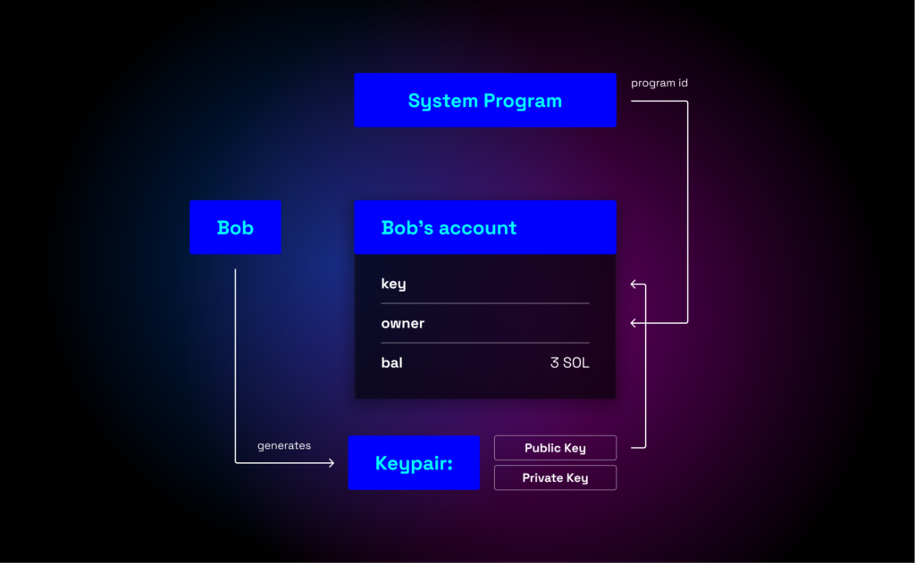
How data is structured and saved on solana blockchain?
Public key
Secret key

Slide 4
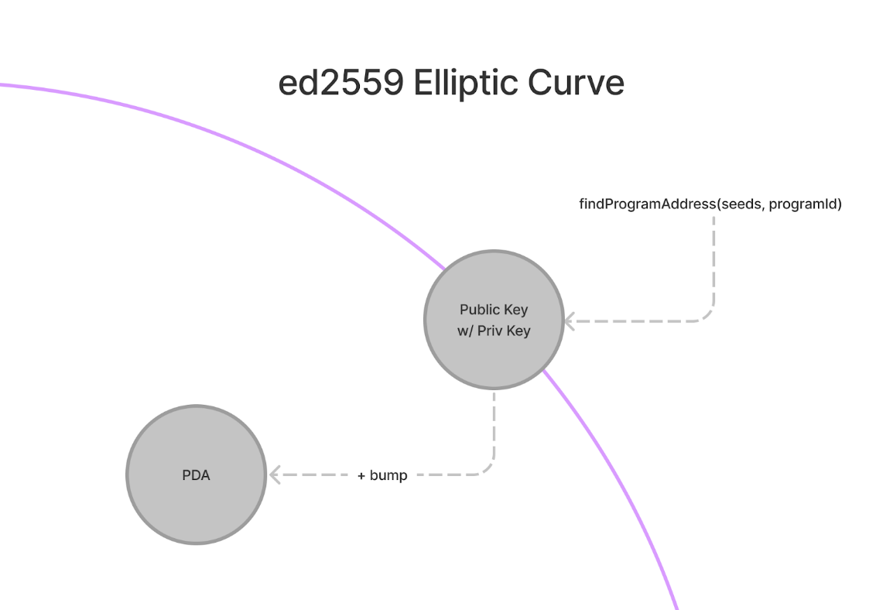
PDAs
PDA(Program derived address)-an account owned by program with no related public key

Slide 5
Mint account (the core of an nft)

Slide 6
Metaplex standard and metadata program
Metaplex represents a standard created specifically for the Solana blockchain, composed of tools and smart contracts that serve to ensure the simplest possible process of creating and exchanging non-fungible tokens on Solana.

Slide 7
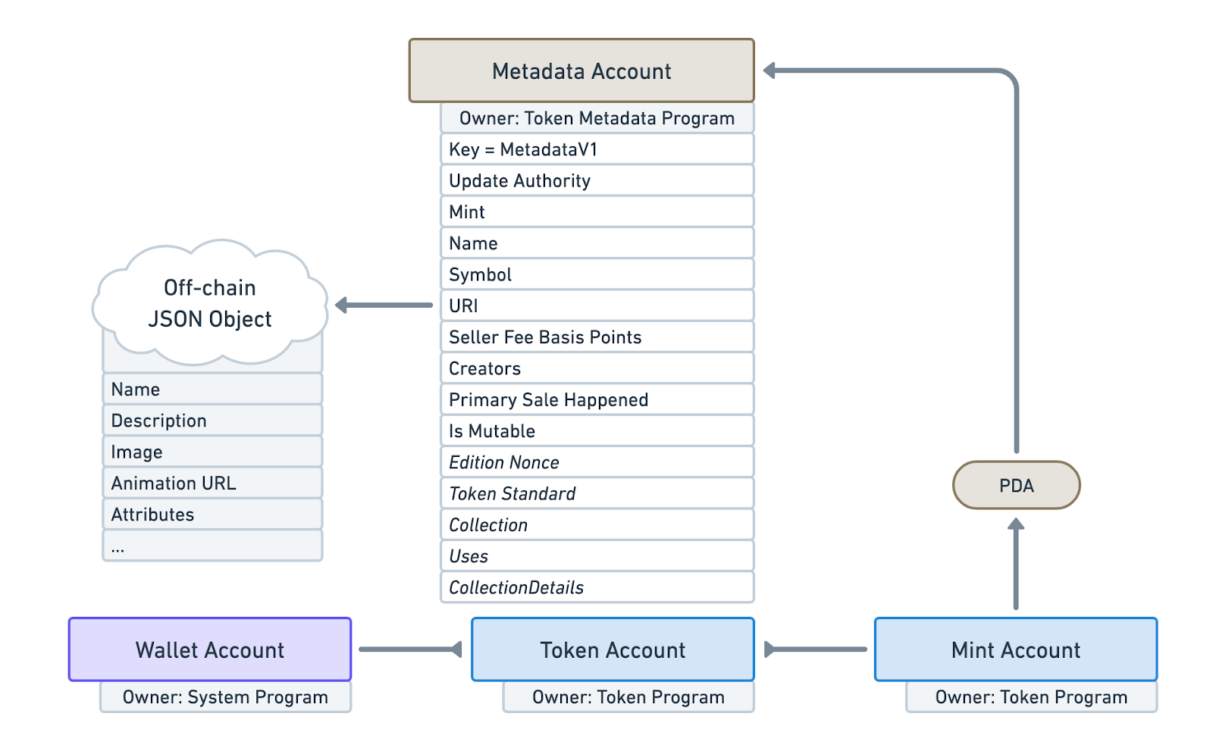
NFT metadata account

Slide 8
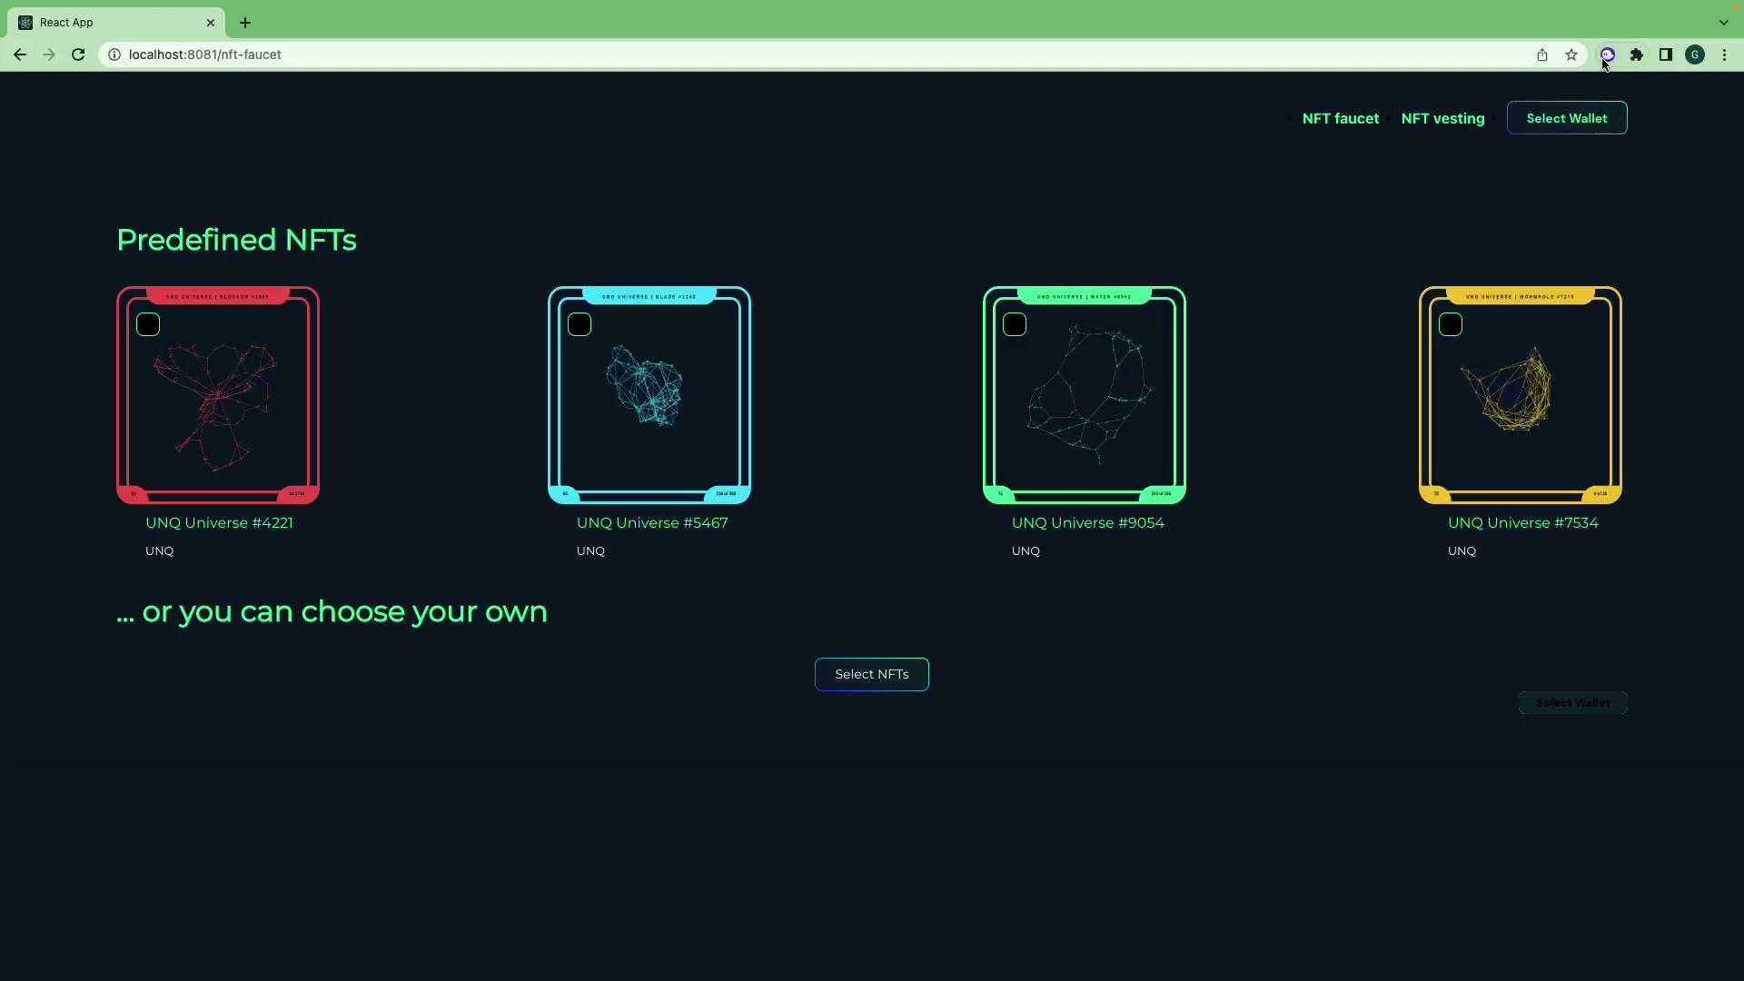
Devnet solana minting tool

Slide 9
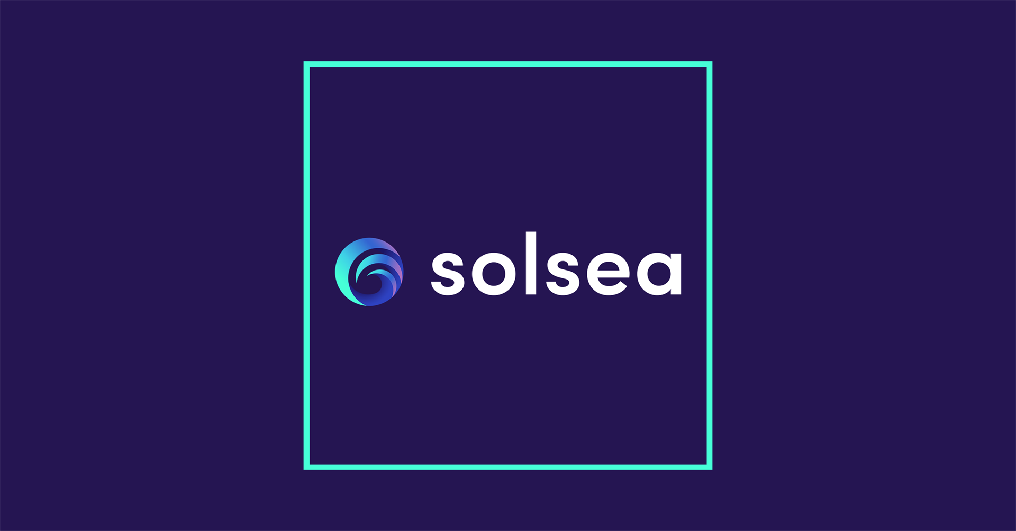
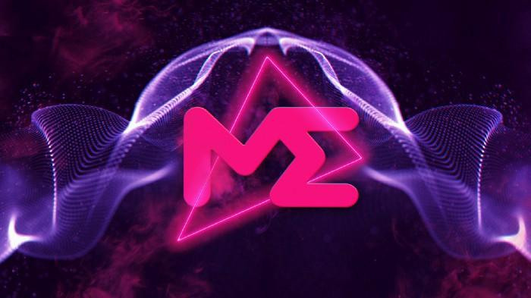
NFT Marketplaces

Slide 10
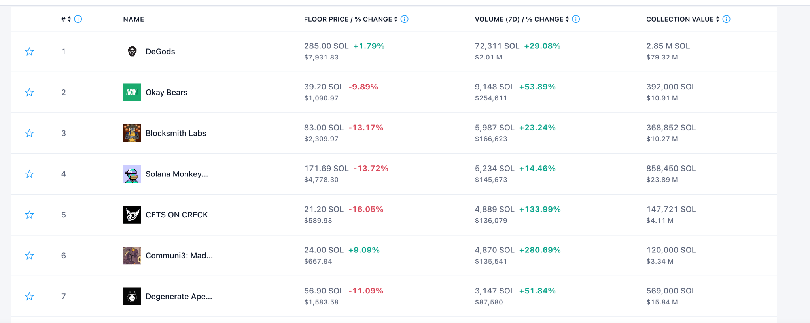
Popular collections

