Slide 1
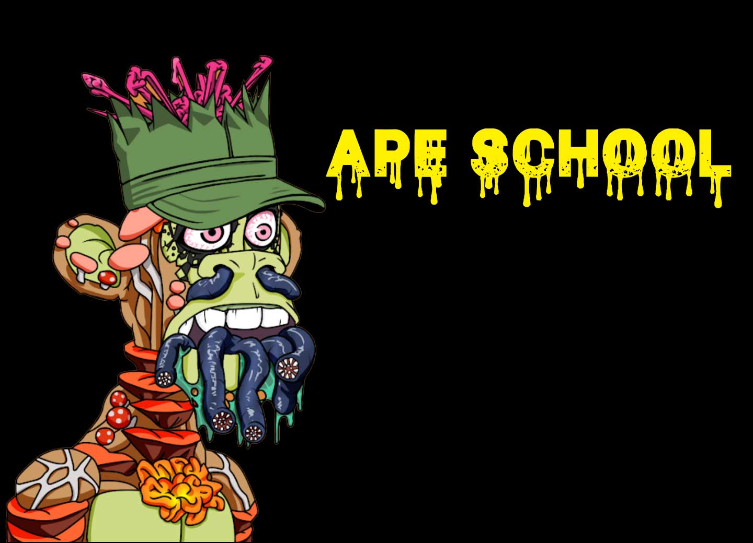
RISK ANALYSIS OF NFT PROJECTS

Slide 2
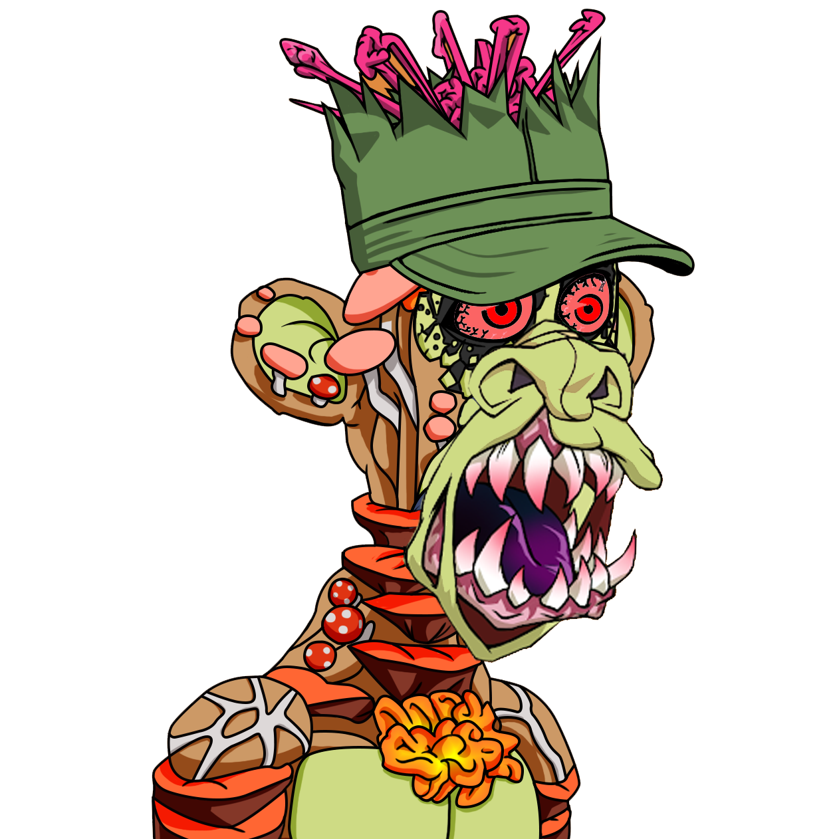
If you want to run a good web3 project, learn how bad projects are done!

Slide 3
Who is @IvanaOnTheBlock?
Ivana Ehrensvärd - Art Director at Ape School and web3 business developer
Education - Faculty of Philosophy (Belgrade), Faculty of Theology (Copenhagen)
Professional background - curator in public museums, collection manager of private collections, organization of a dozen art exhibitions, painting and exhibiting occasionally
Background in humanities (archaeology and religion), culture, and art

Slide 4
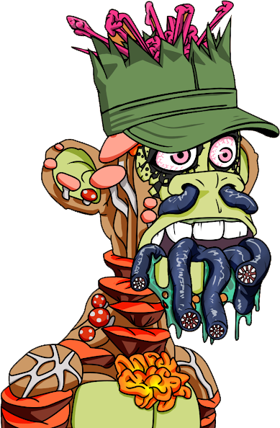
Who is Professor John Keeting?
@ProfKeeting
Darko Pavic, owner and CEO of Fiscal Solutions
We are an IT company (SW).
On the market for 19 years already.
We create software for large international retailers and large POS SW providers.
Our product enables retailers to expand internationally.
Our solution is used in 17 countries.
Engineer and software developer
Founder and director of Ape School
https://www.linkedin.com/in/darko-pavic/
defines technology standards e.g. UML
>800 members (Apple, Google, Microsoft, Oracle …)
HQ in USA
international business organisation
45 million companies
from > 100 countries

Slide 5
Who is Professor John Keeting?
@ProfKeeting
Addicted to social networks
Loving algorithms and cryptology
Developing software as soon as I can
Fighter for decentralization, democracy and freedom to be who you are

Slide 6
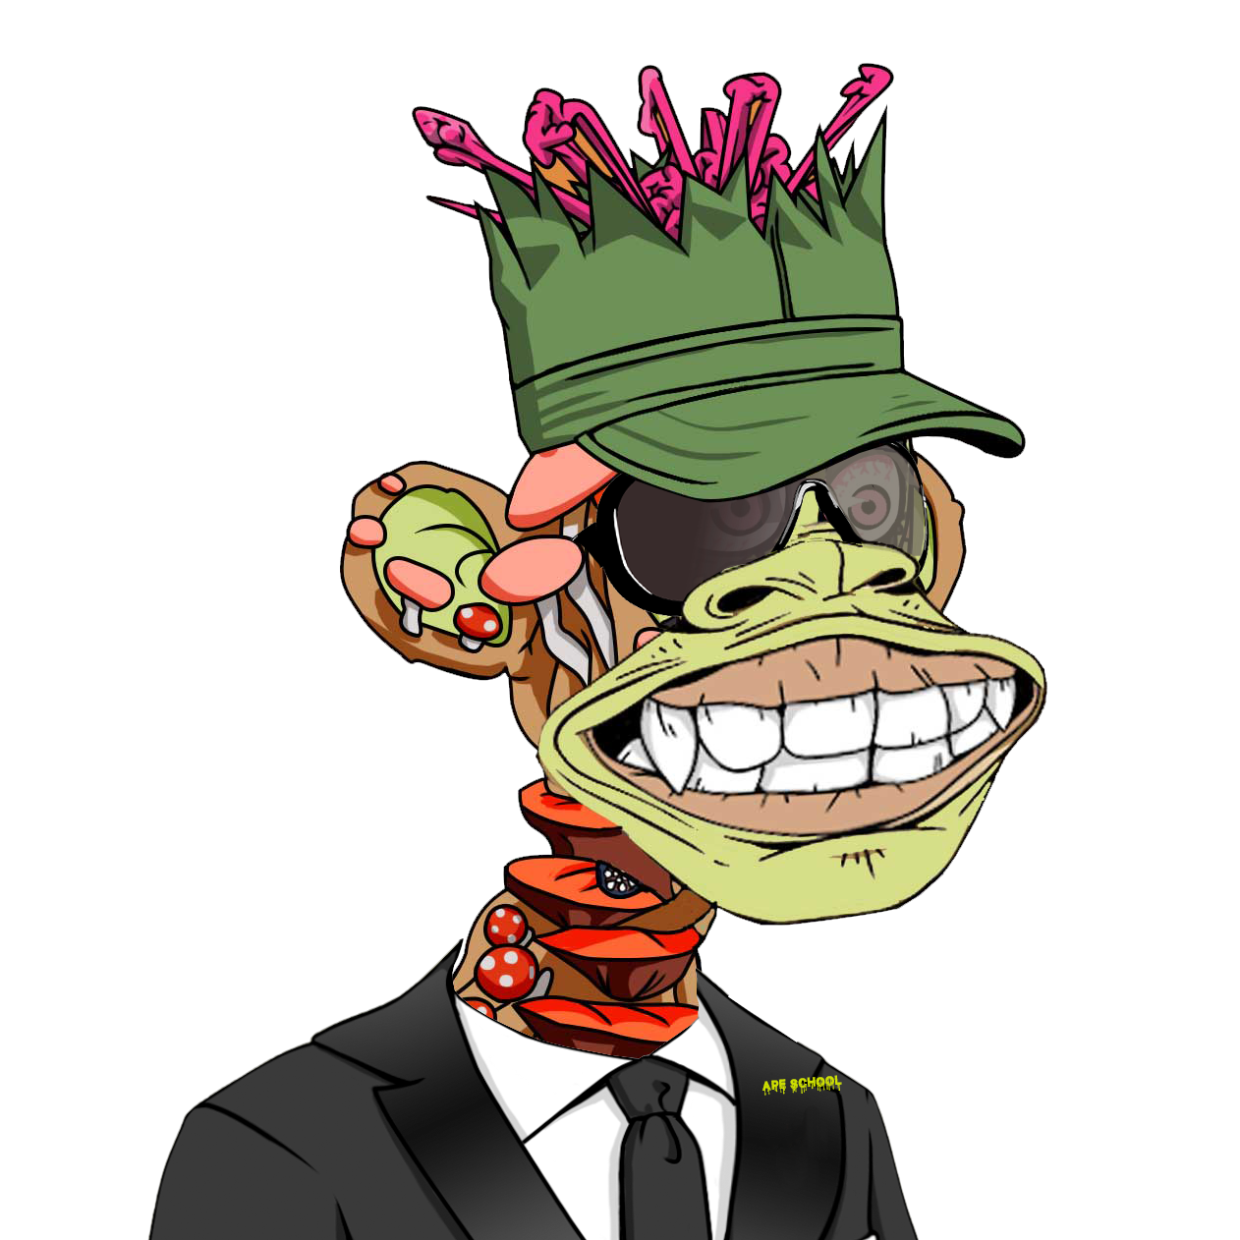
Do you know what NFTs are?

Slide 7
Who knows what a scam is?

Slide 8
Who knows what a rug pull is?

Slide 9
NFT Project
Definition and Explanation
An NFT project is a project (time, resources, tasks) with the target to create NFTs and provide some benefits to their holders or related users but always with their own profit in mind. → first scam indicator
Usage/Benefit can be:
Enjoying the art or great community
Running smart contracts
Using related data to create some benefits and many others
NFT Project = „Start-Up“

Slide 10
NFT Project and you
What is your possible relationship to the project?
Buyer of NFTs (investor, member of the community, somebody who enjoys the utilities etc.)
A user of the NFTs without owning some e.g. retailers, SW companies etc.
Viewer only

Slide 11
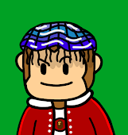
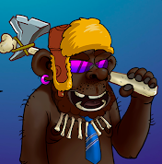
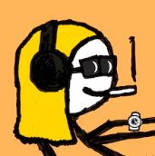
Scam, Rug Pull and Exit
What is what?
Scam
Intentionally not fulfilling promises with the target to get the assets
Rug Pull
Unexpected disappearance with the majority of the received income
Exit
leaving the project with certain compensation in the announced and planed way
For example drain the wallets e.g. DirtyApe
In most cases the project dies e.g. Evolved Apes ($2.7Mio)
Usually, there is successor/s who continue the project e.g. mfers
Notes:
Rug Pull can be intentional and not intentional (on th begining)
Rug Pull can be created during the project e.g. too much stress, menthal health, burnout etc.

Slide 12
Elements of the web3 eco-system
NFT project is related to all elements
Plattform/Tools
Most vulnerable
User
PC
Blockchain
Wallet
Social engineering (Scam)
Hacking
Easy
More complex
Hacking
Very complex

Slide 13
Social engineering
Social engineering is the most common way to scam people.
It is always attacking the user.
Social engineering → influences you to do something you don‘t want to do.
Download malware and compromise your computer
Get your seed phrase
Malicious software
Screensharing
Pretending to be support
Sign some transactions that you should not
Types of social engineering
Targeted social engineering (not that common) and
General social engineering (common)
Being a scammer is not that complex.

Slide 14
Scamming strategies and behaving patterns
They are always very similar, here are some of them:
The scammer will try to earn your trust.
Will give you what you desire the most e.g. artists' desire to be seen
“Your art is so nice“ → is opening the door or
“We would love to hear your opinion in our Twitter space” → everybody wants to be respected
There is a new Discord scam going like this …. Be careful → most people would share this, everybody wants to be respected
Put you under pressure to act (short time to do something, FOMO, …)
Be extremely persistent over days/weeks
Mostly very kind and polite
Introduce some second person who will help

Slide 15
Hacking
Producing software that can use bugs/exploits/features of other software to harm you (still your assets)
It’s always related to the execution of some (hacker) code
Locally or
Remotely (e.g. ActiveX components, browser extensions, etc.)
Much more difficult than social engineering
Being a hacker is very complex.

Slide 16
Combinations
Most dangerous are combinations of hacking and social engineering
Good executed very difficult to recognize
Mostly done in teams

Slide 17
Project analysis tool
Excel sheet with a set of questions - checklist
More than 70 questions about the project to identify risks
Takes time and slows you down
Reduces the possibility to forget something important
Visualization of potential risks
You might be shocked sometimes
Covering following groups
General
Team
Roadmap
Finances
Community
Technology
The tool is free and available for owners of our NFTs. (Postgraduate Program)

Slide 18
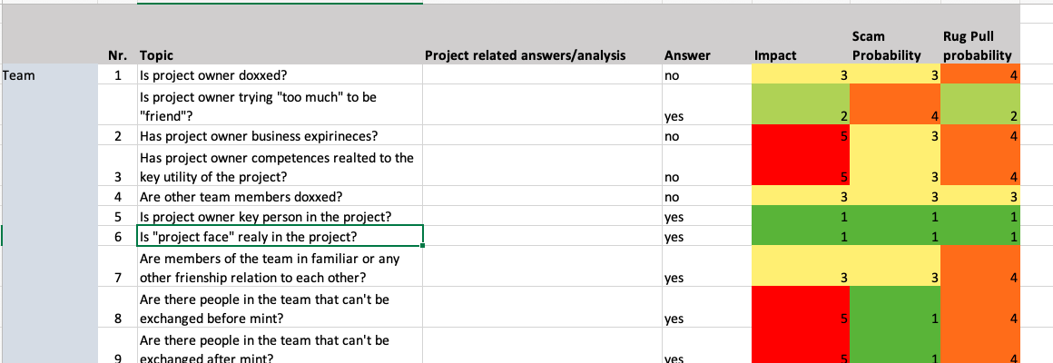
Download it now
Pdf or excel
https://www.apeschool.xyz/risk.pdf or
https://www.apeschool.xyz/risk.xcl

Slide 19
The following are:
Personal opinions and
Probabilities
Could be high risk
Could be risk

Slide 20
General
Is somebody asking you for your seed phrase?
Does a whitepaper exist?
Is the internet page trying to connect with your wallets on load event?
SCAM
RUGPULL/SCAM
SCAM

Slide 21
Team
Are the “face of the project“ and the team founder the same person?
Are the skills of the team members visible/known?
Does the owner of the project have business experience?
RUG PULL
RUG PULL
RUG PULL

Slide 22
Roadmap
Is the roadmap unique?
Are roadmap deliverables corresponding with skills and experiences of the people in the team?
Is the roadmap realistic to deliver?
RUG PULL
RUG PULL
RUG PULL

Slide 23
Finances
Was there a business model before the mint and will there be one after the mint?
How was the project financed before the mint?
How will the project be financed after mint?
RUG PULL
RUG PULL

Slide 24
Community
Is the project founder active in the community?
Are the chatters on Discord paid even though ''organic'' community was communicated on the market?
Is the community approach being pushed too much?
RUG PULL
RUG PULL/SCAM
RUG PULL/SCAM

Slide 25
Technology
Is the smart contract published before the mint?
Is there „Set Approval“ for all functions?
Are there any downloads of executables?
SCAM
SCAM
SCAM

Slide 26
Biggest indicators
Scam and Rug Pull
Asking you for your seed phrase → scam
Connect wallet on load → scam
No financial/business model after mint → rug pull
Abused „Set Approval“ function in the smart contract → scam
„Project face“ not related to web3 space → rug pull

Slide 27
Some tips how to protect yourself
Take your time to analyse projects (no FOMO)
Use checklists
Rugpull – Twitter account (@rugpullfinder)
Use several wallets for different tasks
Learn some important security features to recognize scam e.g. Set Approval
Join our postgraduate program
Access our tools to:
learn all that
get support

Slide 28
Let‘s analyze some projects
https://artgobblers.com/
https://www.venturecapitalx.io/
https://bugatticollectionsnft.com/
https://www.fiendz.io/
https://pokeworld.game/
https://thelittles.io/
https://www.mega404.net/
https://www.averagebob.co/
https://freaks.club/
https://twitter.com/NakedPunksNFT
https://nonfungibleknowledge.webflow.io/
https://www.metabrewsociety.com/
https://eloop.app/en/
https://stayopen.com/stay-pass/
Download the risk analysis tool https://www.apeschool.xyz/risk.pdf or https://www.apeschool.xyz/risk.xcl
Create groups.
Each group should analyze one project – you have 30 minutes!
Some of the groups will present their results at the end.
Presentation of the results should be 3-5 minutes short.

