Slide 1
Creating a decentralized wallet and a short introduction to Solidity programming language
Bane Avramović, bane.avramovicc@gmail.com

Slide 2
What is decentralized finance
Decentralized finance vs Centralized finance
What are decentralized applications
Choosing a right wallet for you
Introduction to solidity programming language

Slide 3
What is decentralized finance (DeFi)

Slide 4
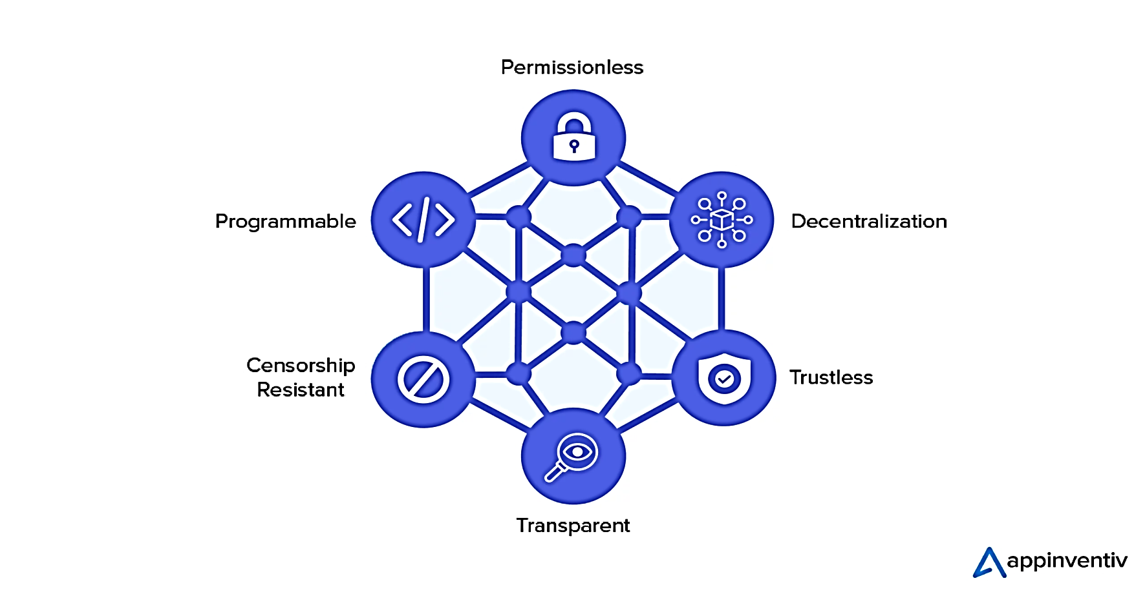
Decentralized finance, or DeFi, uses emerging technology to remove third parties and centralized institutions from financial transactions.
The components of DeFi are stablecoins, software, and hardware that enables the development of applications.
The infrastructure for DeFi and its regulation are constantly evolving.
DeFi space is still unregulated and it has a lot of scams surrounding it.

Slide 5
DeFi vs CeFi

Slide 6
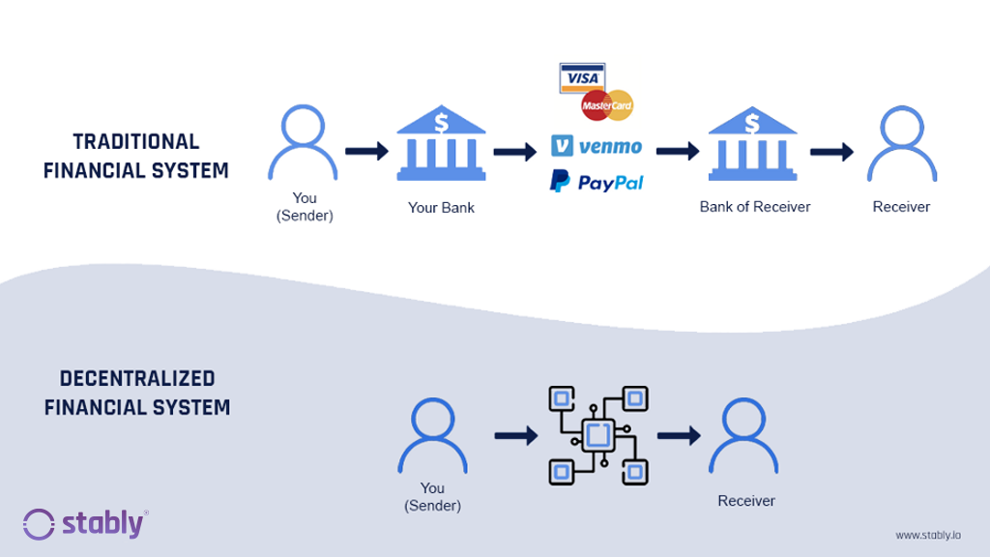
Doing a side by side comparison of CeFi and DeFi is very much possible. Some of the criteria we can take in considoration are:
Regulatory compliance and KYC - CeFi abides by regulations in the country where it operates, following KYC and anti-money laundering. DeFi remains largely unregulated and doesn’t require KYC.
Third-party reliance – CeFi users depend on trusted third parties to access finance, but for DeFi that isn’t the case.
Custody - Users are not in control of their assets. DeFi only allows crypto-to-crypto on-ramps, but users are in complete control.
There are some other criteria worth mentioning like: platform development, transprency and security.

Slide 7
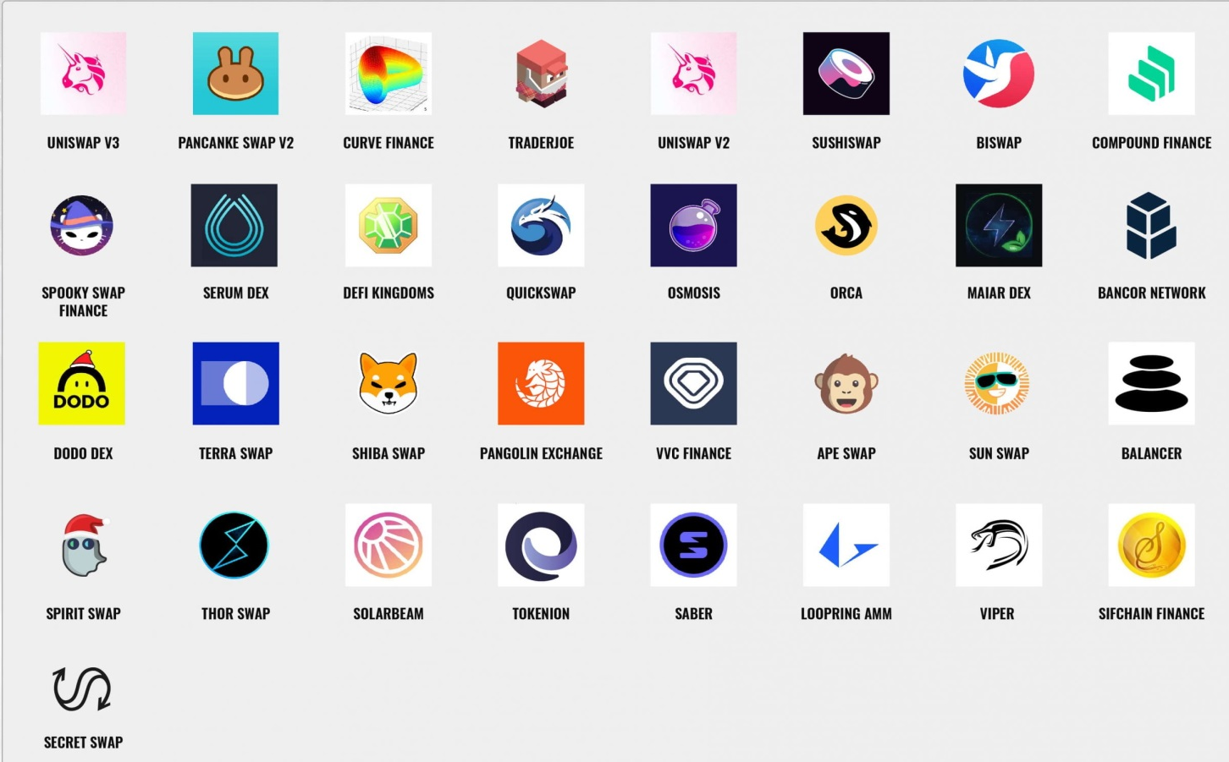
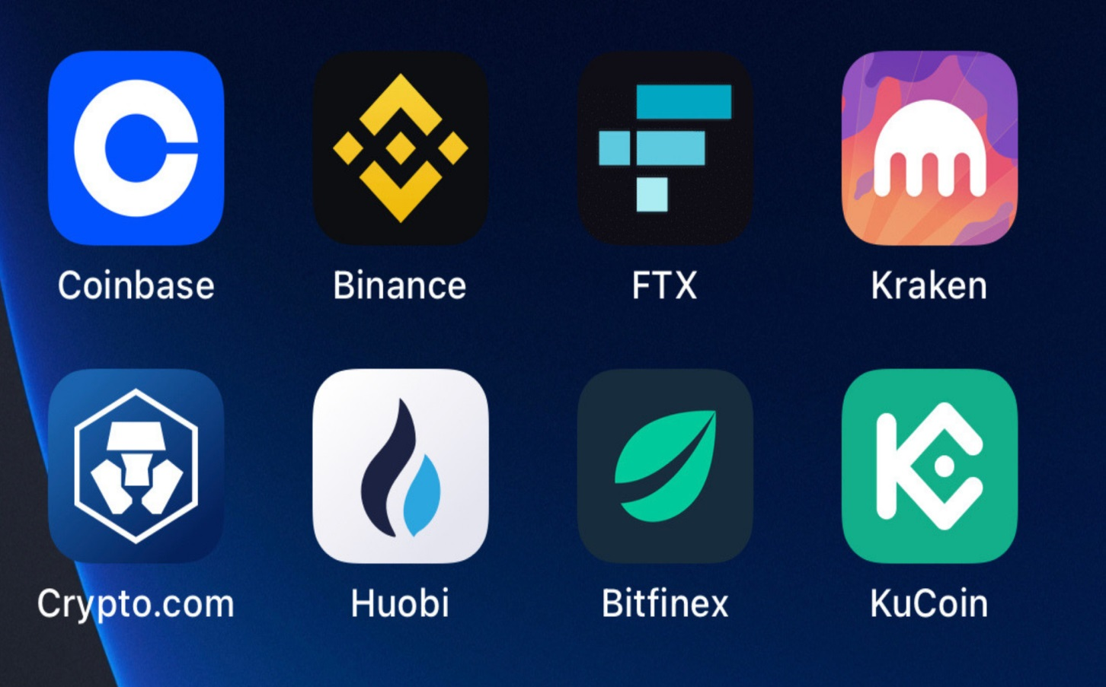
Top 33 DeFi exchanges
Top 8 CeFi Exchanges

Slide 8
What are decentralized applications
(dApps)

Slide 9
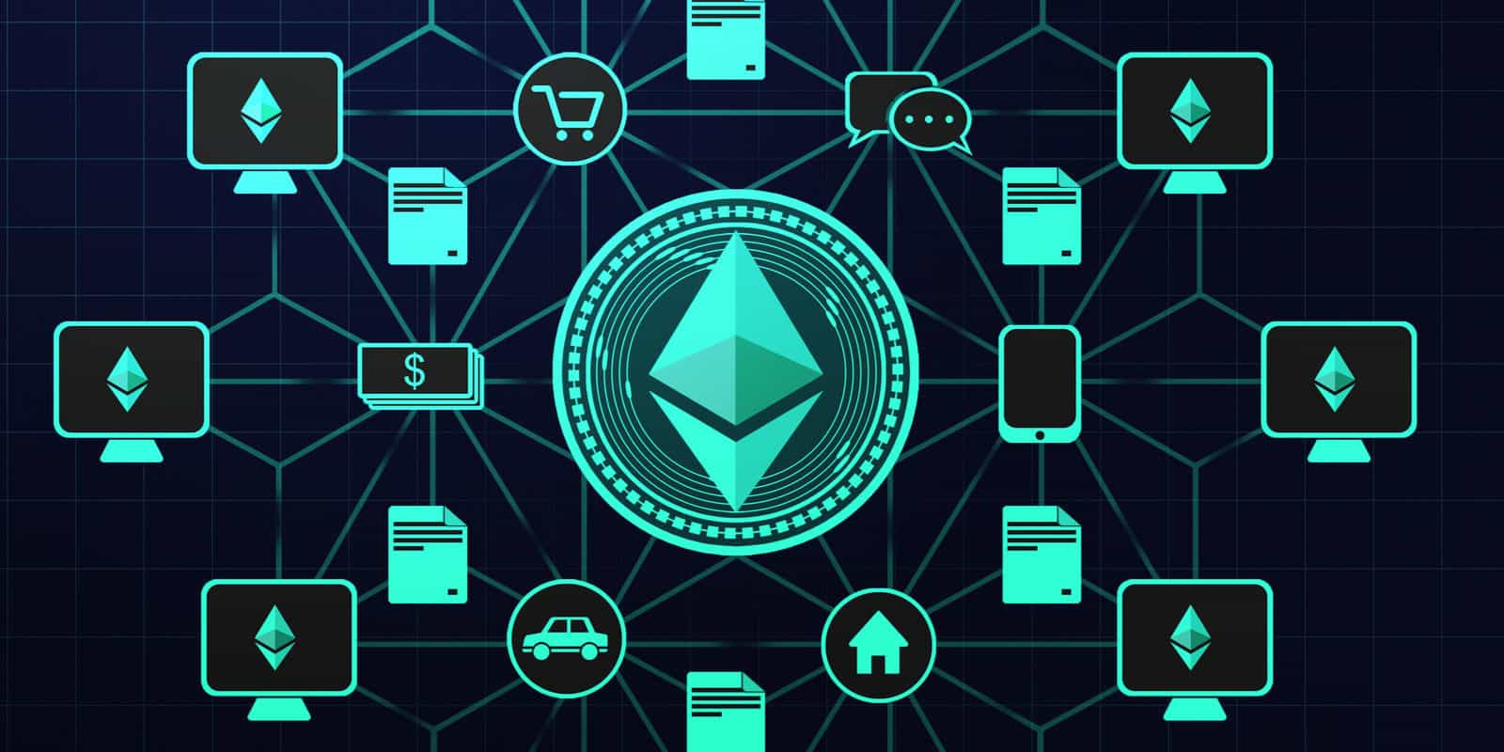
Traditional definitions of a decentralized application require a dApp to be open-source.
dApps also have a public, decentralized blockchain that is used by the application to keep a cryptographic record of data, including historical transactions
Smart contracts are used by developers to maintain data on the block chain and to execute operations. Multiple smart contracts can be developed for a single dApp to handle more complex operations. Over 75% of DApps are supported by a single smart contract, with the remainder using multiple smart contracts.

Slide 10
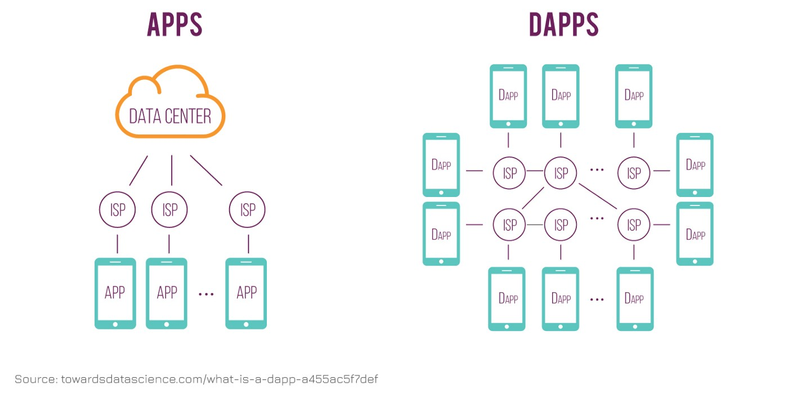
A decentralized application is an application that can operate autonomously, typically through the use of smart contracts, that run on a decentralized computing, blockchain or other distributed ledger system.

Slide 11
Choosing a right wallet for you

Slide 12
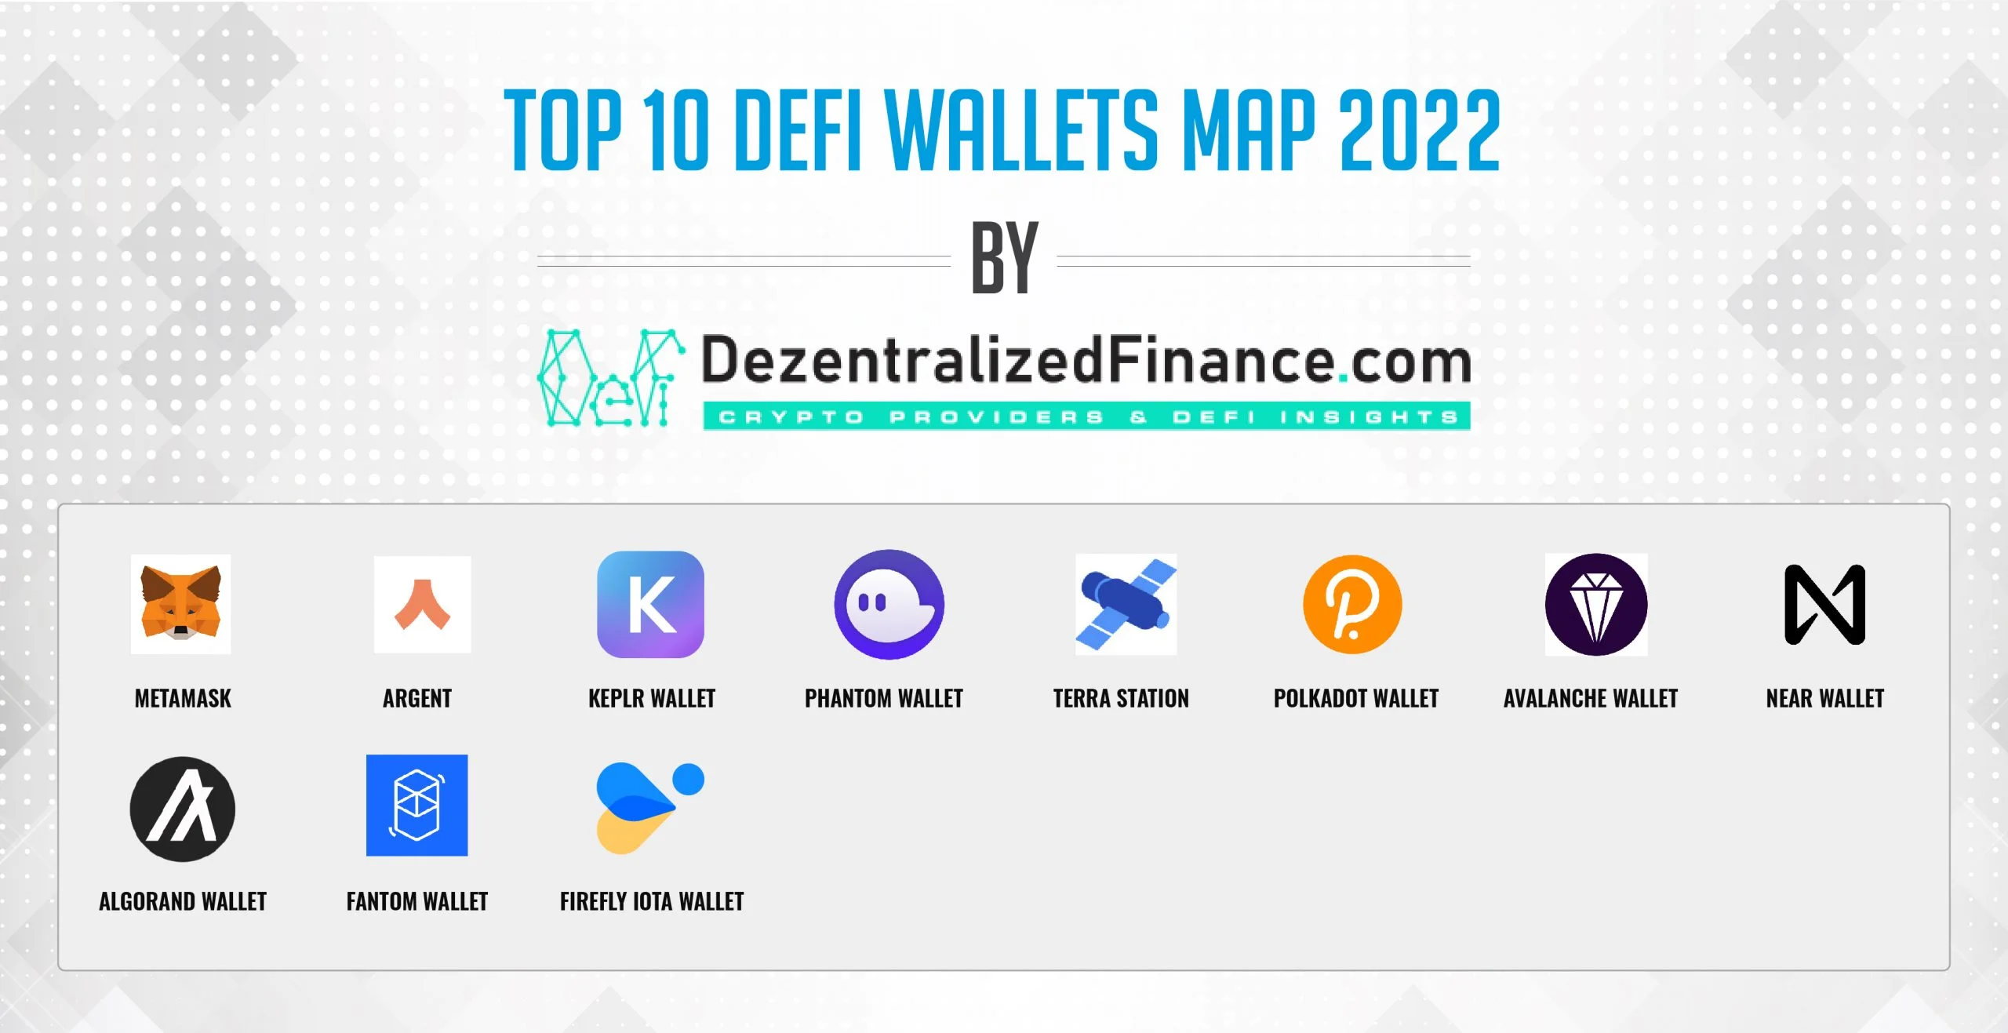
Some of the other popular wallets that can be used are:
MetaMask – Overall Best DeFi Wallet for 2022 with 30 million active users
Crypto.com DeFi Wallet – Top DeFi Crypto Wallet with Low Fees
ZenGo – DeFi Dapp Compatible Wallet
Trust Wallet – Best DeFi Wallet for Asset Selection

Slide 13
Introduction to solidity programming language

Slide 14
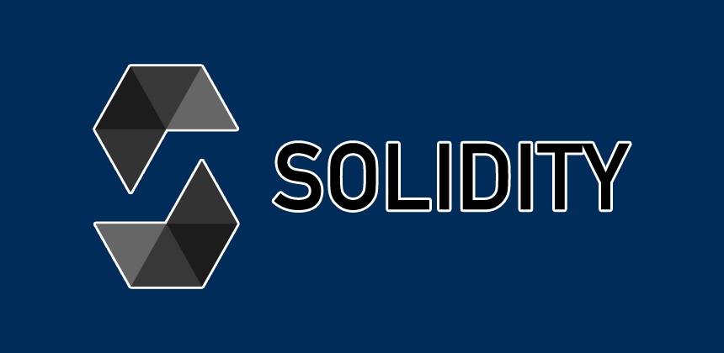
Solidity is a statically-typed programming language designed for developing smart contracts that run on the Ethereum Virtual Machine.
Smart contracts are programs that are executed inside a peer-to-peer network where nobody has special authority over the execution, and thus they allow to implement tokens of value, ownership, voting and other kinds of logics.
For coding using solidity the most popular tool is Remix - an integrated development environment or IDE, which can help in writing, compiling and debugging Solidity code.

Slide 15
Thank you for your attention!
Questions?

Slide 16
Creating a decentralized wallet and a short introduction to Solidity programming language
Bane Avramović, bane.avramovicc@gmail.com

