Slide 1
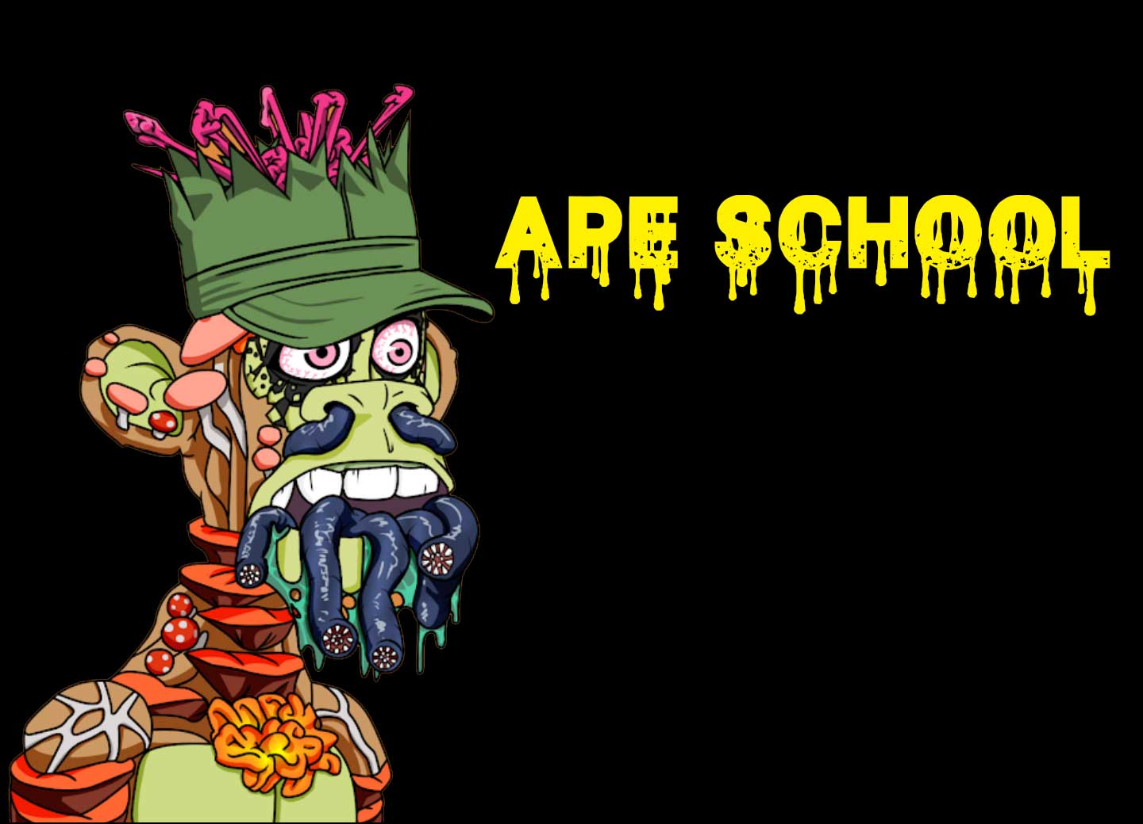
Methodology and tools for the creation of NFT collections on Ethereum blockchain

Slide 2
Our targets for today
Understand „philosophy“ of NFTs and
Understand methodology and tools how to create collection
Notes:
Filozofija je vazna da bi razumeli primenu i pronasli novu
Metodologija nam pomaze da napravimoono sto zelimo

Slide 3
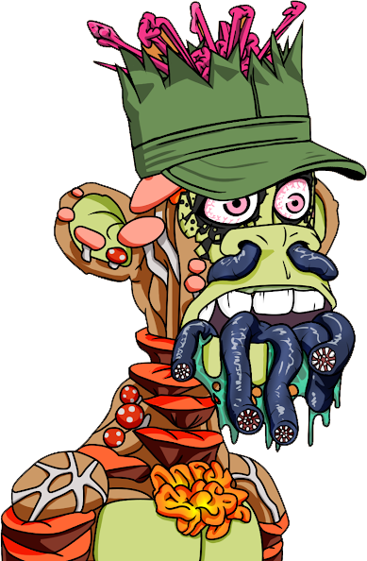
Who is Professor John Keeting?
@ProfKeeting
Darko Pavic, owner and CEO of Fiscal Solutions
We are an IT company (SW).
On the market for 19 years already.
We create software for large international retailers and large POS SW providers.
Our product enables retailers to expand internationally.
Our solution is used in 17 countries.
Engineer and software developer
Founder and director of Ape School
https://www.linkedin.com/in/darko-pavic/
defines technology standards e.g. UML
>800 members (Apple, Google, Microsoft, Oracle …)
HQ in USA
international business organisation
45 million companies
from > 100 countries

Slide 4
Begining of nintees ….
Notes:
Znate sta znaci ova maska i za sta se koristila?
Osim u seriji boja novca.
Iza ove maske se kriju teme kao sto su demokracija, decentralizacija, anonimnost,moc odlucivanja nad svojim zivotom
U 90 je ona bila simbol hakerskih organizacija koje su se borili za tu ideologiju
Ona je bila simobol buntovnista i zelje za promenom drustva.
Npr. na mom fakulteti smo pokusavali hakirati sisteme → unix/sinix
To sto smo mi radili naravno da nije dobro, ali je potaklo drustvo na razvoj sigursnosih sistema i kriptografije
Tako je nastala tehnologija koja se posle primenila u kontekstu blockchain algoritham.
Blockchain ispunjava sve te ideologije
Sta mislite kako su nastali fiskalni sistemi → ljudi su hackirali porezni sistem
Nema potrebe vise da se bavimo hakiranjem, sada to radimo oficijelno na fakultetima i komoanijama

Slide 5
REVOLUTION
is now
NFTs are intelligent barcodes
Notes:
Prvi put u istoriji covecanstva mozete staviti pametnu oznaku na digitalno sredstvo i istu oznaku i na fizicko

Slide 6
My identity in web3 space is represented by this NFT
Notes:
Identitet je abstraktno sredstvo
Kroz digitalnu adresu na blockchainu i jjenu repreznetaicju ja sam jedinstveni vlasnik ovog absratnog dobra

Slide 7
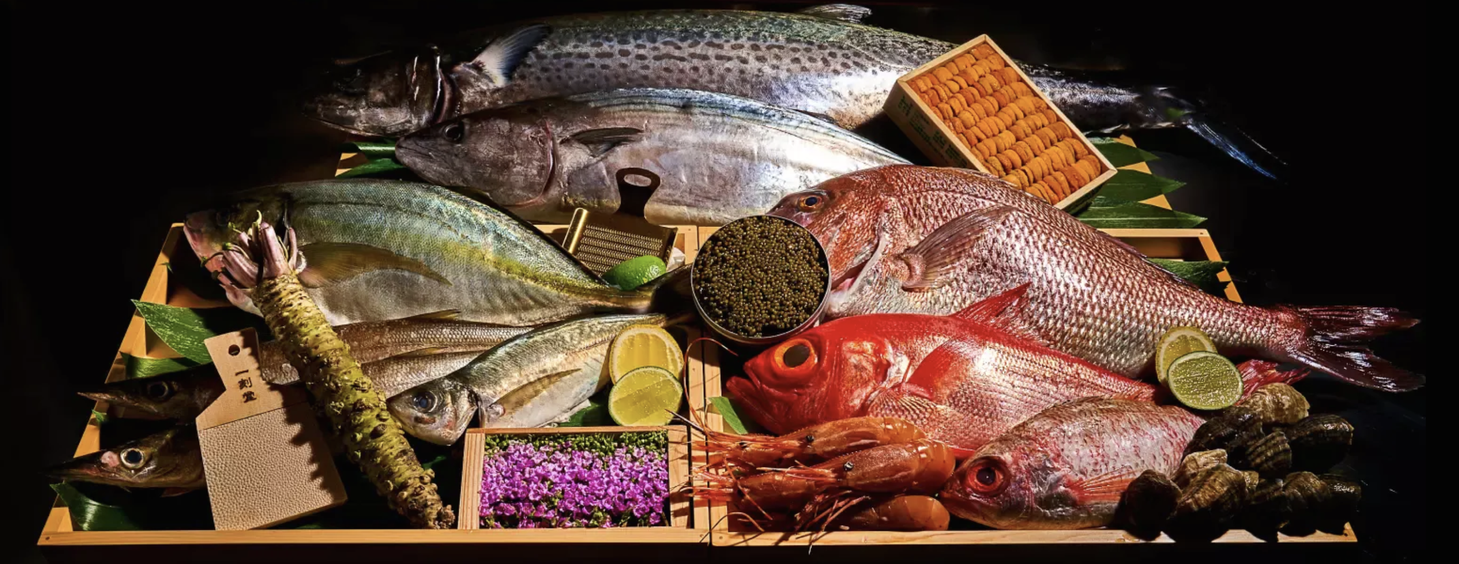
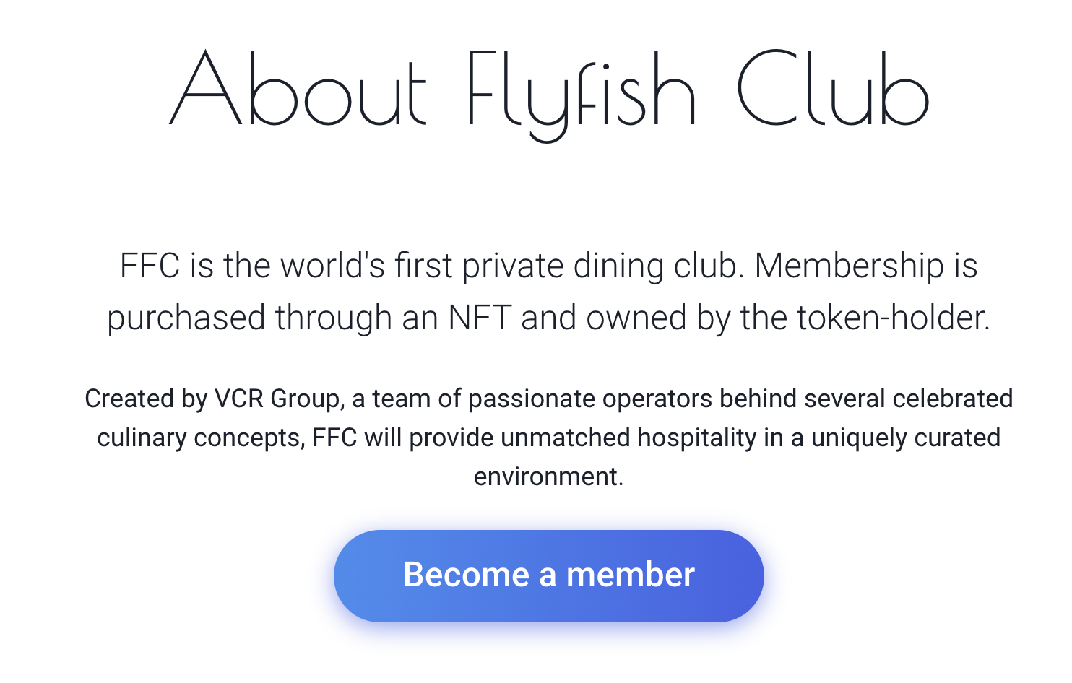
Token can be leased.
Royalty fees are 10%
NFT with utility
New business model

Slide 8
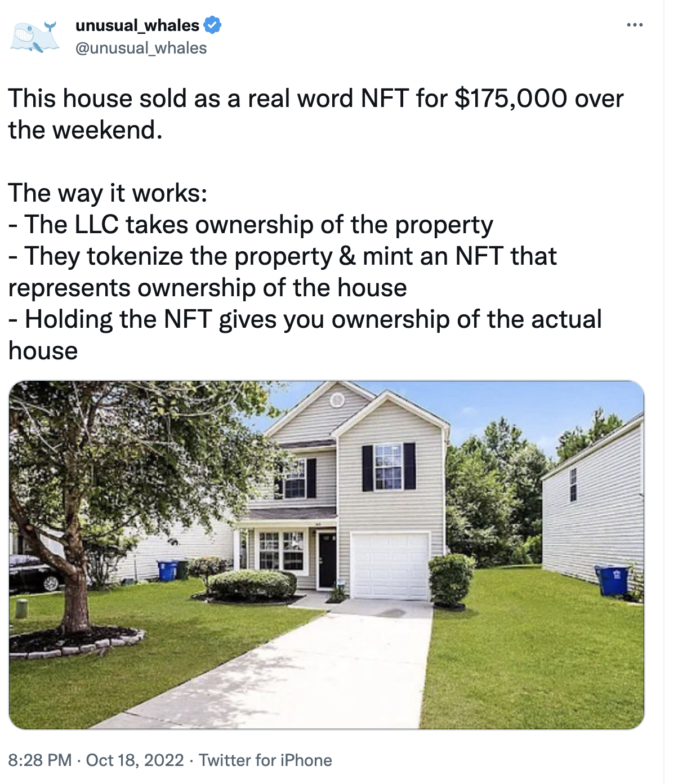
propert

Slide 9
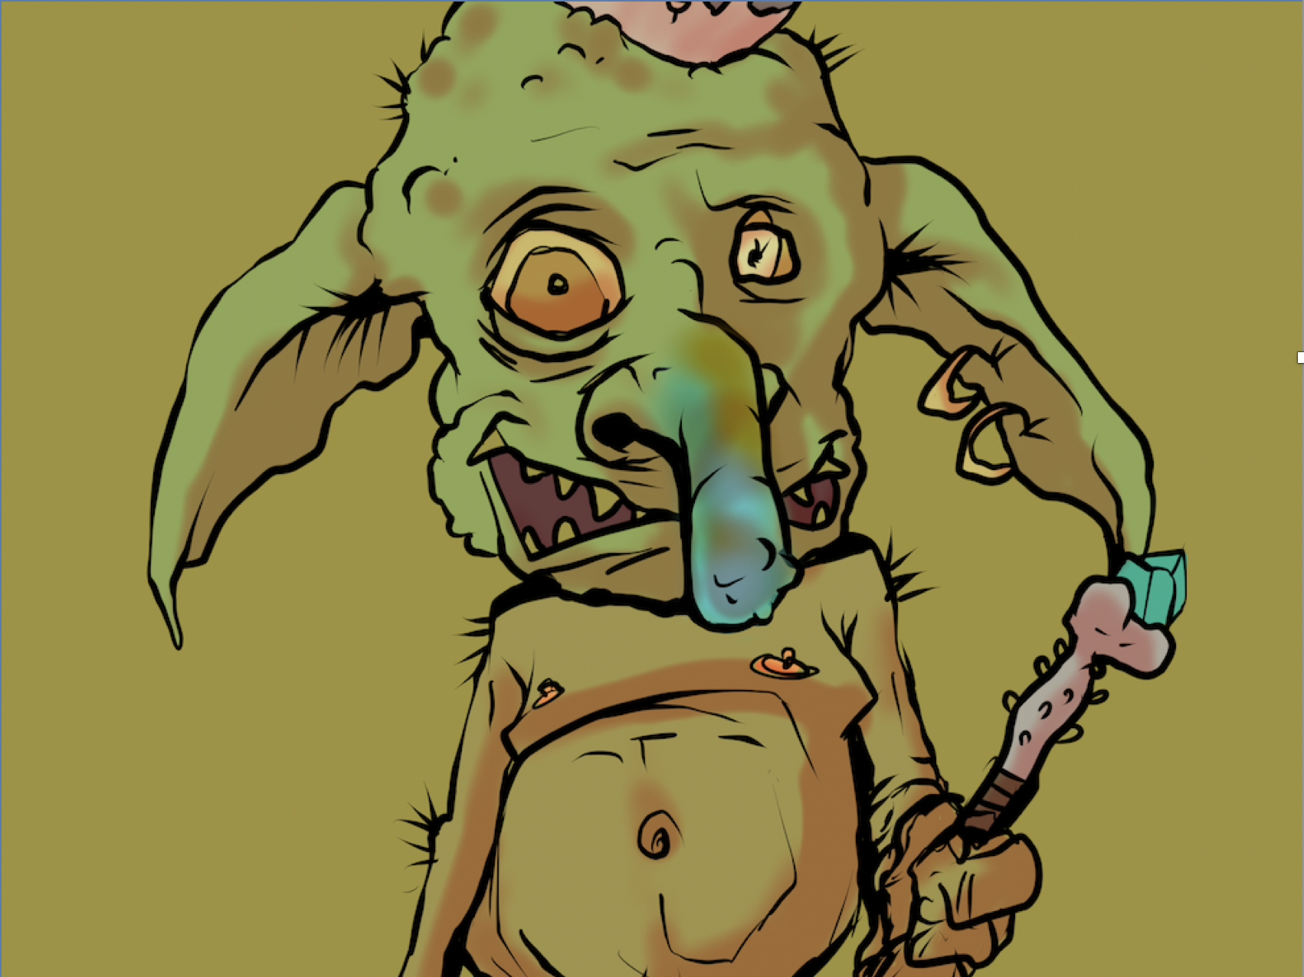
Notes:
Ovo je jedan NFT iz jedne poznate
Kolekcija se zove Goblin town i pfp je kolekcija
https://opensea.io/assets/ethereum/0xbce3781ae7ca1a5e050bd9c4c77369867ebc307e/8995
U jednom momentu je cena bila oko 7eth

Slide 10
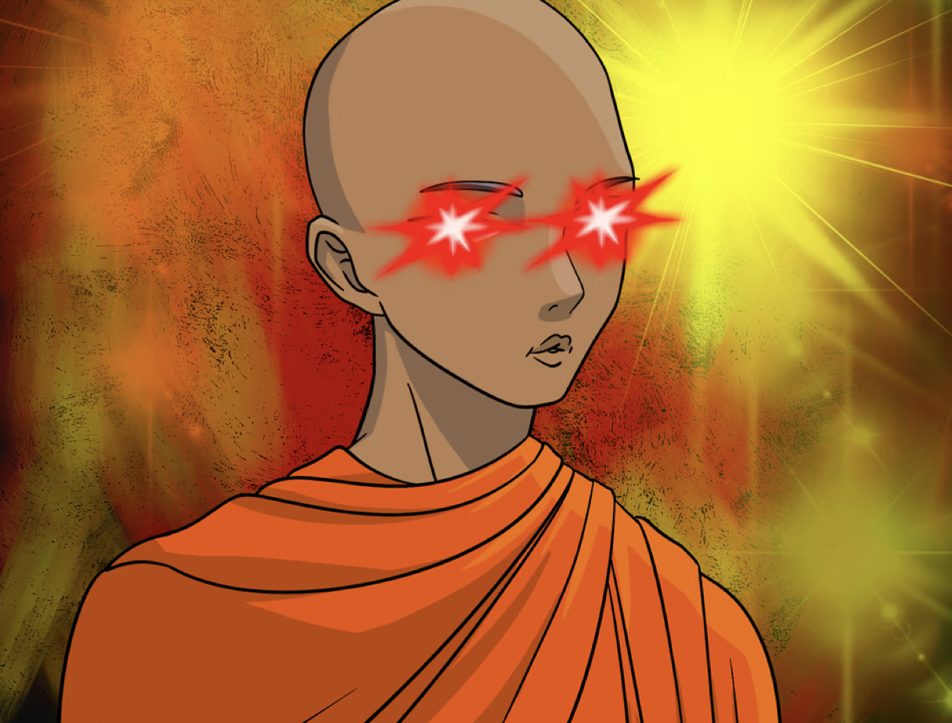

Slide 11
Non-Fungible Token (NFT)
Some definitions
Non-Fungible means not interchangeable.
Tokens represent assets.
What are assets?
Something useful or valuable who's ownership can be transferred to another person or entity across space and time
It can be physical, digital, abstract (e.g. knowledge)
Tokens don’t have a value by themselves, but they represent value like for example a gift card (plastic doesn’t really have a value, but you can exchange it for value).

Slide 12
Non-Fungible Token (NFT)
Some definitions
Creating tokens that represent a value is called tokenization.
Tokenization of assets on blockchain technology is how NFTs are created.
Digital assets can be: art, event tickets, in-game items, virtual property, a song etc.
Physical assets that can be tokenized could be: ownership contracts, leasing contracts, licenses etc. and by that houses, cars etc.
Abstract assets that can be tokenized could be: identity, knowaldge etc.

Slide 13
Non-Fungible Token (NFT)
What is it actually?
“Logicaly”
It is a digital “certificate”e of ownership over digital or even physical assets.
Technically
Data stored on the address owned by somebody
Verified on the blockchain
Data usually points to the server upon which the digital asset is stored.
There can‘t be two different addresses pointing to the same digital asset.
public address on
the blockchain
on the
blockchain
belonging data:
address of asset
smart contract,
others
Asset e.g.
jpg, contract etc.
different
server

Slide 14
Elements of the „NFT“
If you are developing NFTs you will have to work on:
Asset e.g. IP rights
Representation of asset e.g. jpg
Metadata (json file that describes NFT)
Smart contract e.g. ERC-721
NFTs are intelligent barcodes

Slide 15
Non-Fungible Token (NFT)
What is it actually?
Standards for tokenization are implementing interoperability (in different eco systems, trading platforms etc.):
(ERC=Ethereum Reuest for Comments → suggestions about features to add to the network)
ERC-721 (base of NFT token)
ERC-998 (bundelling of several ERC-721 tokens in one transaction)
ERC-1155 (related to distribution of different tokens from one smart contract)
Based on blockchain technology they can easily be traded and transfered without changing them.
You can‘t move NFTs from one Blockchain network to another.
NFTs are programmable (smart contracts).
Complete list of EIP standards: https://eips.ethereum.org/all

Slide 16
Overview of cryptocurrencies and tokens
Ethereum
Cryptocurrency
Fungible tokens
Non-Fungible tokens
Ether
- Native implementation
Based on ERC-20
e.g. $apecoin
Based in ERC-721
e.g. Bored Apes, Masters of Blockchain etc.

Slide 17
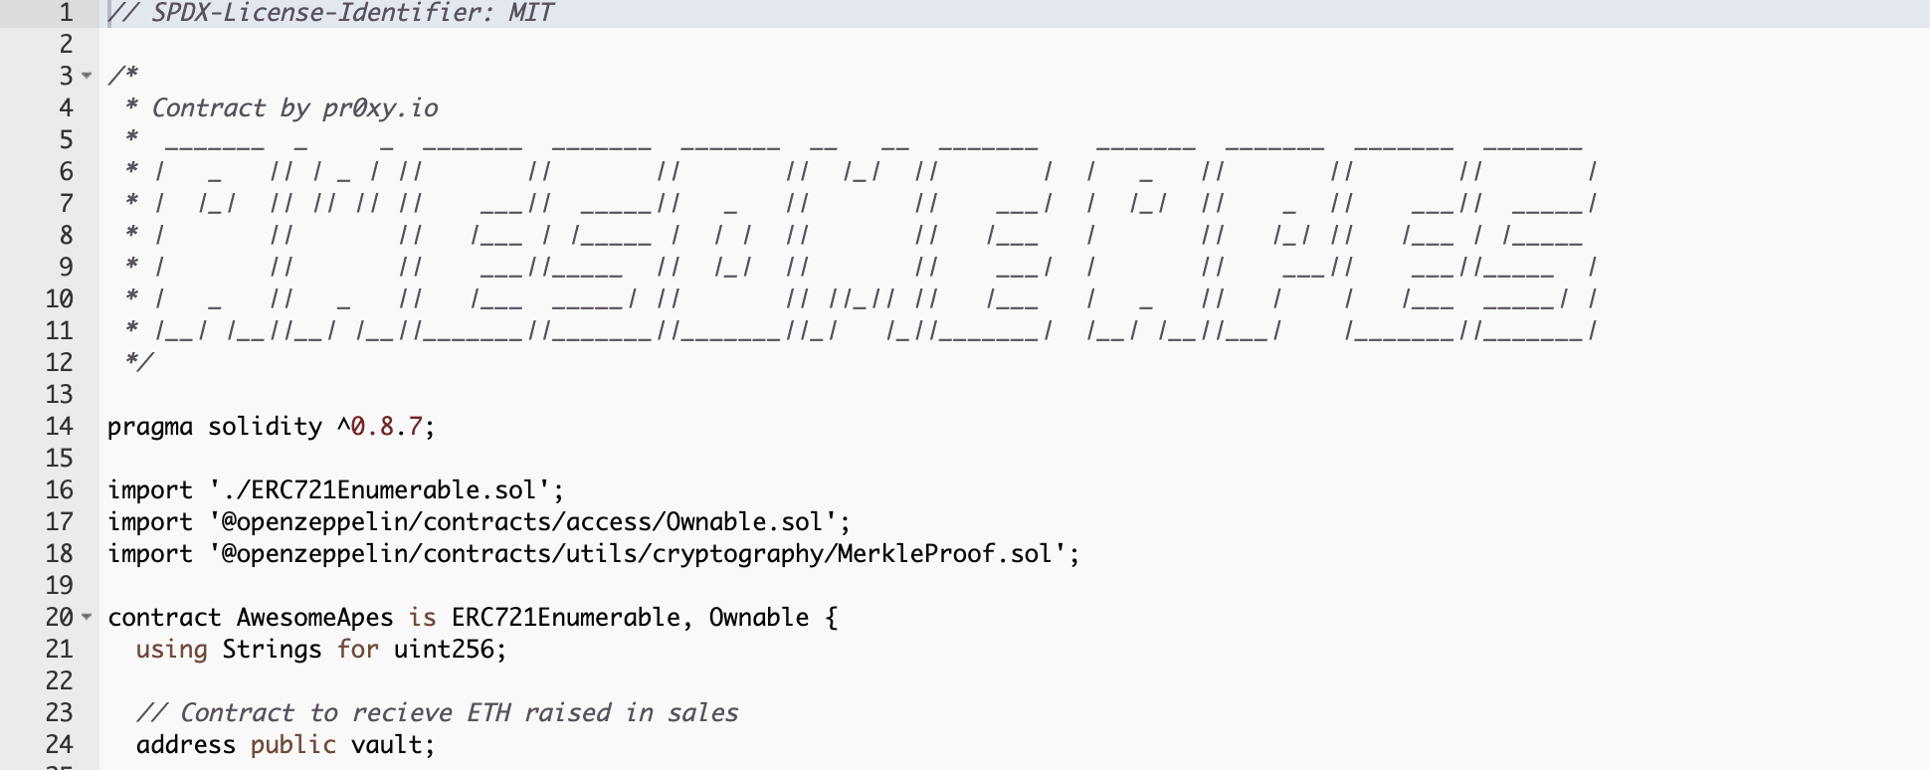
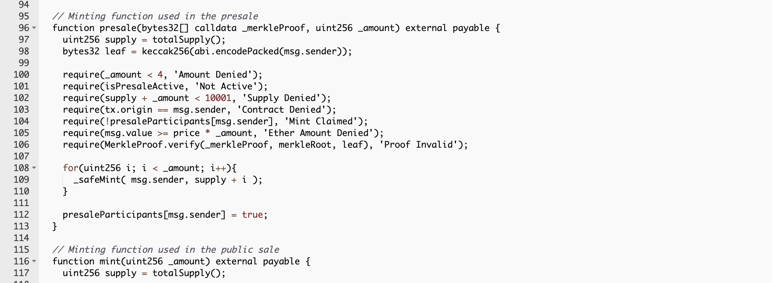
NFT is piece of software
Smart contract
Smart Contracts are applications called Dapps (Decentralized Applications)
Dapps are stored and executed on the blockchain e.g. Ethereum
On Ethereum is the most common programming laguage for smart contracts: solidity

Slide 18
Elements of the „NFT“
If you are developing NFTs you will have to work on:
Asset e.g. IP rights
Representation of asset e.g. jpg
Metadata (json file that describes NFT)
Smart contract e.g. ERC-721
On-Chain or Off-Chain
On the blockchain

Slide 19
NFT Projects
Typical phases
Execution of roadmap
Value
Adding feature to
the project (Metaverse, game …)
Excitement is
disappearing
Adding feature to
the project (staking, breading, collaborations …)
Excitement is
disappearing
Reveal
Launch/
Minting
Hyping
the project /
Whitelisting /
Giveaways
Time
Before launch
launch
After launch

Slide 20
What is needed in order to make NFT collection?
From idea to reveal
Project planing
Setup of the Team
Creation of the concept and strategy
Creation of project roadmap
Development of whitepaper
Development of marketing materials (internet page, banners, ads etc.)
Development of smart contract
Requirements definition
Development
Testing
Deplyment
Development of mint page
Artwork
Creation of artwork (layers)
Generation of NFTs - Artwork
Generation of Metadata
Selection of NFTs and update of Metadata
Upload of artwork and metadata to e.g. ipfs
Mint
Reveal
Execution of the roadmap
Can be partially paralelised

Slide 21
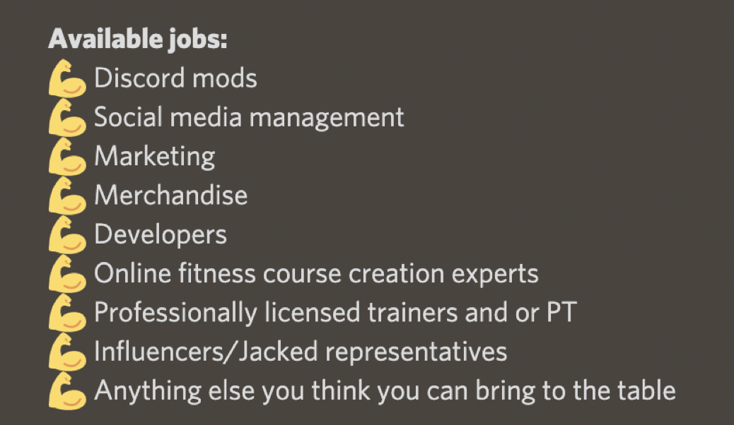
Key to sucess: TEAM
To have friends in the team is great but you need also people with expirience and knowaldge
Web3 focused people are key
You need at least following skills:
Artis
Somebody who is taking care of artwork
Community manager (Twitter, Discord etc.)
Developer (minting page, smart contract)
“Founder“
Best places to find the team: Twitter and Discord
Combinations are possibke but difficult
Doxxed or anno

Slide 22
Concept and strategy
Your strategy should answer at least this questions:
Which problem are your NFTs solving?
Why should somebody buy your NFTs?
What makes your project different?
How will you generate income/profits in pre-mint phase and in after mint phase?
What is your vision for the project in 2-3 years?
Which risks do you see and what are your messures to minimize them?
It has to create demand on the market
Over and over again
It can influence (limit) suppy as well
Don‘t mix strategy and plan:
Plan is concrete implementation of defined strategy

Slide 23
Concept and strategy
Tokenomics
Team
Possibility to earn
Minting (Speed)
Celebrity
Marketing / Hype
Burning (Speed)
Fixed supply
Utility
Roadmap

Slide 24
Roadmap
The Roadmap is defining what the NFT project wants to deliver when
It can be seen as a
Major product
Generator of demand before and after launch

Slide 25
Roadmap
It should be unique
At least for 1 year
It should be simple (not more than 2-3 milestone per year)
Realistic e.g. maped with skills of the project team
Avoid: metaverse, p2e, 3d avatars, merch, DAO etc.

Slide 26
Whitepaper
Some laws are regulating it e.g. Serbia, EU etc.
It should explain the strategy
It is very important instrument to gain trust
Main elements are:
Business model e.g. income, costs, allocations etc.
Strategy
Responsibilities e.g. team, companies, investors, …
Road map

Slide 27
Marketing strategy
Community and hype centric
Community building
Hype building
Key tools: Discord and Twitter
Targets: follower, engagmenet and relevance
Most important: twitter spaces
Marketing strategy has to define:
Who is your target „customer“?
What do you communicate?
How do you communicate?
Where do you communicate?
When do you communicate?
What is the value that you are giving to the community?
Why should somebody give to you his time?

Slide 28
5 Tipps for sucesfull marketing startegy
Web3 Space
Identify the leaders in the space
Try to connect with leaders
Create and give value to the community
Don‘t try to shill (sell)
Don‘t be fake, be real

Slide 29
Paralelisation and sequence
Marketing execution
Requirements definition
Development of smart contract
Local testing
Deployment of Test NFTs/Metadata on ipfs
Deployment and test on Testnet
Development of mint page
Deployment on mainnet
Deployment of NFTs/Metadata on ipfs
Deployment of mint page
Creation of artwork and utilities
MINT
REVEAL

Slide 30
Development of Ethereum smart contract
Needed tools
IDE: REMIX (https://remix.ethereum.org)
Develop
Test
Deploy
Etherscan.io
Deplyment
Control of the process e.g. mint, reveal, pause, payout etc.
Marketplace e.g. Opensea (https://opensea.io/)
Mint page → your separate development
Greate example of the smart contract that you can use as base:
https://github.com/HashLips/hashlips_nft_contract/tree/main/contract

Slide 31
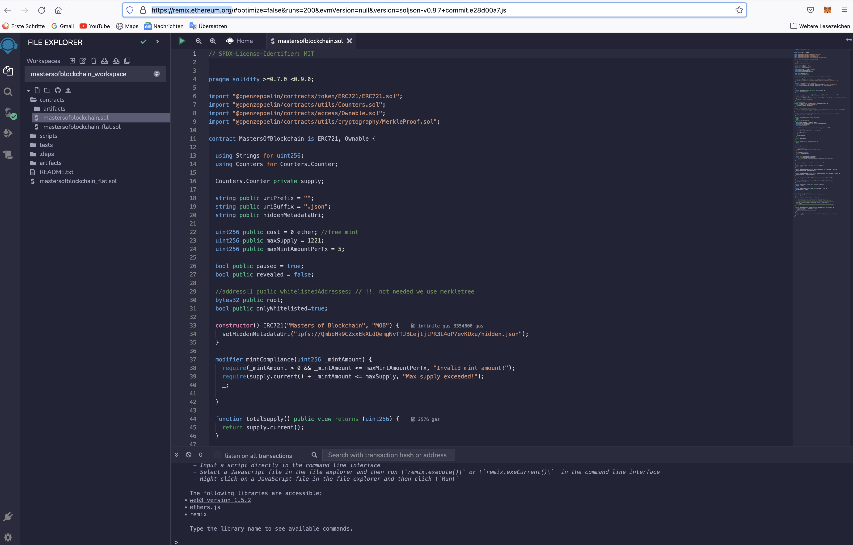
Remix
Browser based environment

Slide 32
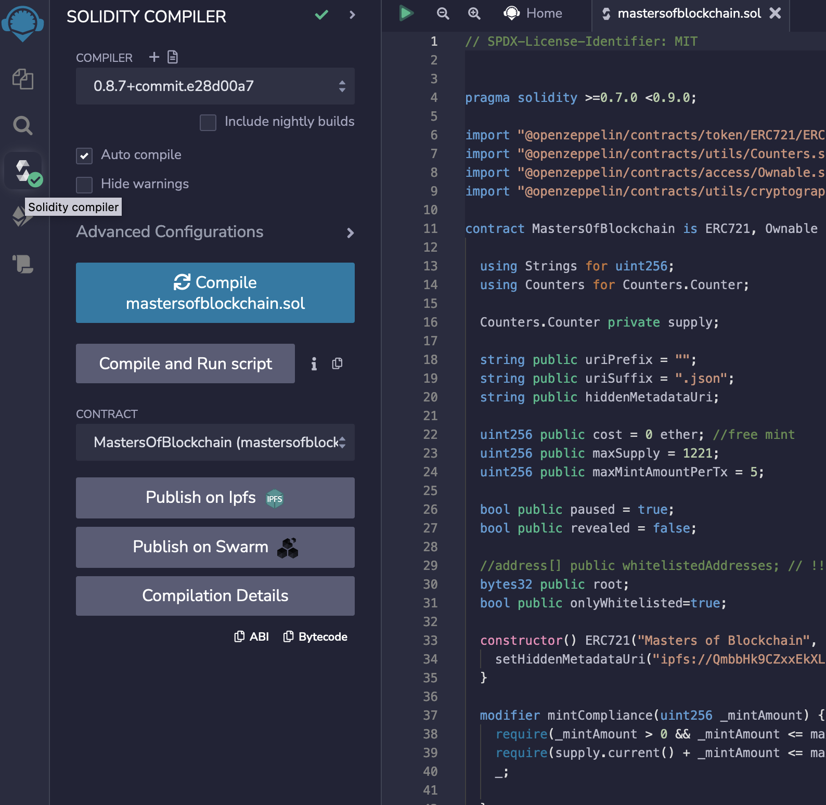
Remix
Development - Compiler

Slide 33
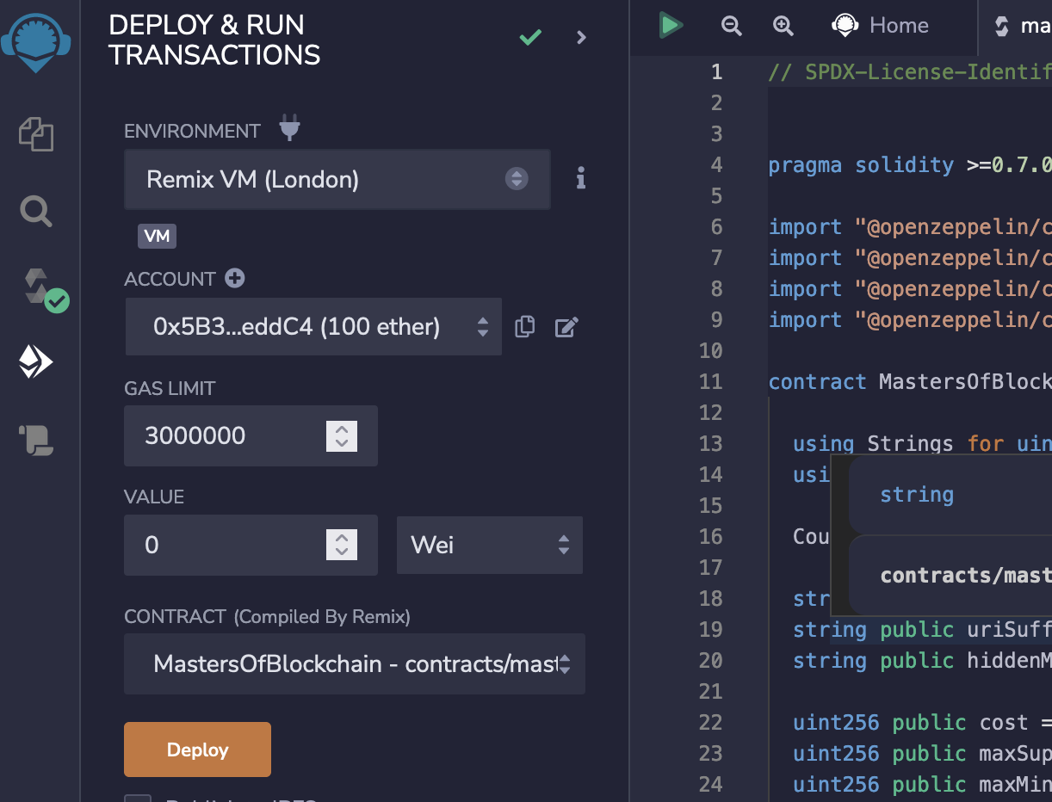
Remix
Test – Step 1
Virtual mashine based
No deployment needed

Slide 34
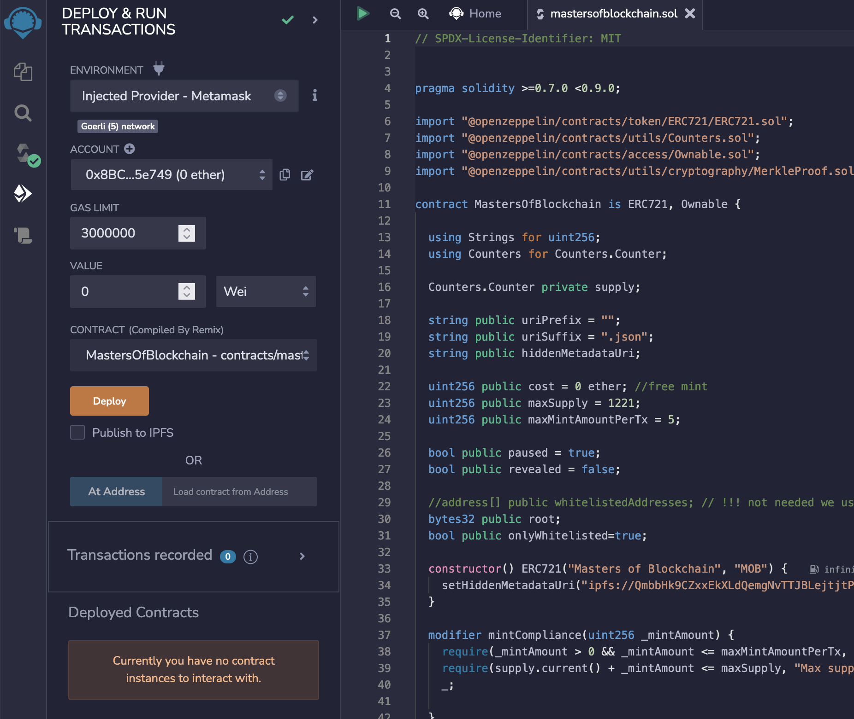
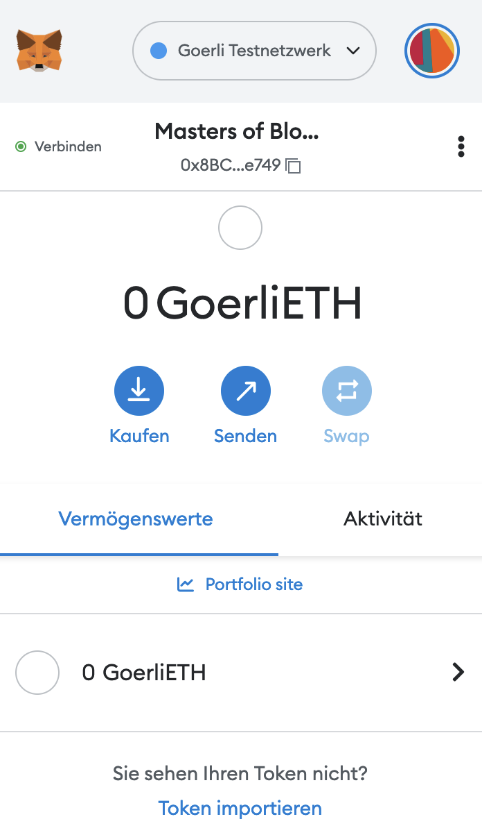
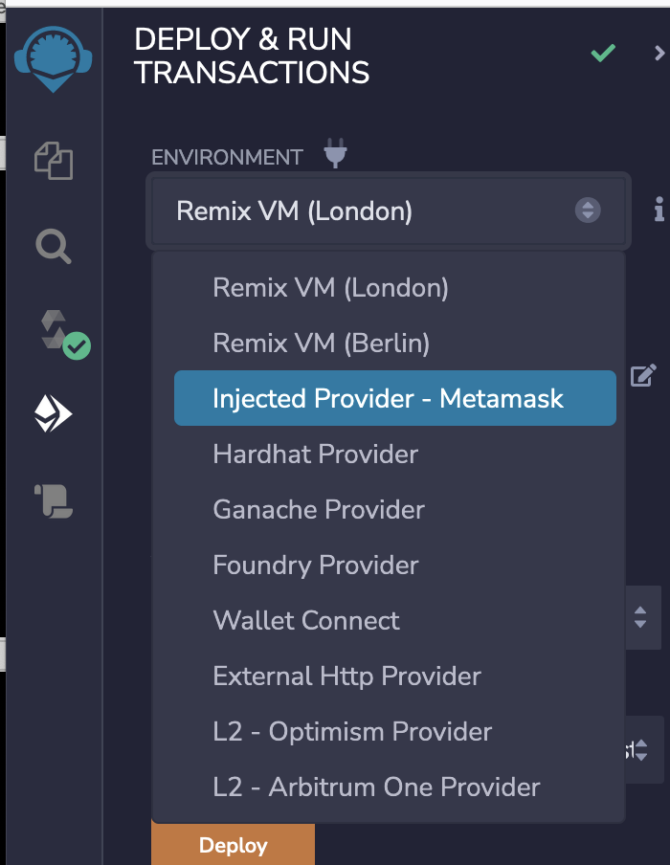
Remix
Test – Step 2
Goerli Testnet
Deployment needed
Everything like on the live blockchain

Slide 35
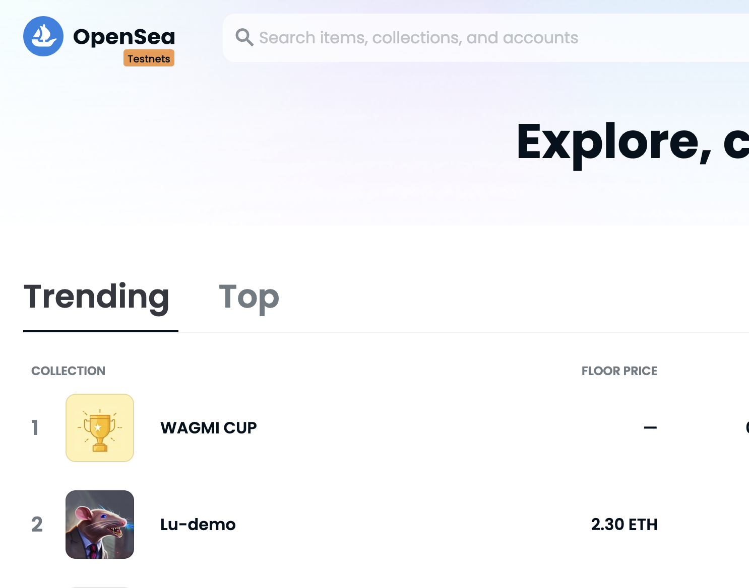
Test
Collection
Opeansea switch to testnet based on connected Wallet e.g. MetaMask

Slide 36
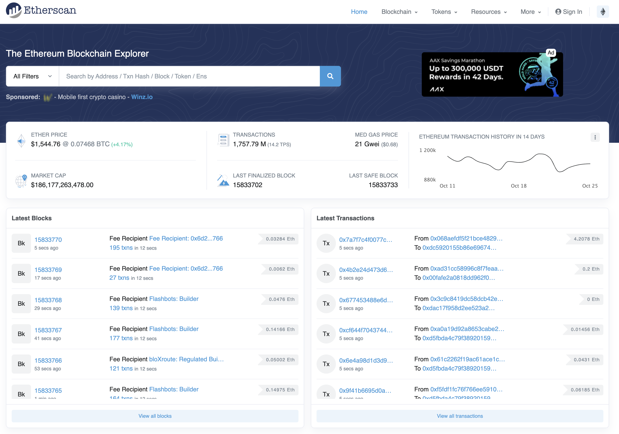
Etherscan.io

Slide 37
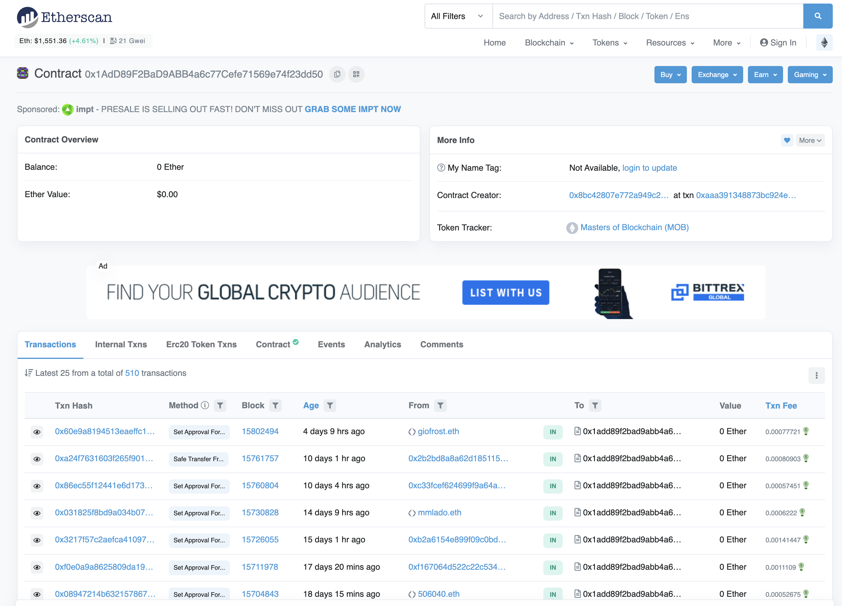
Etherscan.io
Smart Contract

Slide 38
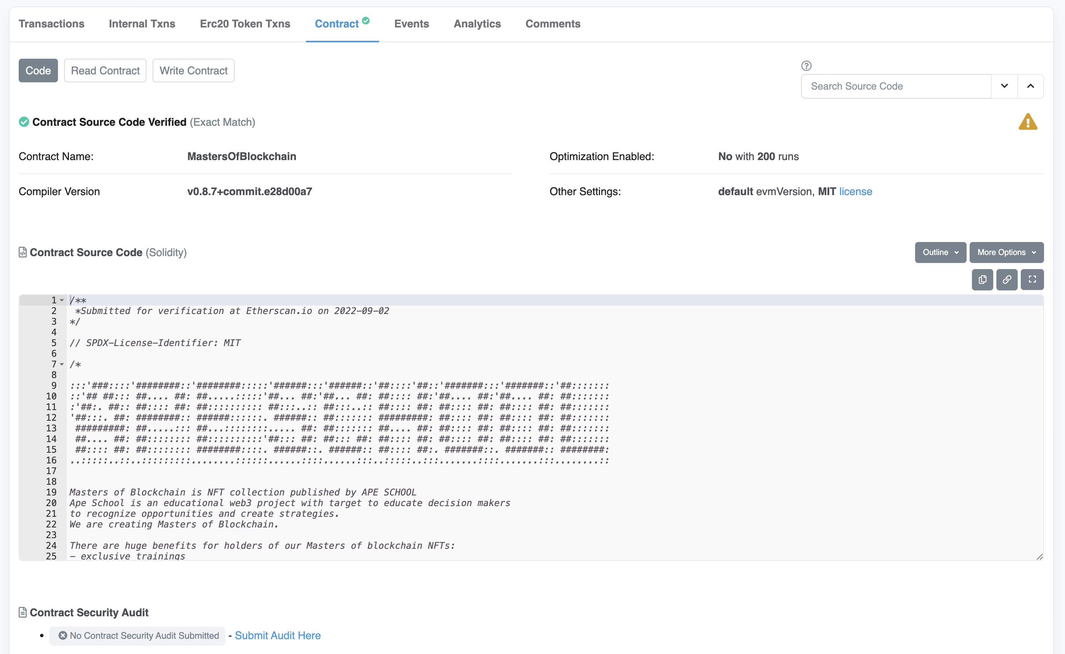
Etherscan.io

Slide 39
Etherscan.io
Is used for:
Inspect smart contracts
Publishing of smart contracts
Interaction with smart contracts
View transactions
Check the “conten“ related to an wallet Adresse
And much more

Slide 40
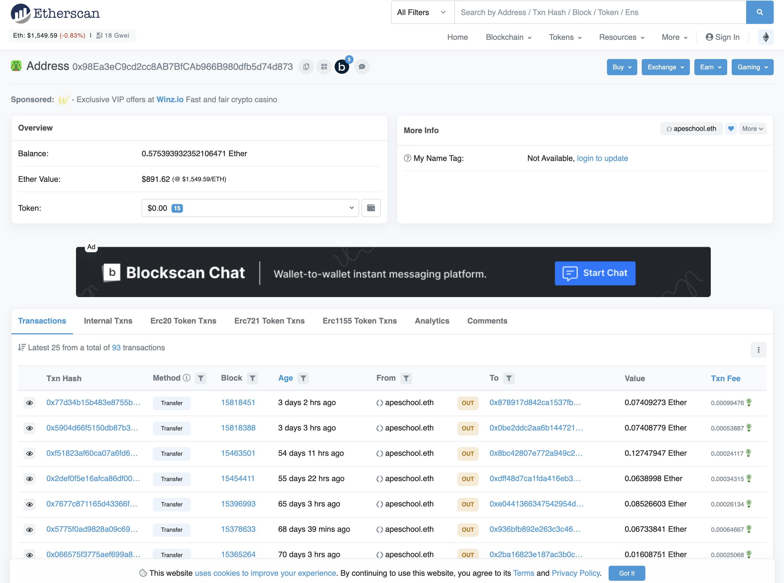
Etherscan.io
Example of „wallet“ „contet“

Slide 41
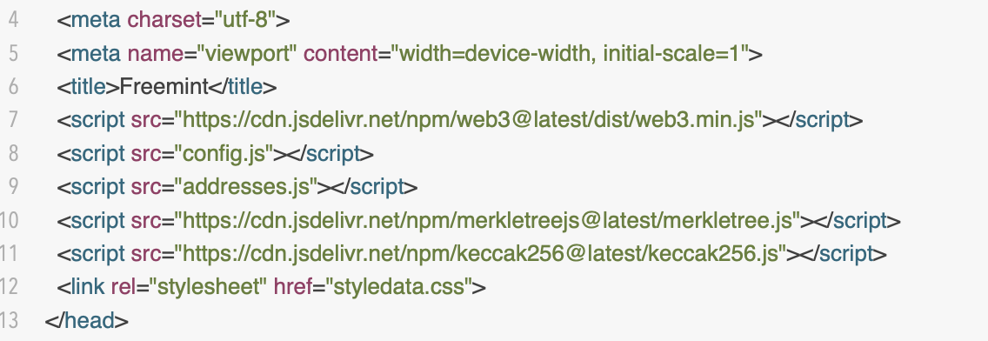
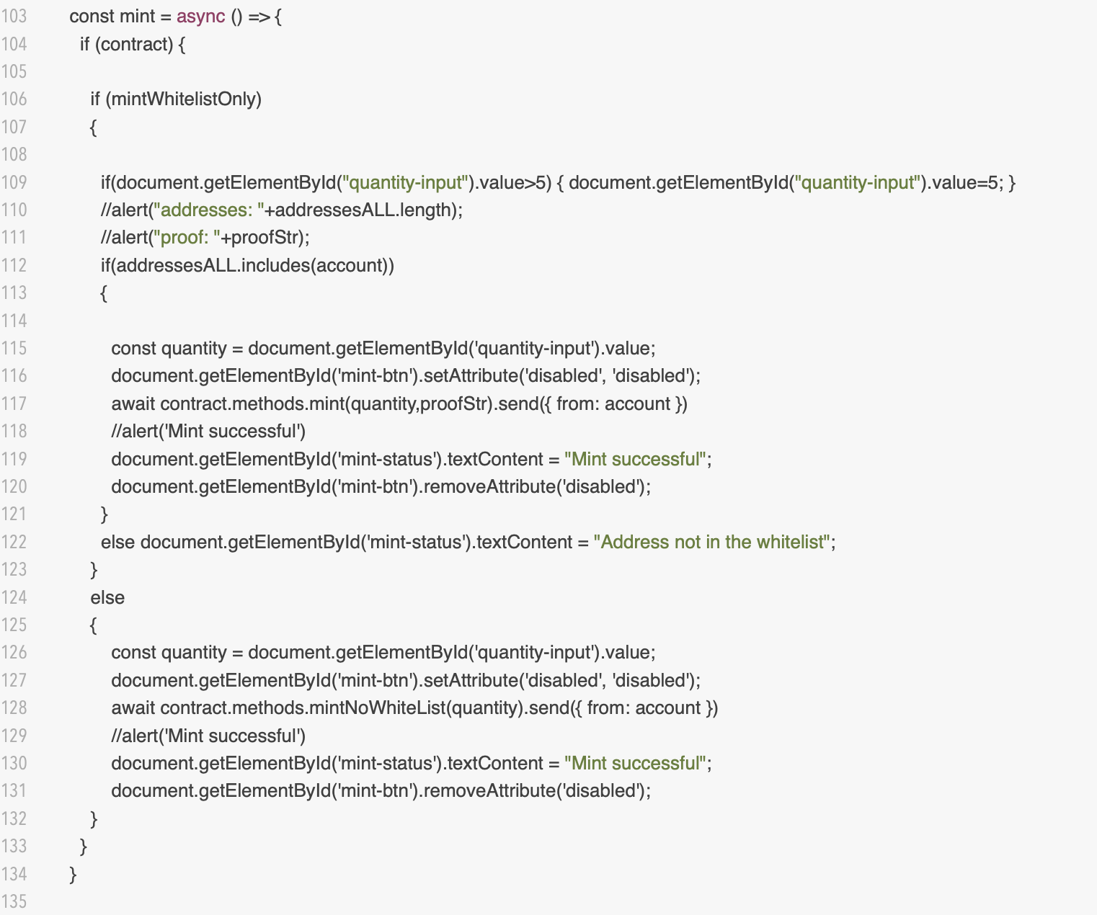
Development of Mint page
Needed tools and libraries
Local web server
Any text editor or IDE
Additional libraries
Most popular javascript libraries to interact with smart contract are: etheres.js and web3.js
Other libs depending on language/environment that you use
Live web server to deploy
FTP client for deploy
Great example oft minting app
https://github.com/HashLips/hashlips_nft_minting_dapp

Slide 42
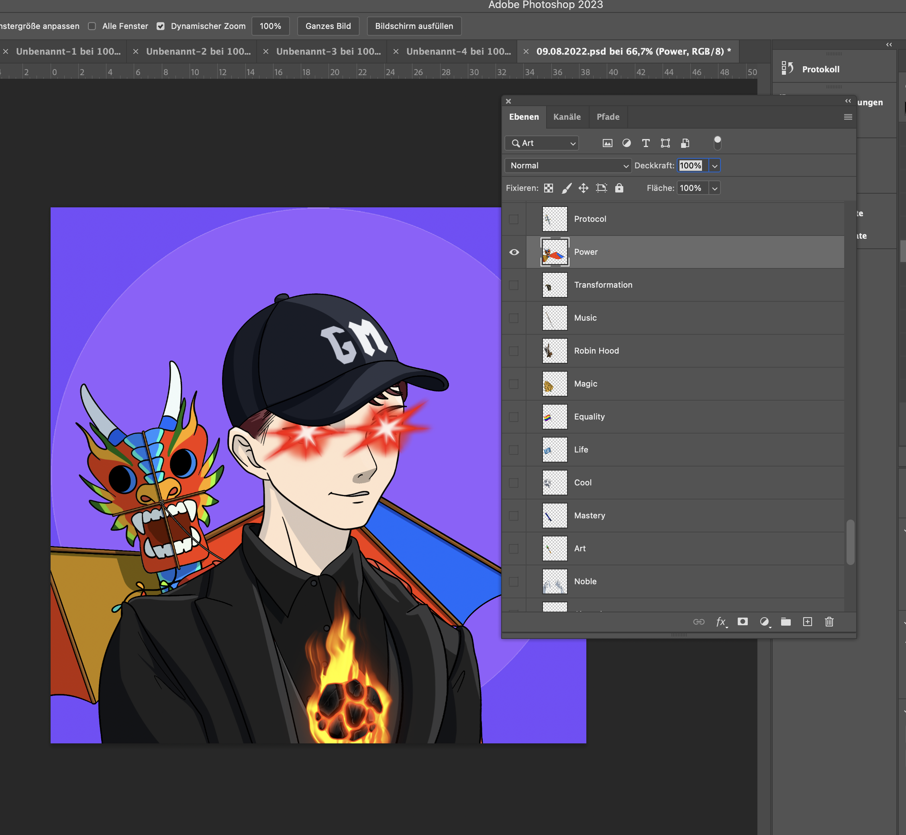
Artwork
Creation of layers

Slide 43
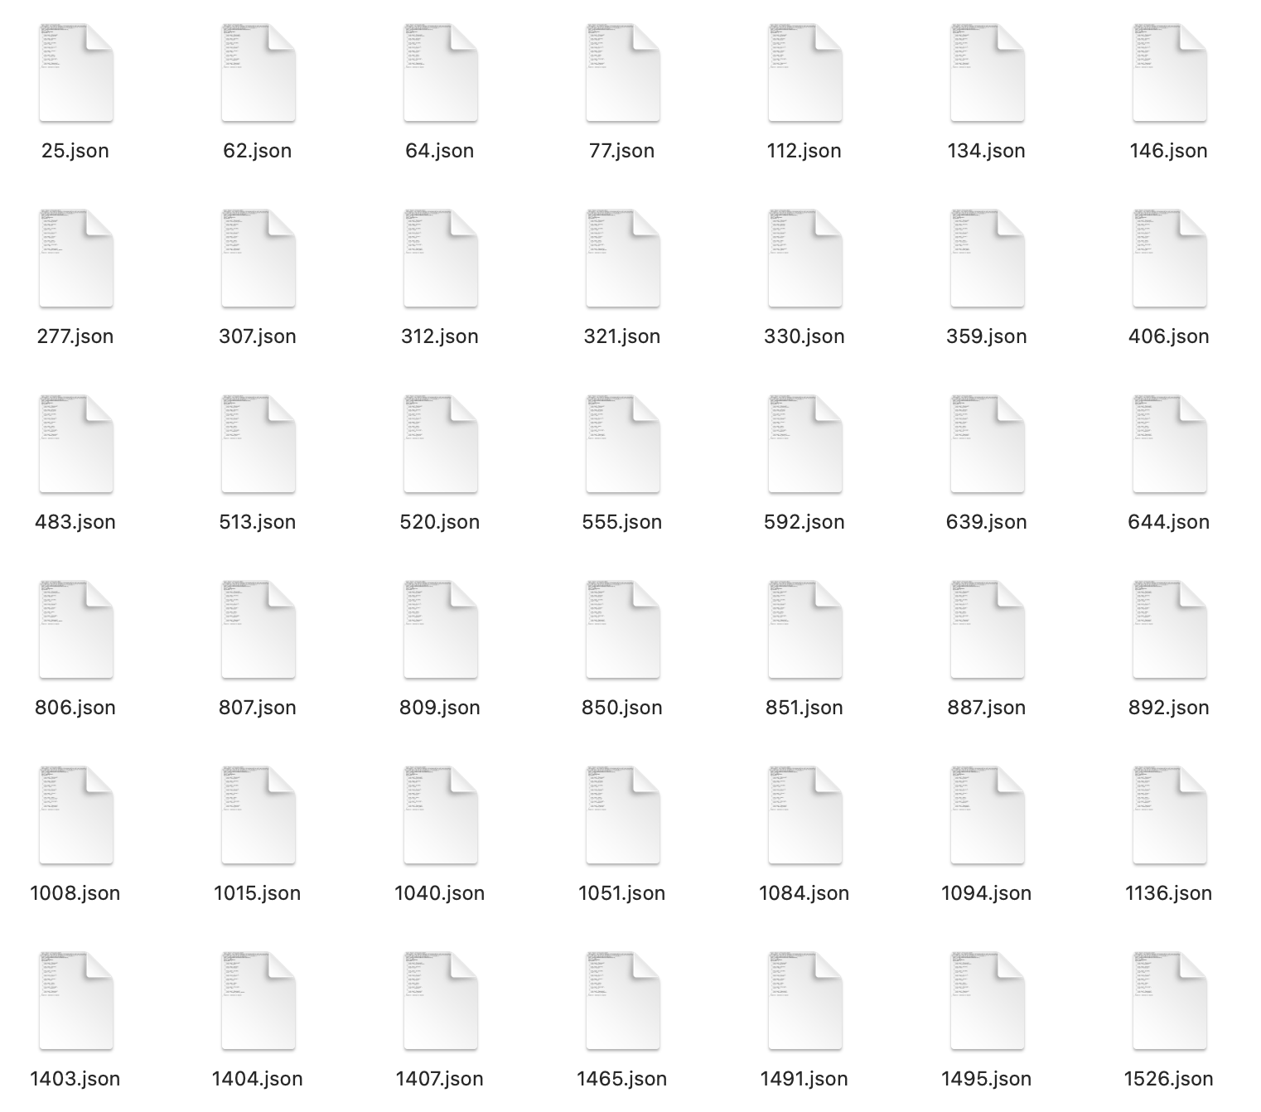
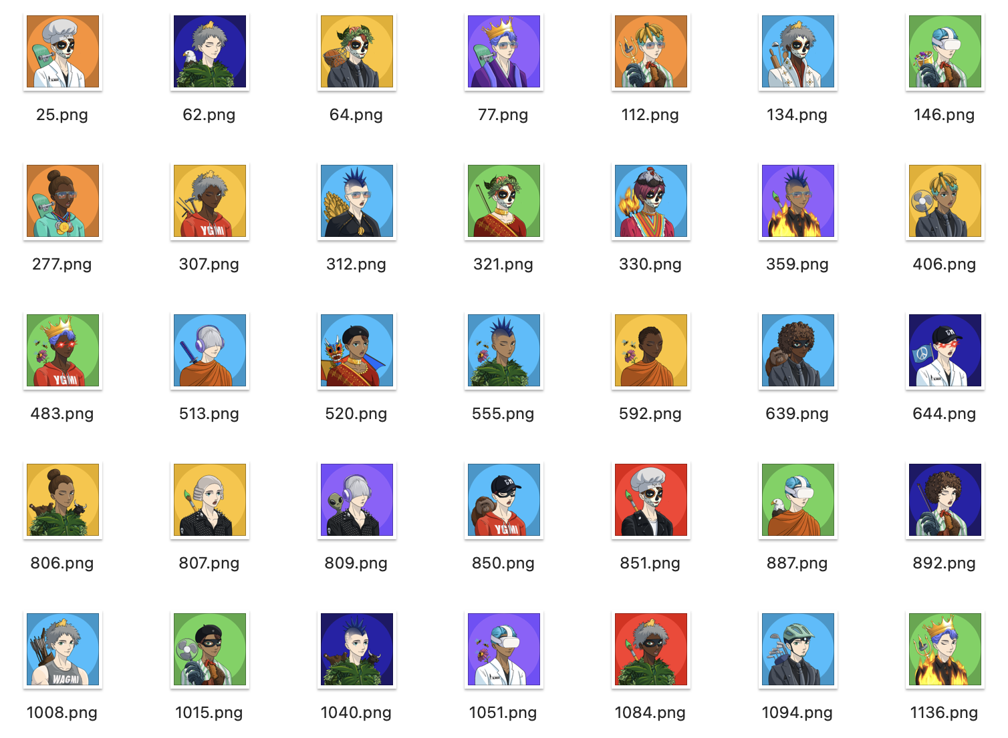
Artwork
Gnereation of artwork (pfp)
Cration of files is done via script
Small collections within Photoshop
Bigger collectionseparate scripts (export of layers needed)
Good example of scripts: https://github.com/HashLips/hashlips_art_engine

Slide 44
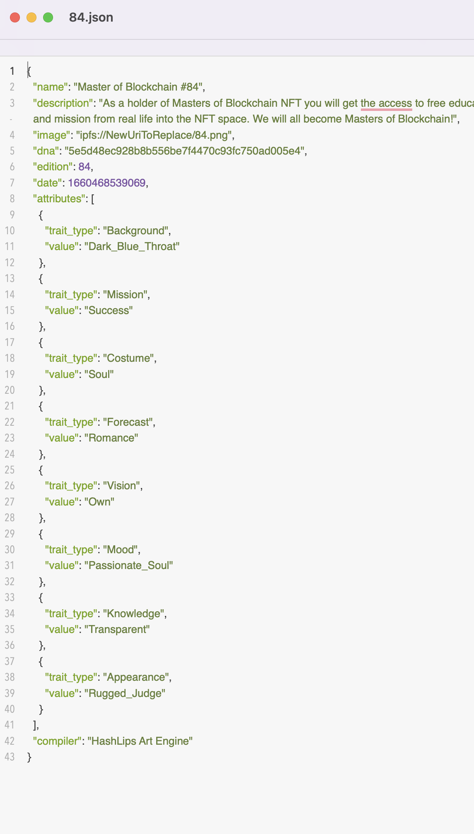
Artwork
Selection of collection
Select artwork and related metadata
Rename all files to have sequence
Edit metadata
Write script to rename and edit files
Download example of bash scripts here:
https://www.apeschool.xyz/tools/helper_tools.zip

Slide 45
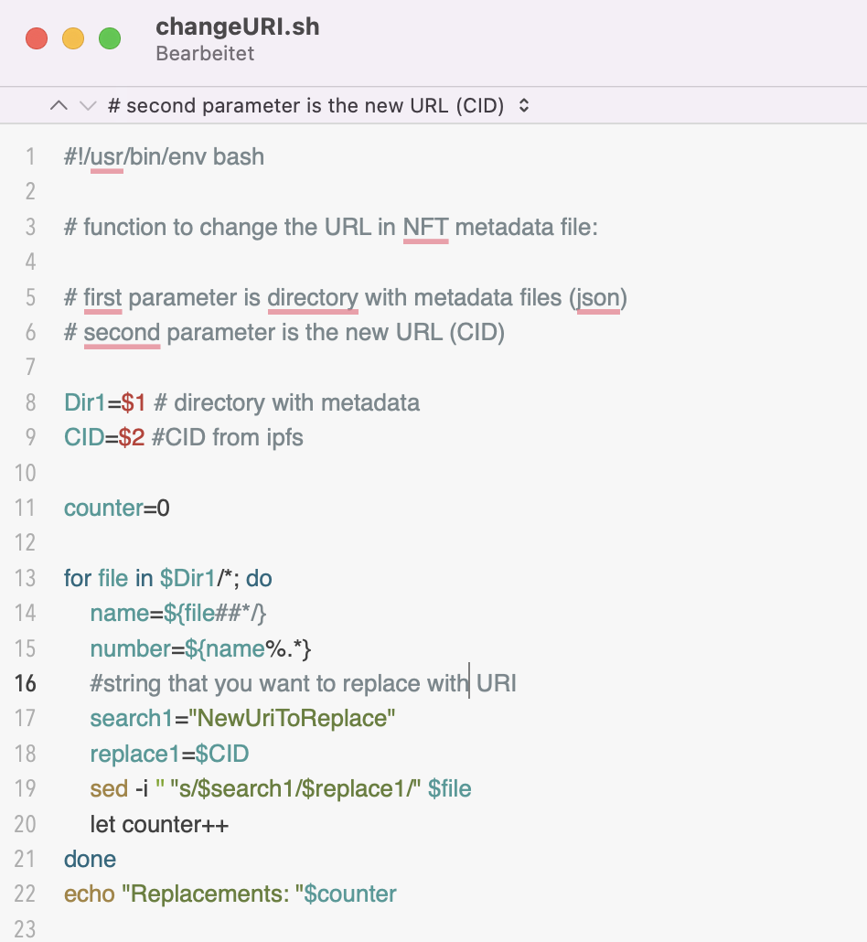
Artwork
Upload and Update of Matafata
Upload artwork to ipfs
Update Metadata
Add real CID (link on ipfs)
Upload Metadata (write script for that)
Update smart contract (hidden or/and final data)

Slide 46
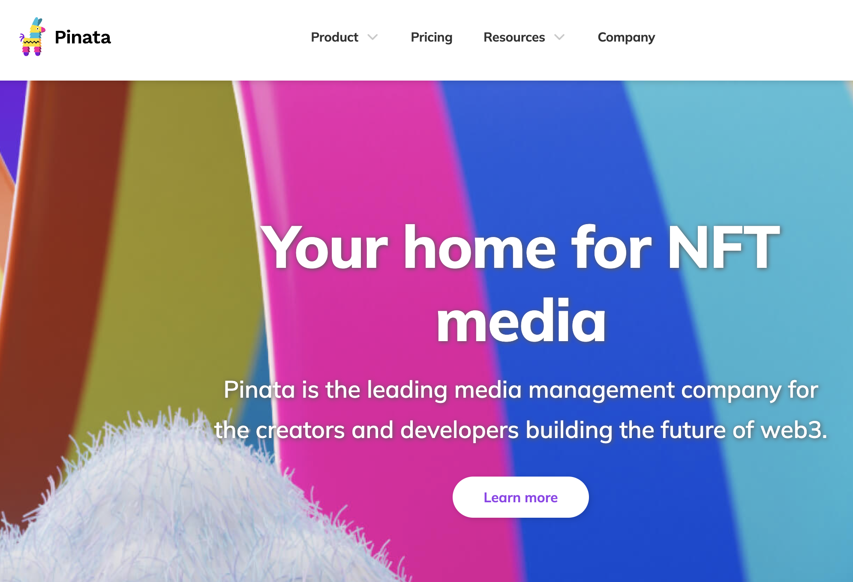
Deployment of Artwork and Metadata
IPFS = InterPlanetary File System
IPFS is P2P data storage (blockchain like)
A dedicated gateway to IPFS nodes

Slide 47
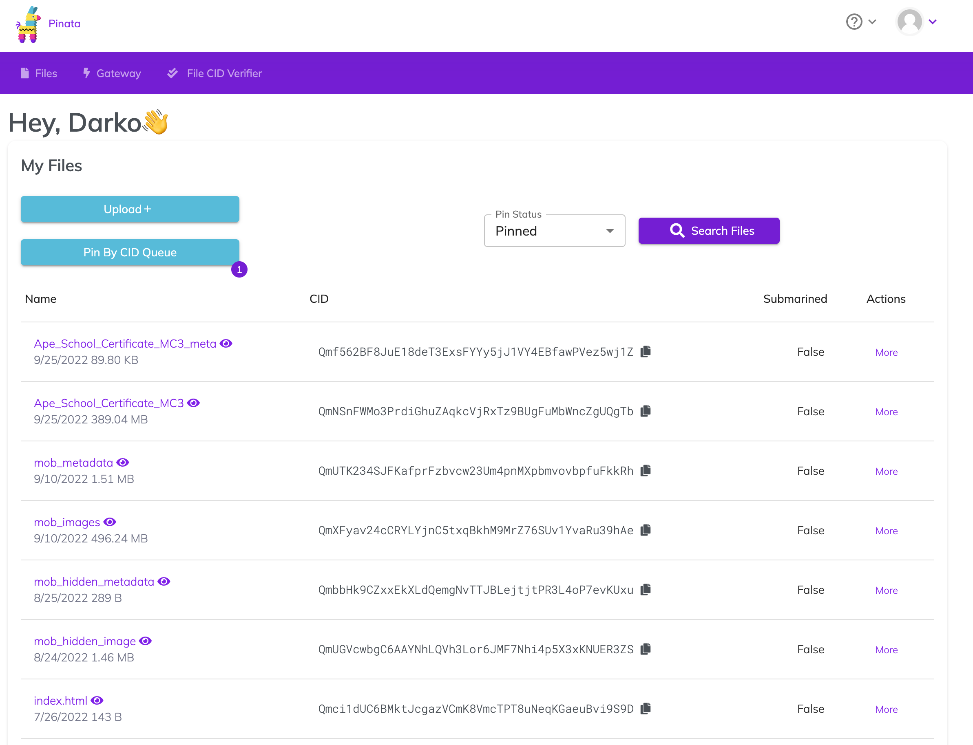
Deployment of Artwork and Metadata
Ipinata: https://www.pinata.cloud

Slide 48
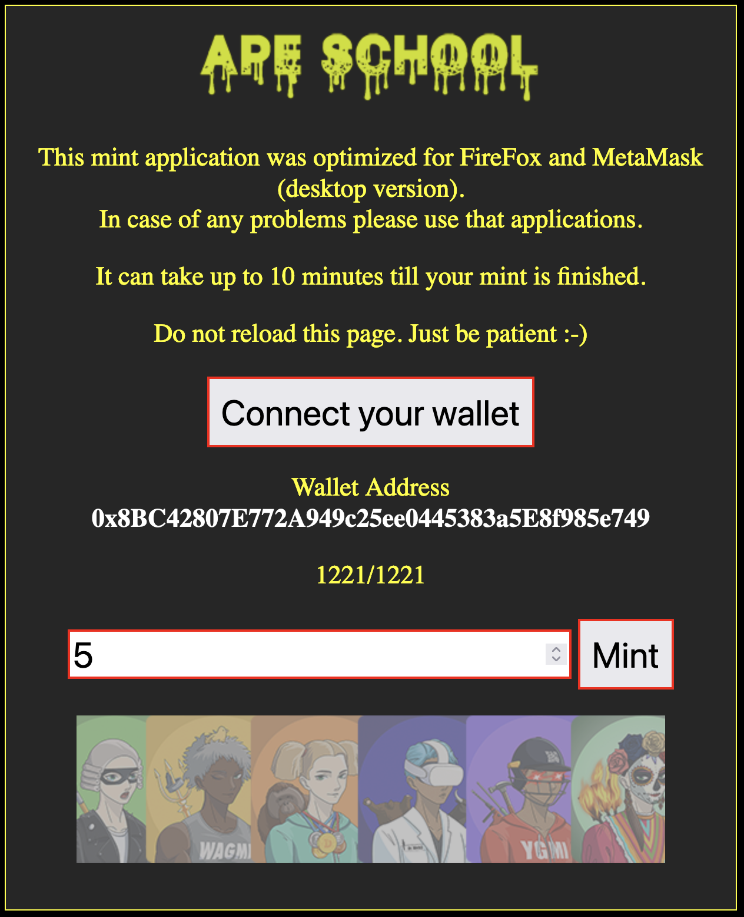
MINT
Last check of each parameter
Set contract to paused=false
Set mint page live
Support it in discord and on Twitter

Slide 49
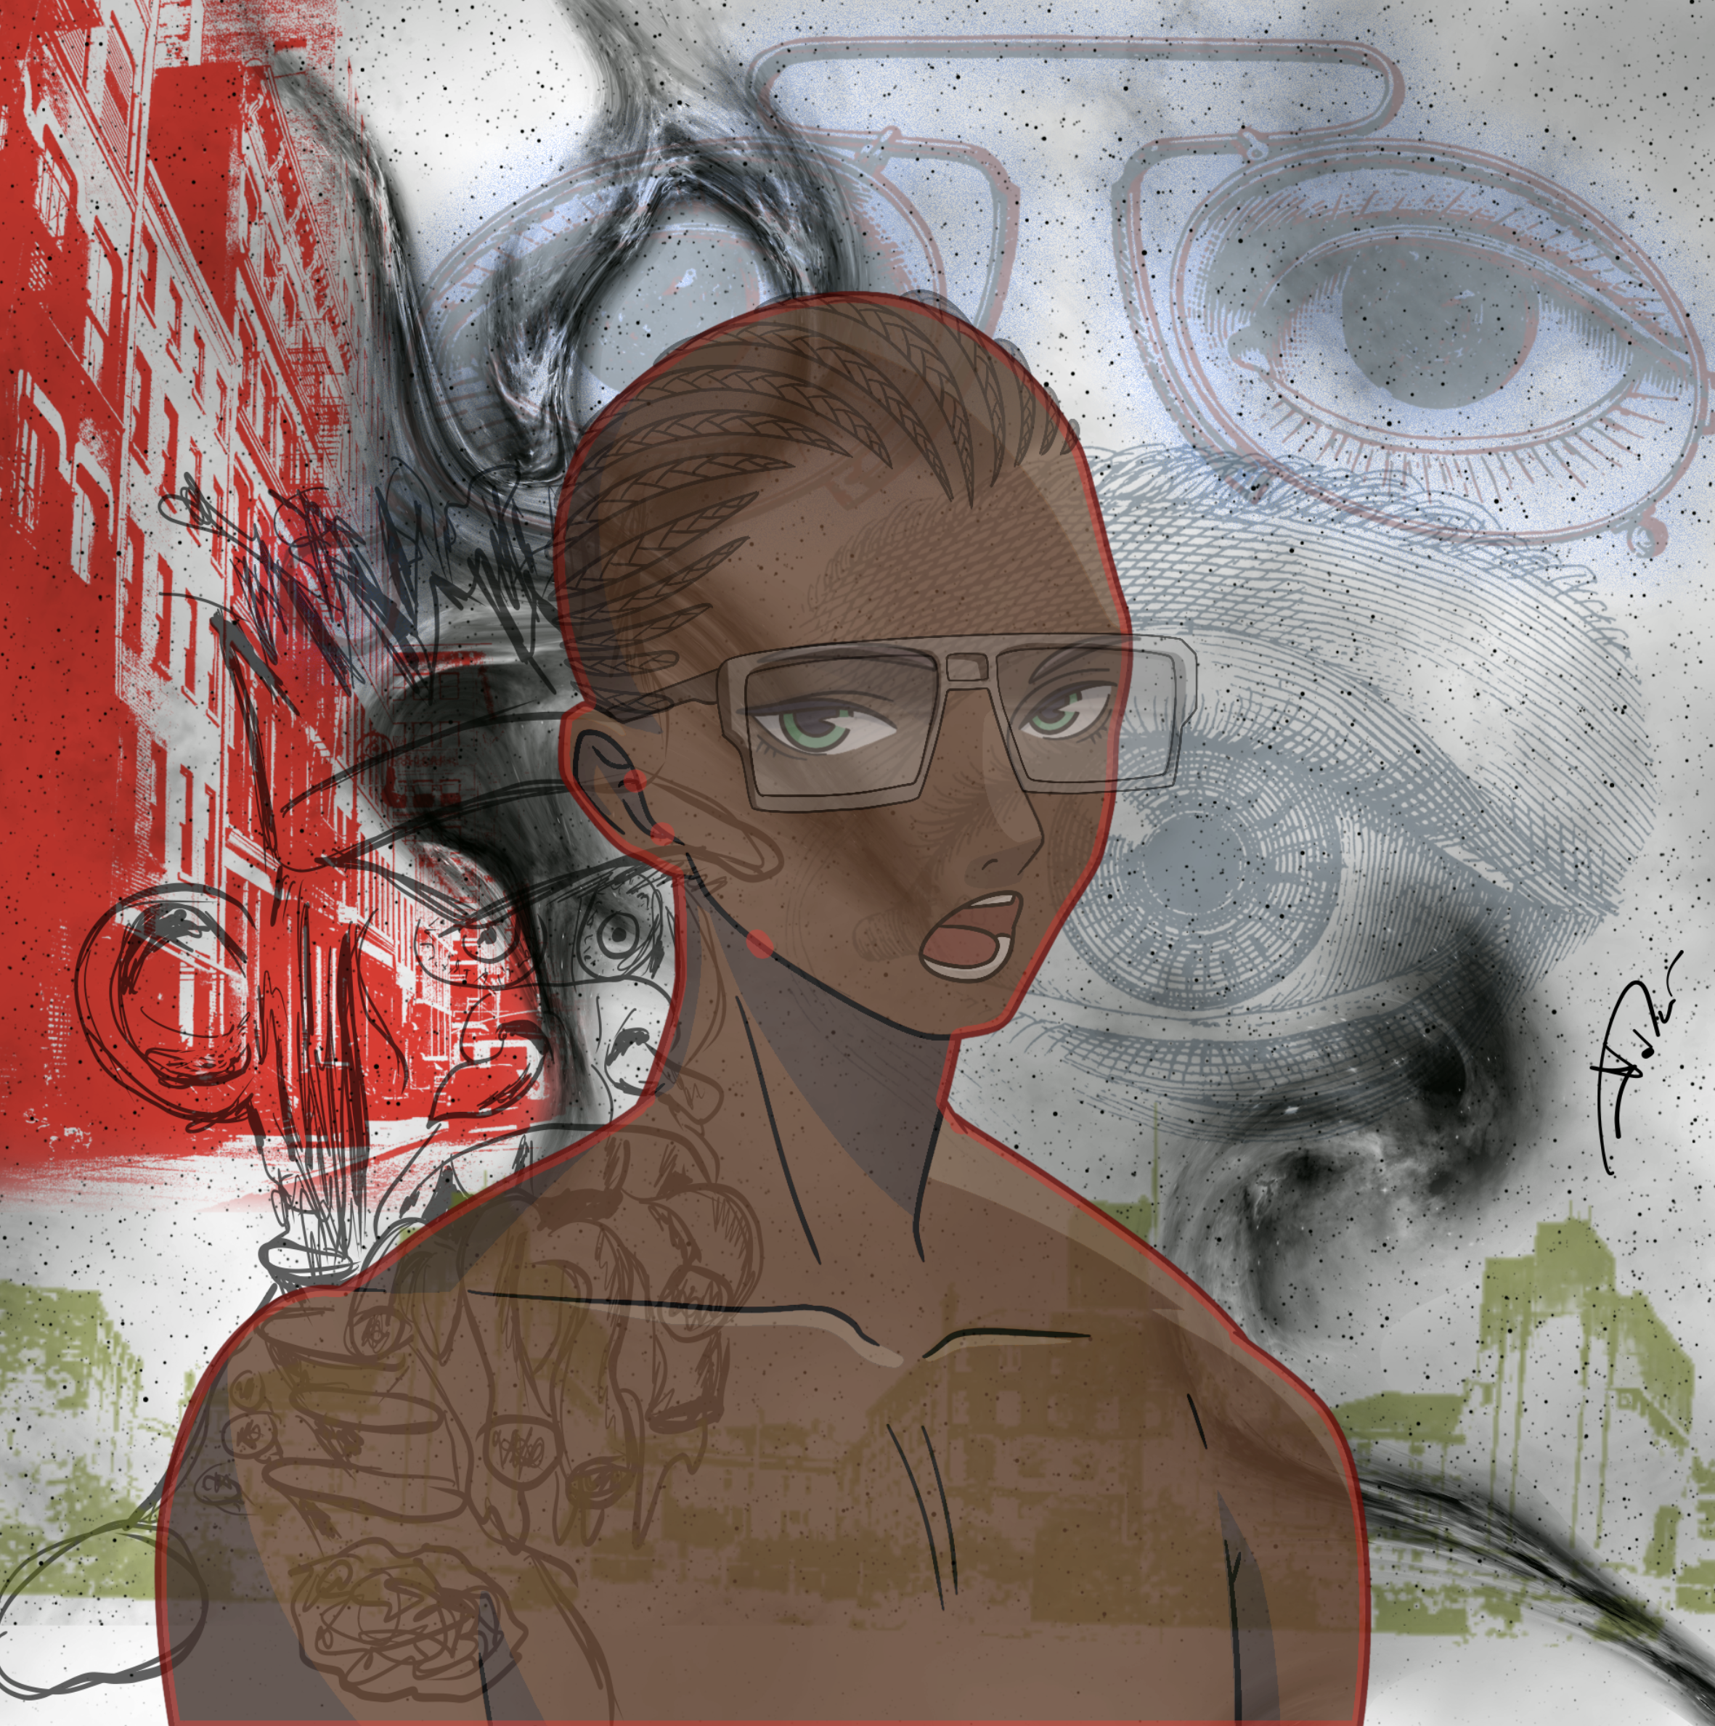
Reveal
Showing the „real“ artwork of the NFT
Hyped moment followed by price drop
Technically exchange of metadata (link with CID in the smart contract)
CID → data identifyer on ipfs

Slide 50
Coming soon
You will analyse different projects with help of the framework
Workshops
“Risk analysis of NFT project”
25.11.2022 18:00-20:00
“Marketing strategy in NFT projects with the main focus on Twitter Spaces”
16.12.2022 18:00-20:00
You will develop pitch for Twitter spaces
Prepare yourself:
Make yourself familiar with twitter (install it and play with it)
Make yourself familiar with discord (install it and play with it)
Jump on some spaces, join some discord servers …

