Slide 1
Current state of NFTs and how they are made
Vukašin Despotović - despotovic@ooxcit.com
Konstantin Đuričković - konstantin@ooxcit.com

Slide 2
WHAT ARE NFT?
Properties
TYPES OF NFTs
Collectibles
Art
Gaming
Metaverses
Utilities
RECENT TRENDS
ART AND NFTs
Generative and procedural art
AI and NFTs
PROCESS - MAKING OF
From the idea to realization
Asset creation pipeline
Problems and solutions
Result

Slide 3
Introduction

Slide 4
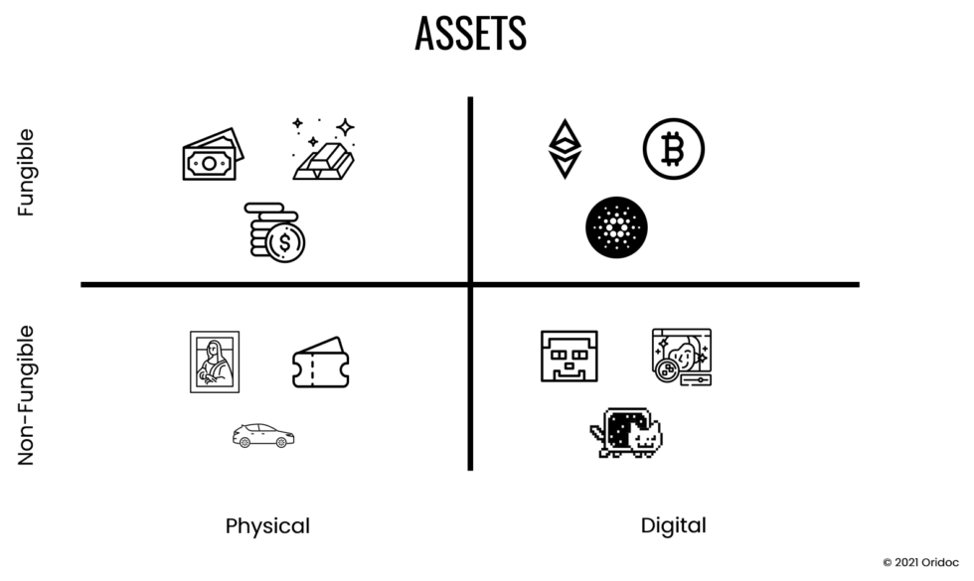
Non-Fungible

Slide 5
NFTs important properties
Verifiability
Transparent Execution
Availability
Tamper-Resistance
Tradability

Slide 6
Types of NFTs

Slide 7
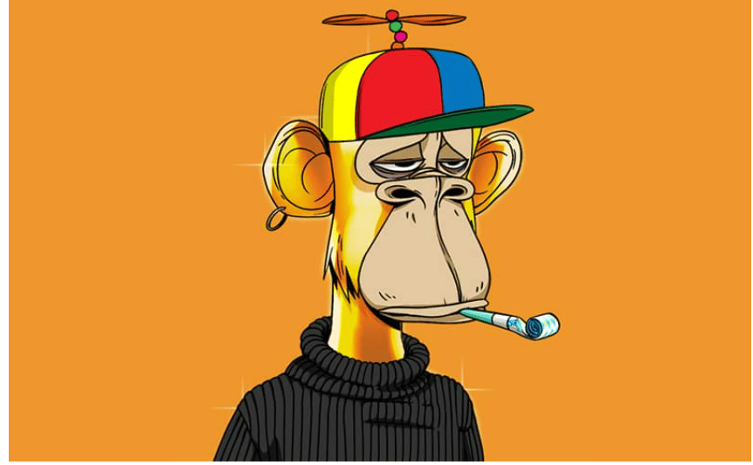
Collectibles
Crypto Punks
$ 23 700 000
Bored Ape Yacht Club
$ 3 408 000

Slide 8
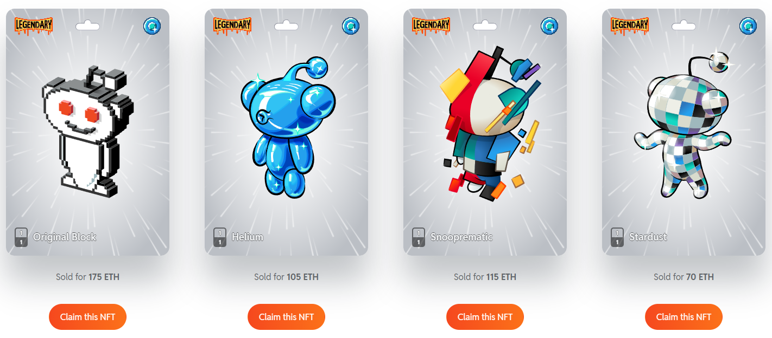
Collectibles
Reddit Avatar NFT

Slide 9
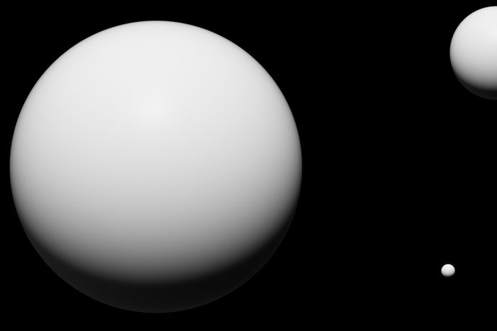
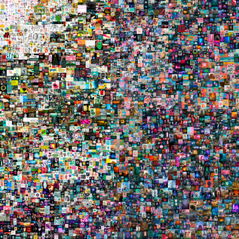
Art
Pak’s “The Merge”
$ 91 800 000
“Everydays : the First 5000 Days”
$ 69 300 000

Slide 10
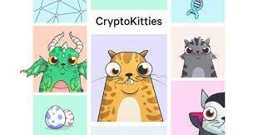
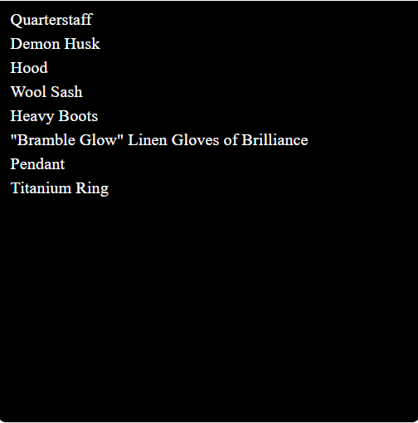
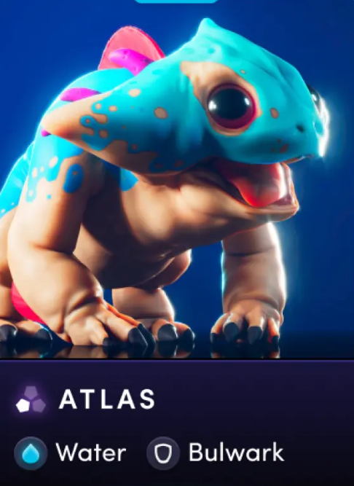
Gaming
PLAY 2 EARN MODEL
Items as NFT
Characters as NFT
Development Funding

Slide 11
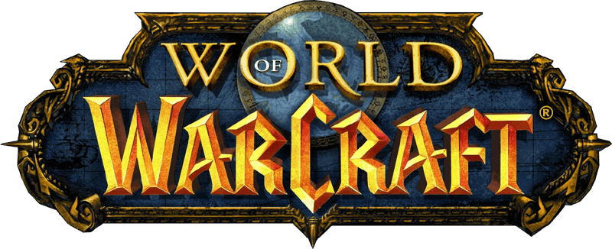
Metaverses
Metaverse is a perpetual and persistent multiuser virtual environment unifying digital and physical reality.
NFTs provide:
Ownership of virtual assets
Access to exclusive content
Governance

Slide 12
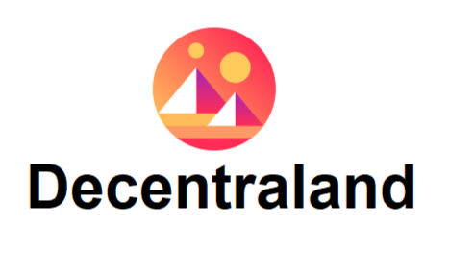
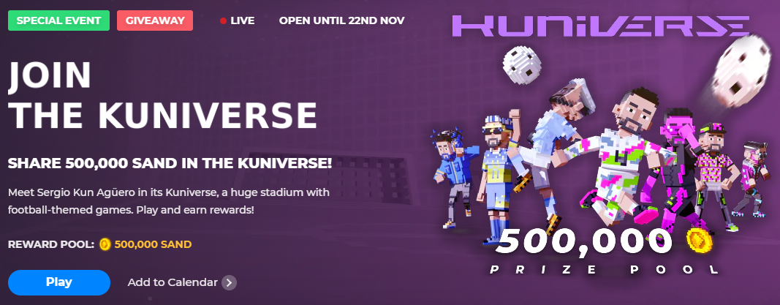
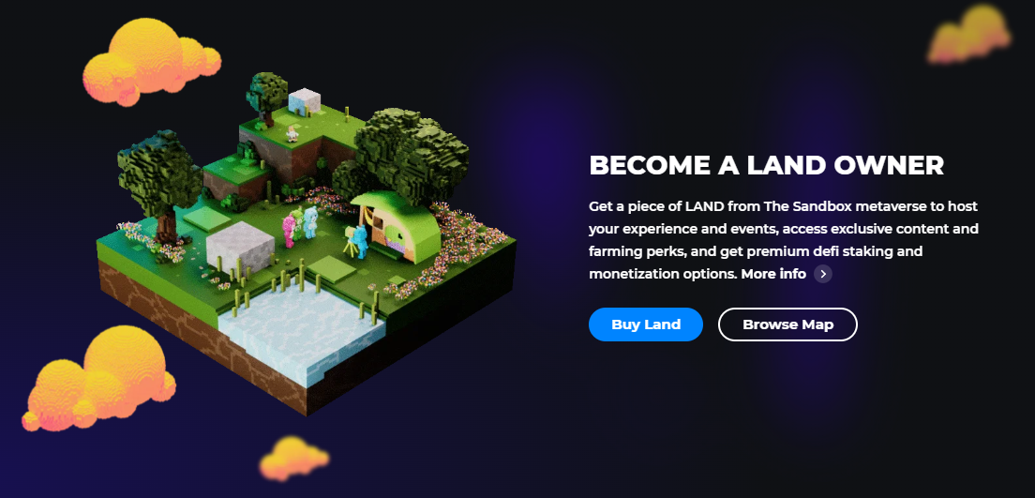
Metaverses

Slide 13
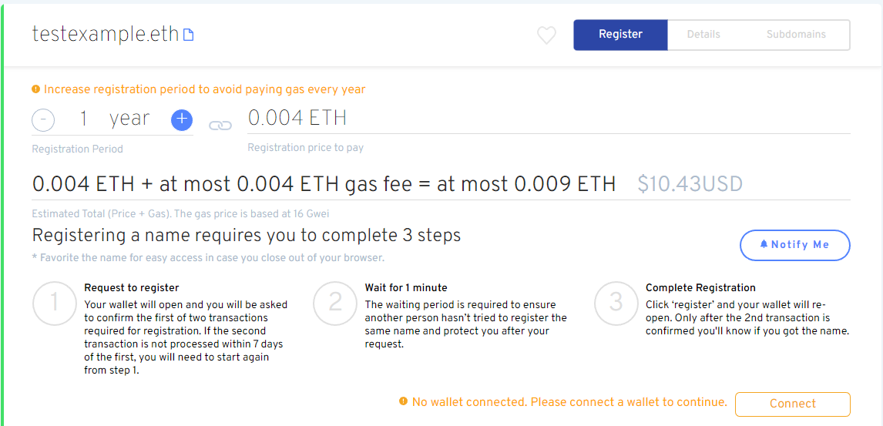
Utilities
Ethereum Name Service
Access to exclusive events

Slide 14
Active Wallets in Q3

Slide 15
Sales Volume in Q3

Slide 16
USD Trading Volume in Q3

Slide 17
Differences between Q2 and Q3
 | Q2 2022 | Q3 2022
Volume of USD traded | $7 364 971 977 | $ 1 675 127 336 (-77%)
Volume of Sales | 11 458 033 | 10 905 632 (-5%)
Buyers | 1 158 445 | 903 259 (-22%)
Sellers | 711 262 | 635 258 (-11%)
Active Wallets | 1 415 297 | 1 173 650 (-17%)
Total Profit (at resell) | $2 070 417 287 | $326 953 607 (-84%)
Total Loss (at resell) | - $1 406 403 739 | - $783 340 664 (-44%)
Average Ownership Duration | 27.5 | 31.1 (+13%)
Active Smart Contracts | 16 109 | 17 619 (+9%)
Average Price | $643 | $154 (-76%)

Slide 18
Profitable Wallets
Q1 2022 | Q2 2022 | Q3 2022
4536 | 2583 | 272
Number of wallets that generated more than $100,000 in profit over the quarter.

Slide 19
Are NFTs dead?

Slide 20
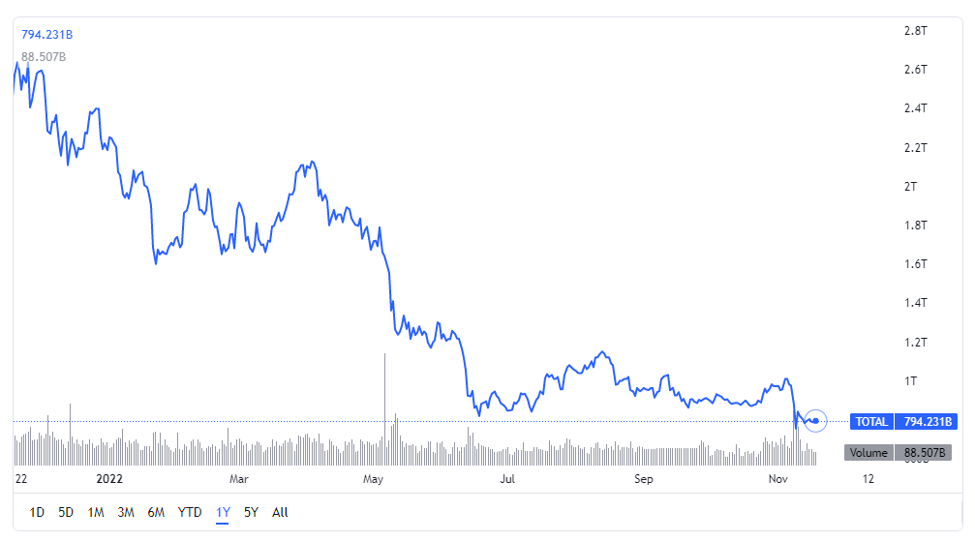
Crypto market cap – 1 year chart

Slide 21
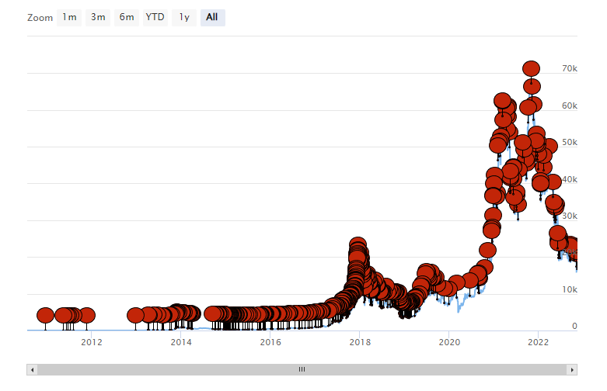
Bitcoin has died – 466 times

Slide 22
ART AND NFTs
THOUGHTS AND EXAMPLES

Slide 23
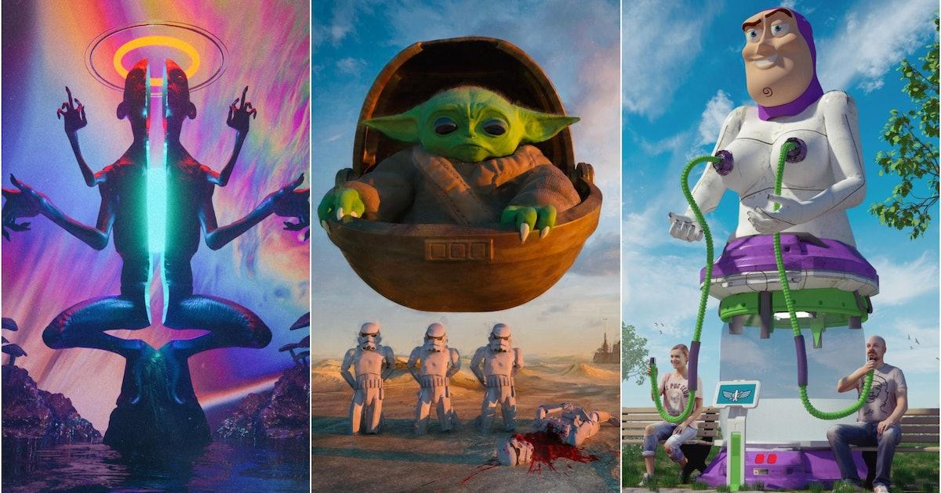
THE IDEA SOLD
BEEPLE

Slide 24
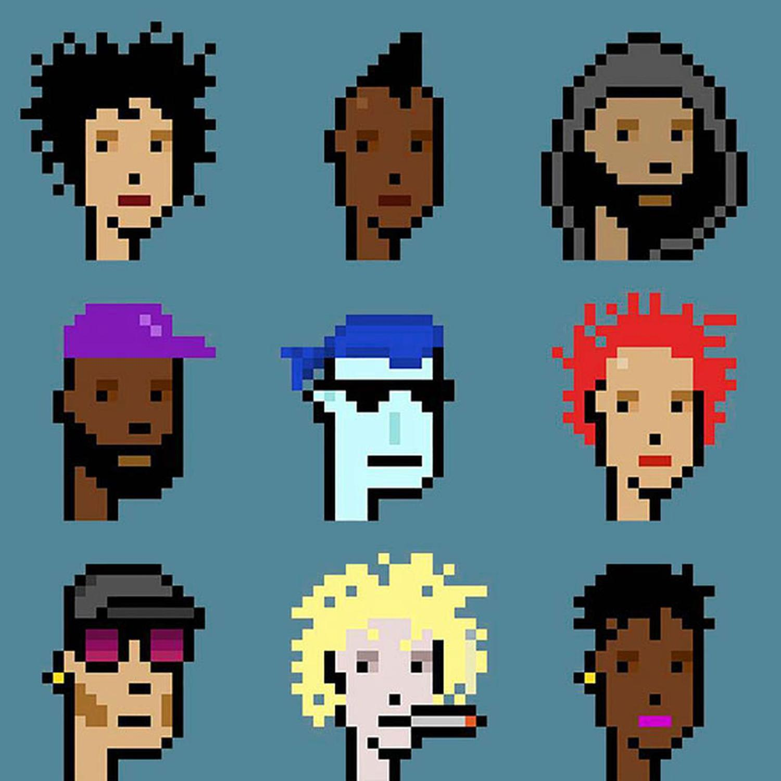
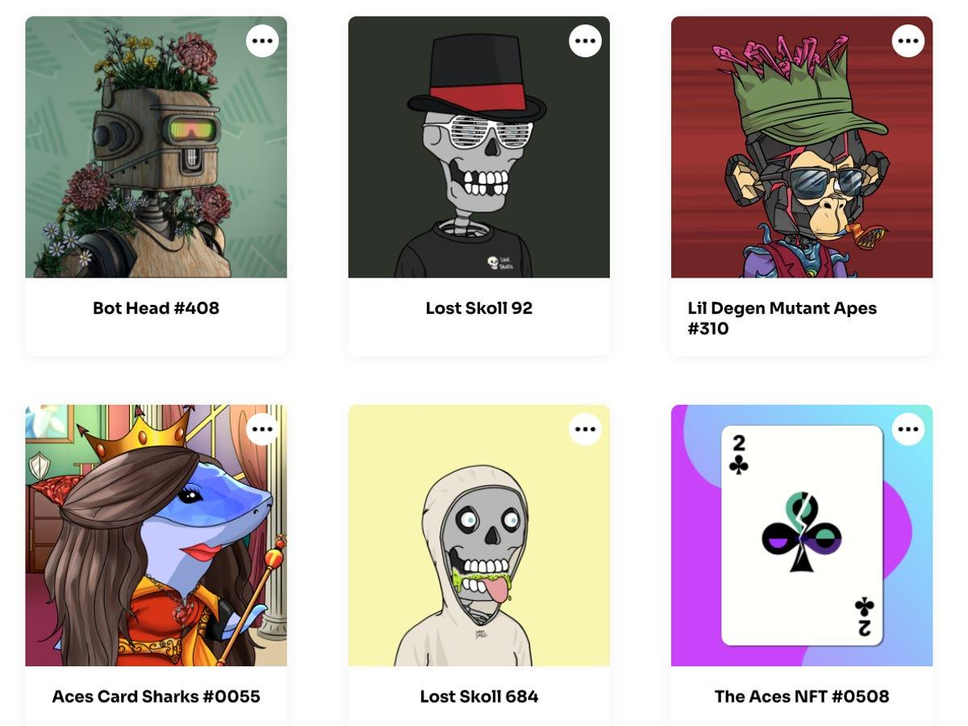
THE REALITY

Slide 25
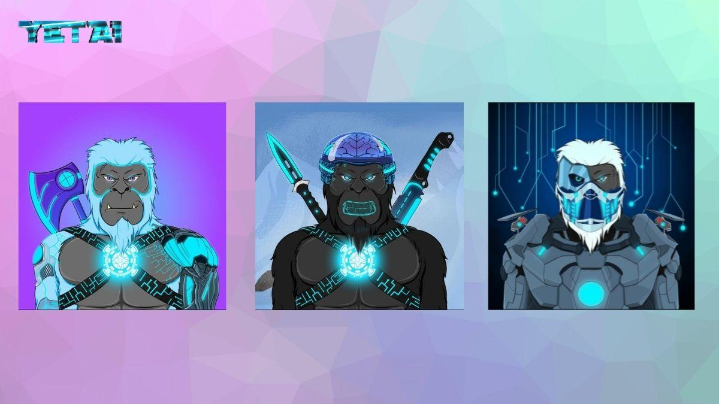
AI GENERATED NFTS
YetAi to Launch SOLANA blockchain-based AI-Generated NFTs in 2022
SPECULATIVE VALUE
ART AND VALUE

Slide 26
MAKING OF
IDLE HOOLIGANS NFT collection

Slide 27
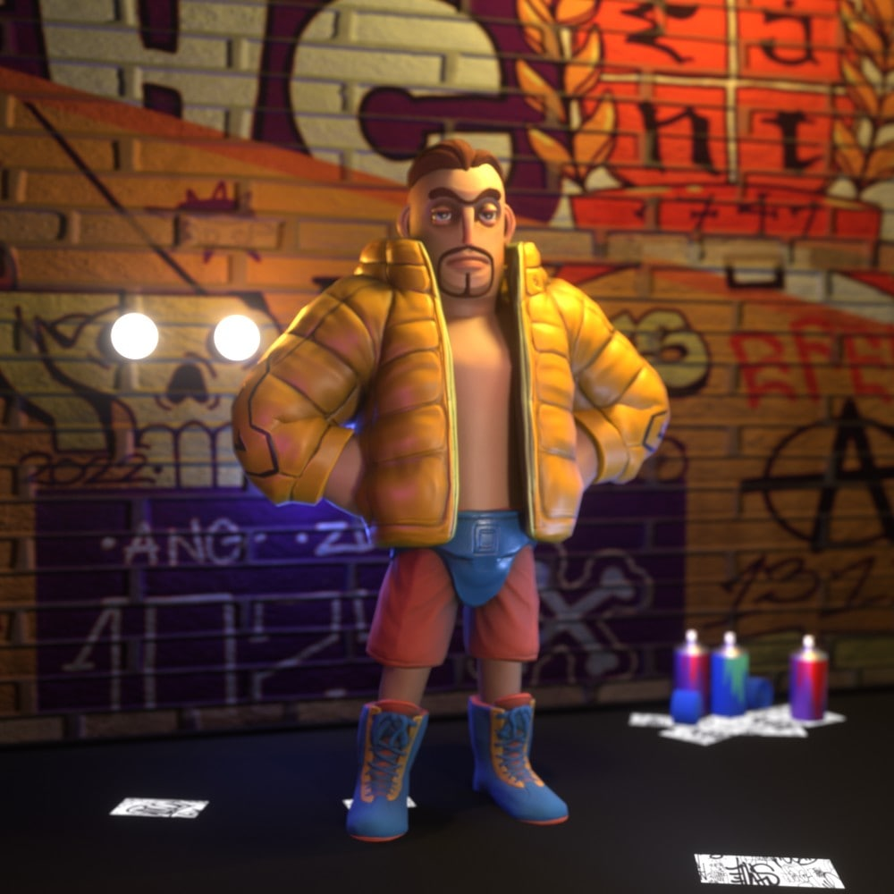
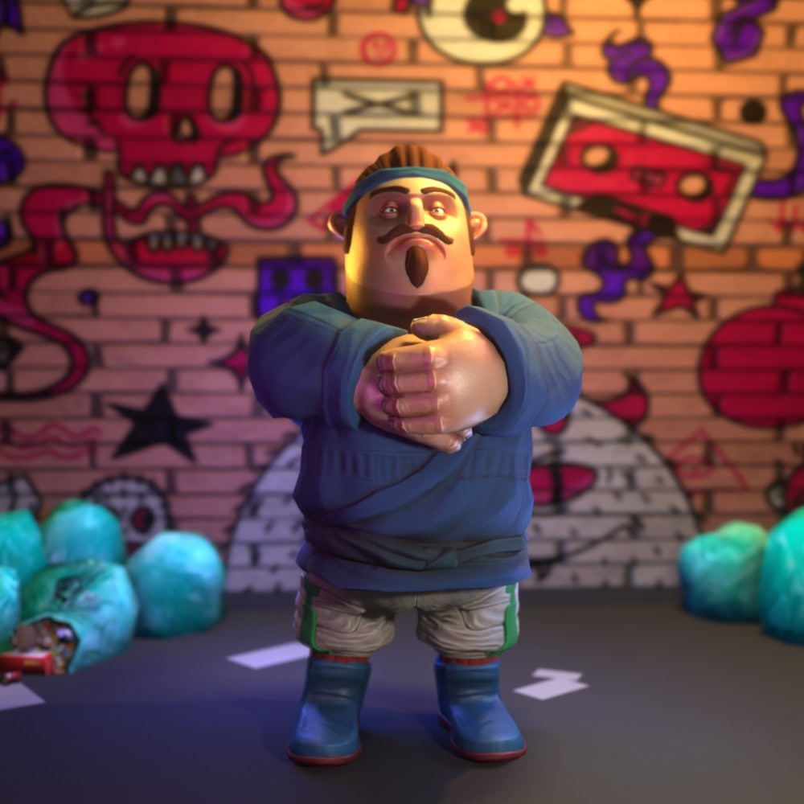
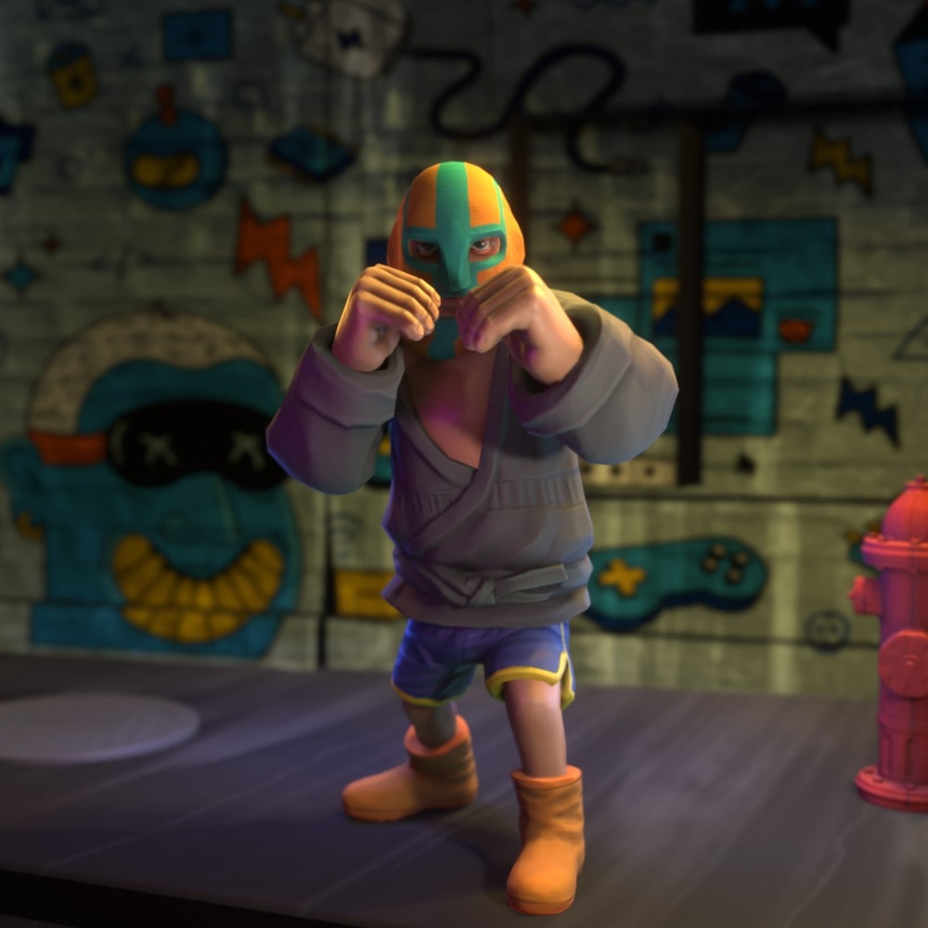
FROM THE IDEA TO REALISATION
REALISATION:

Slide 28
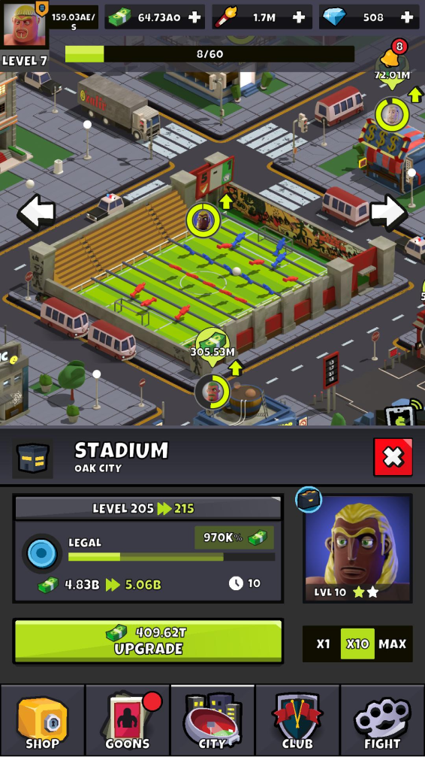
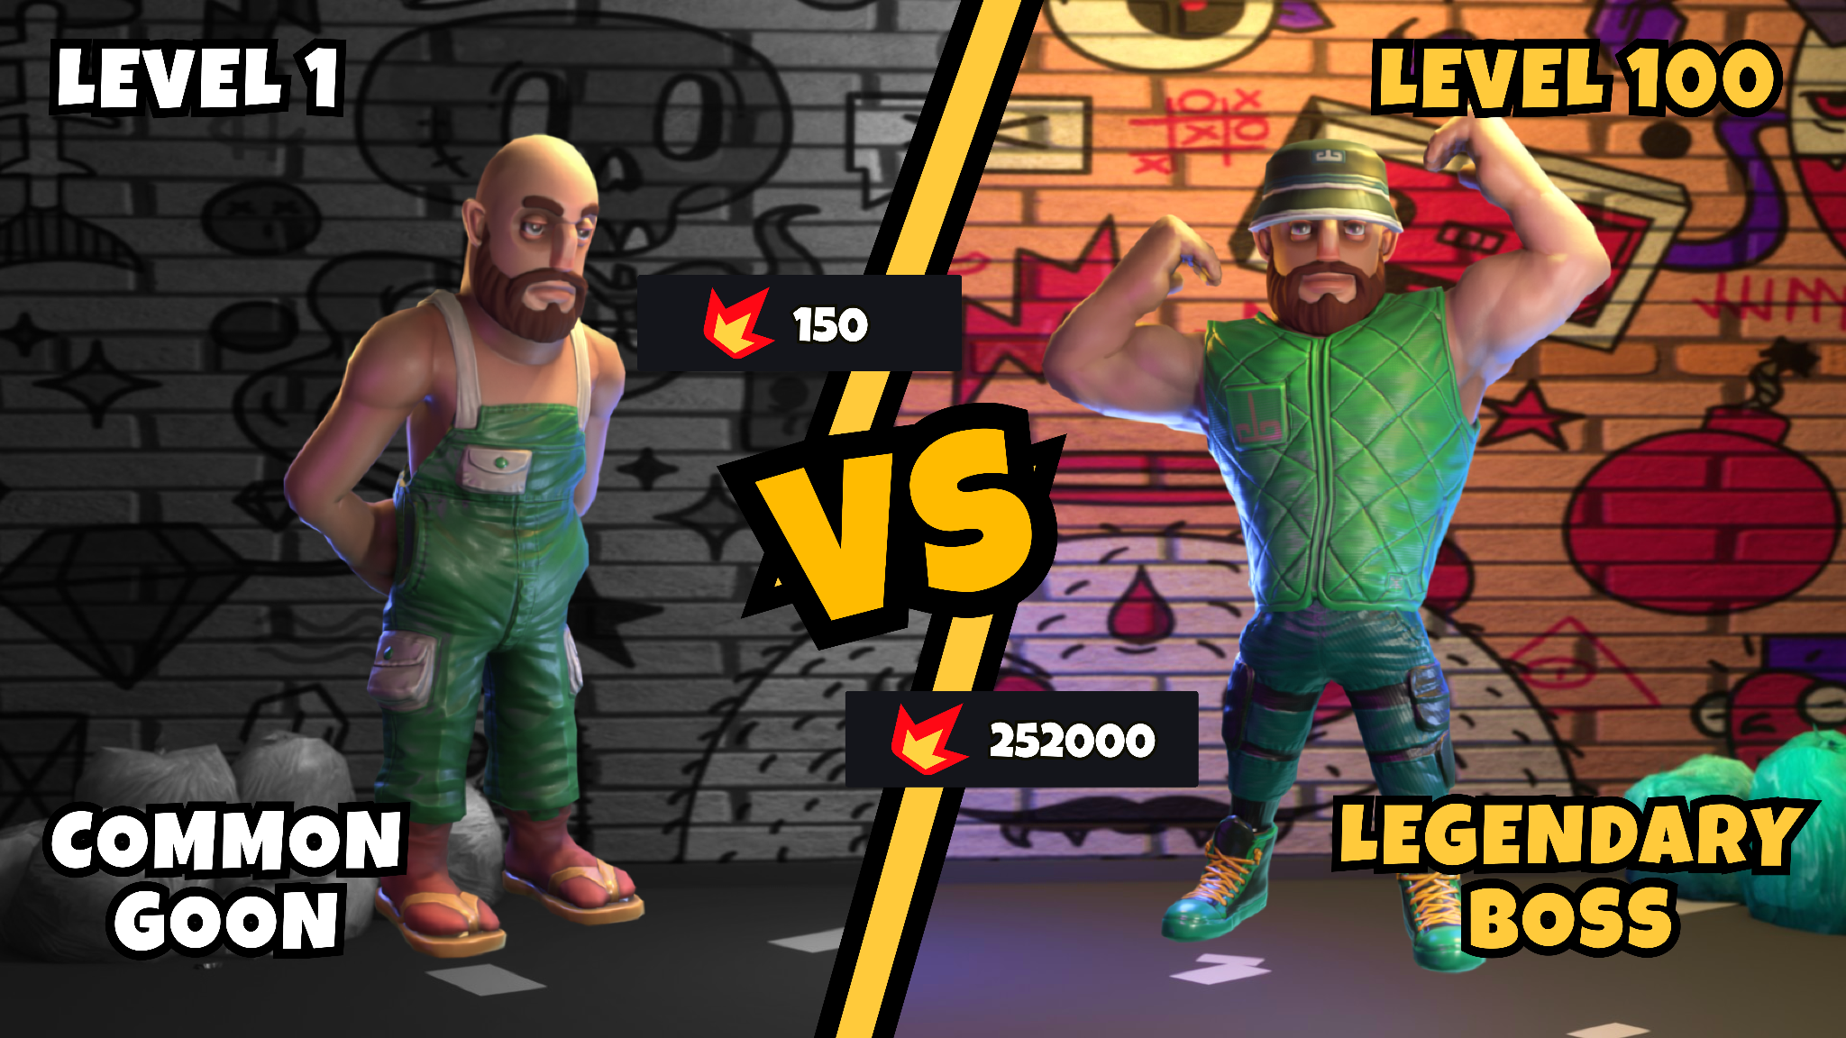
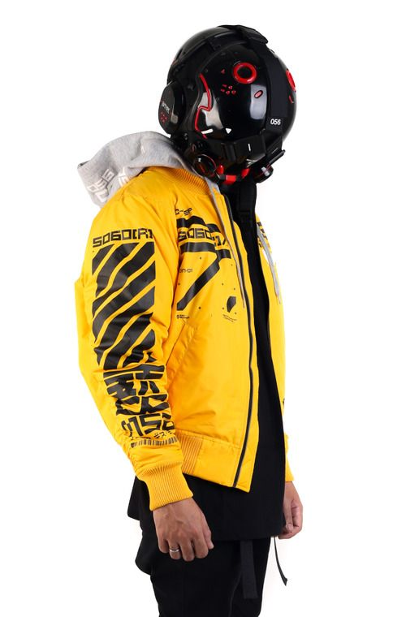
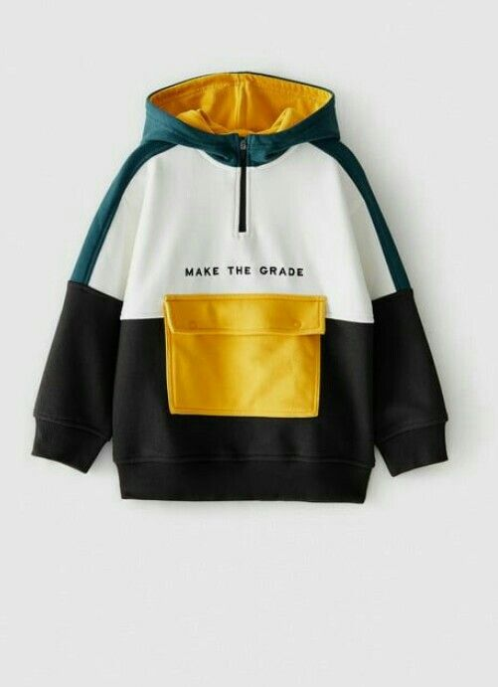
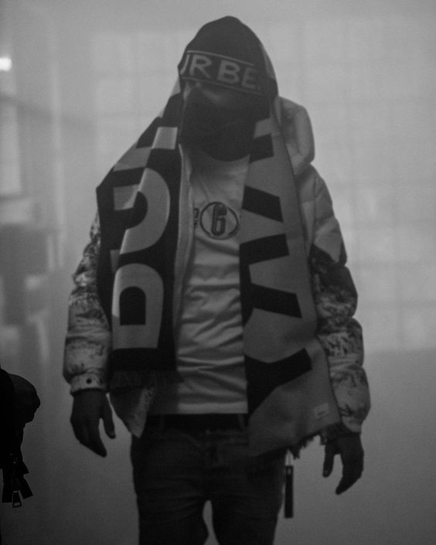
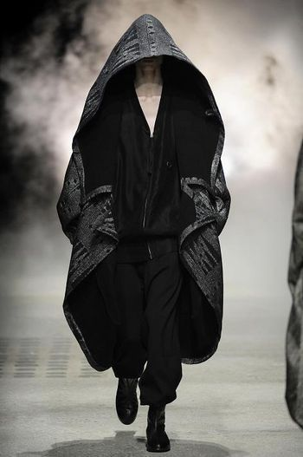
THE GAME:

Slide 29
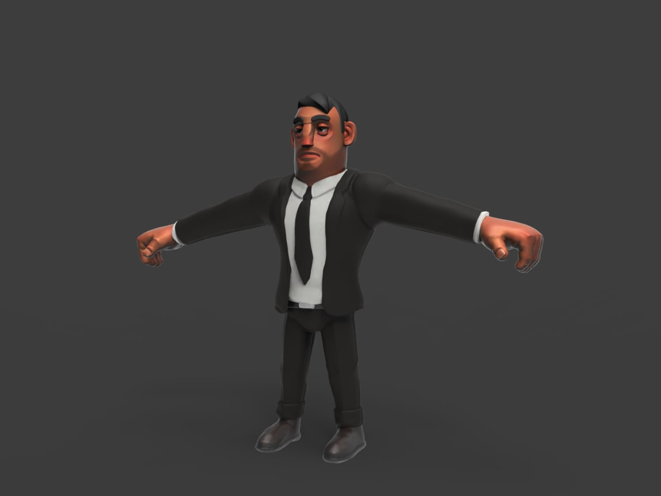
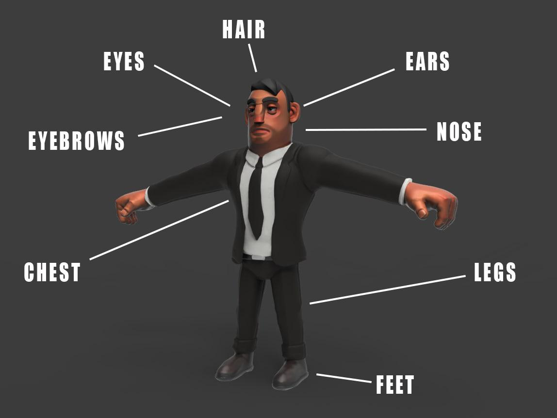
ASSET CREATION AND PIPELINE:
A MANAGER GOON

Slide 30
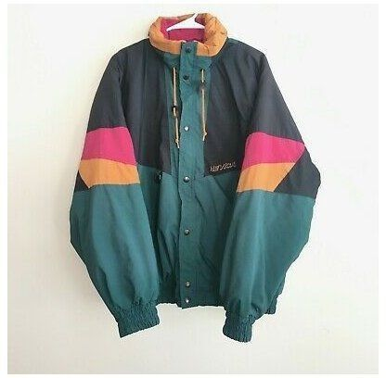
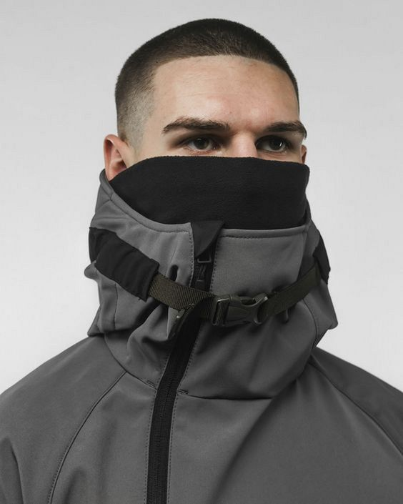
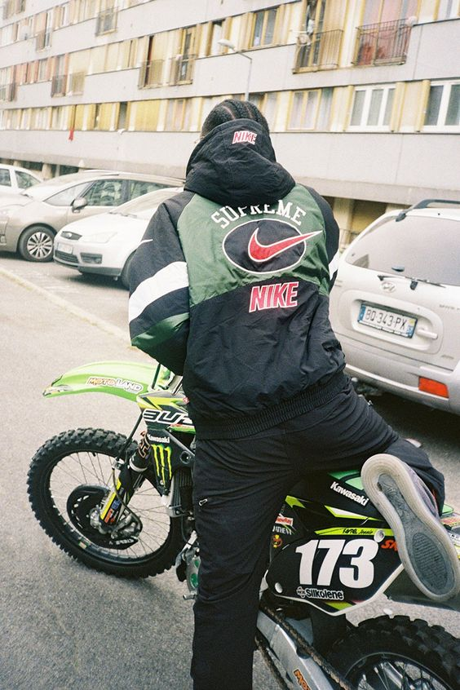
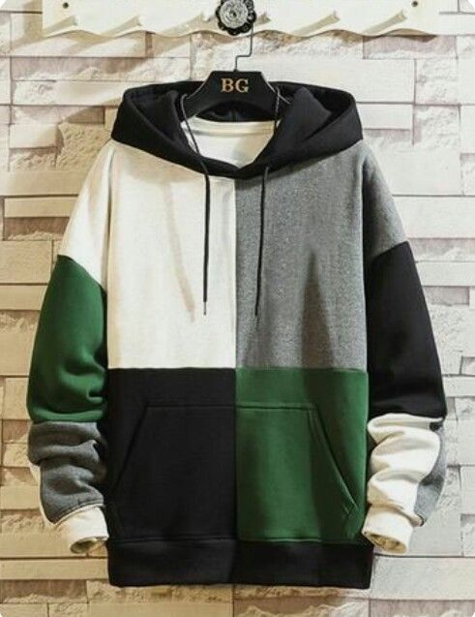
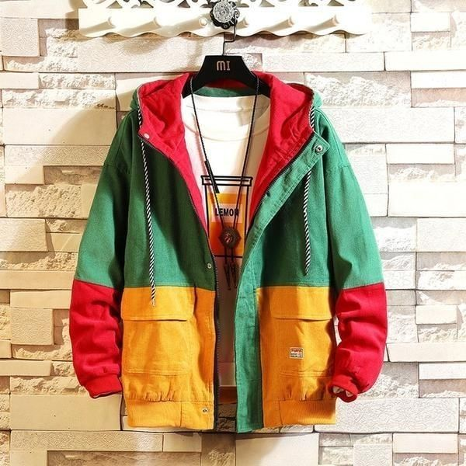
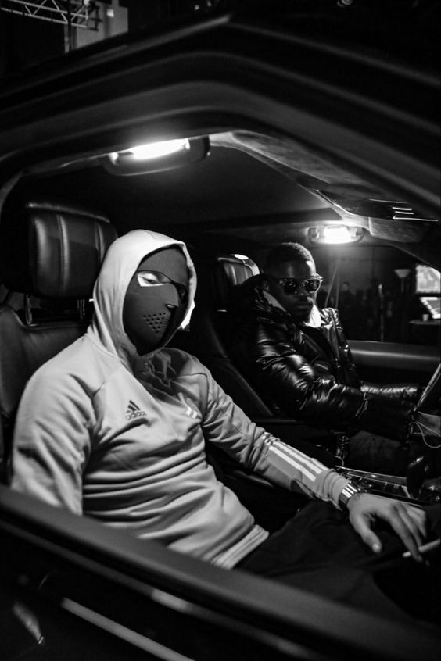
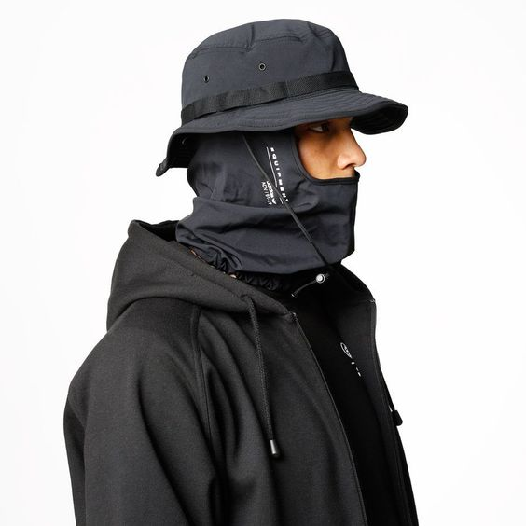
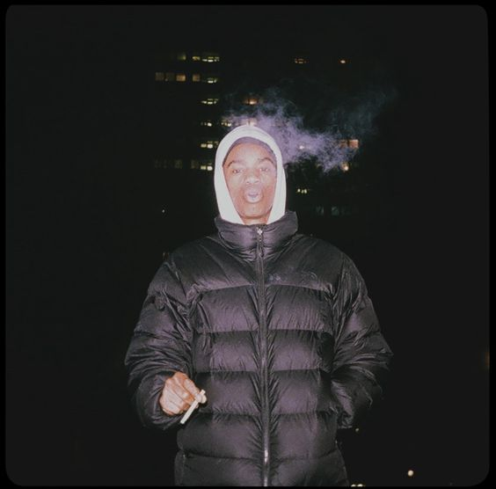
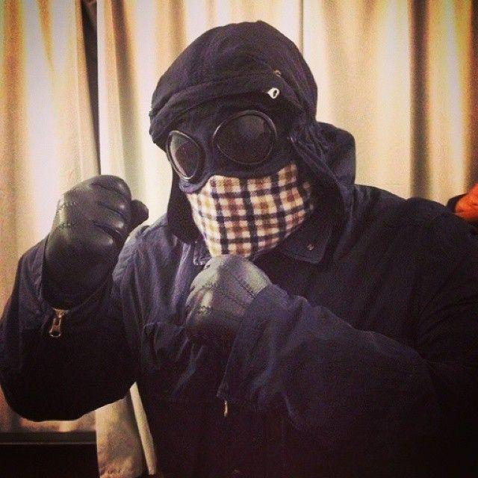
ASSET CREATION AND PIPELINE:
ASSET CREATION AND PIPELINE:

Slide 31
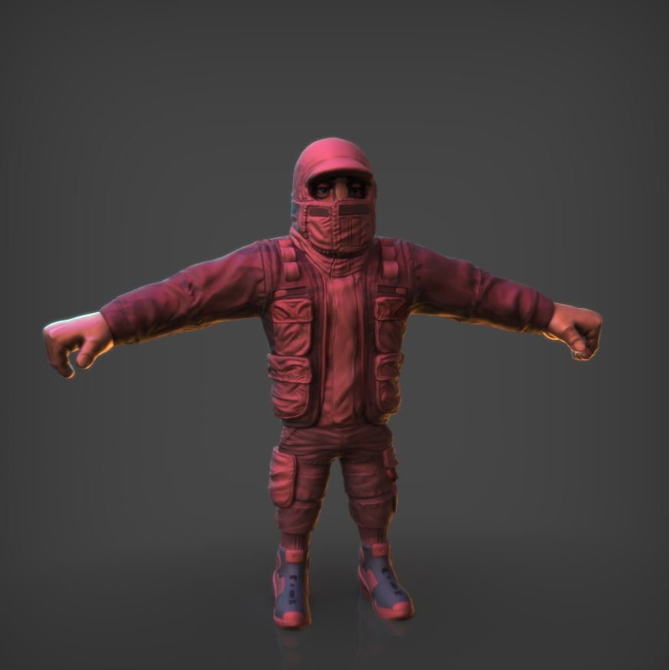
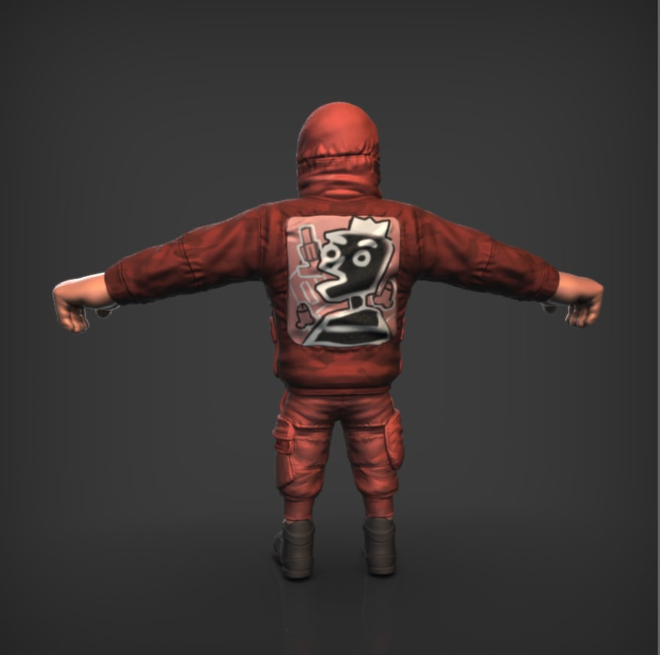
ASSET CREATION AND PIPELINE:

Slide 32
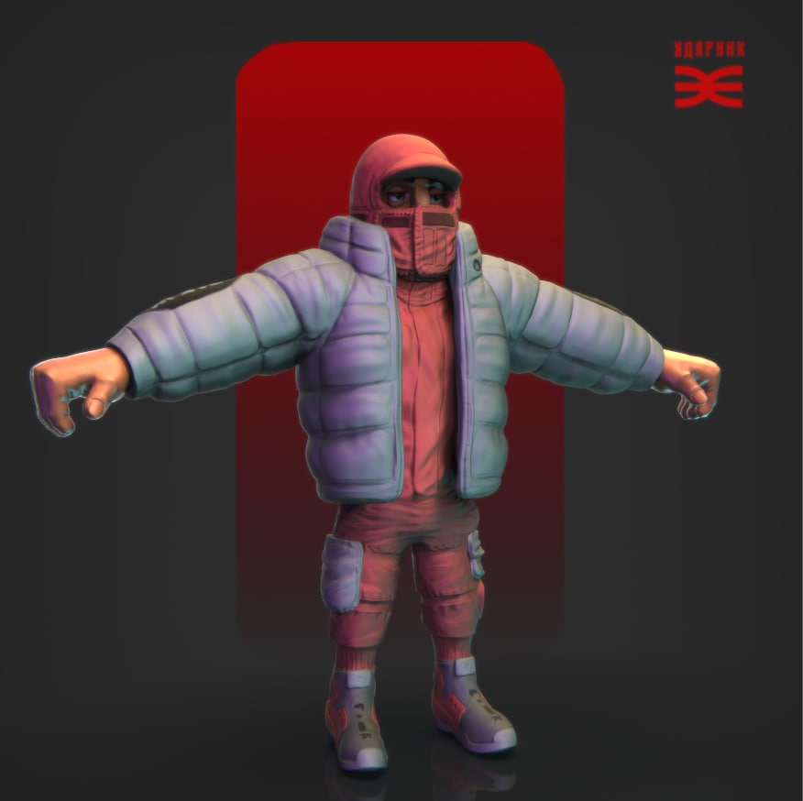
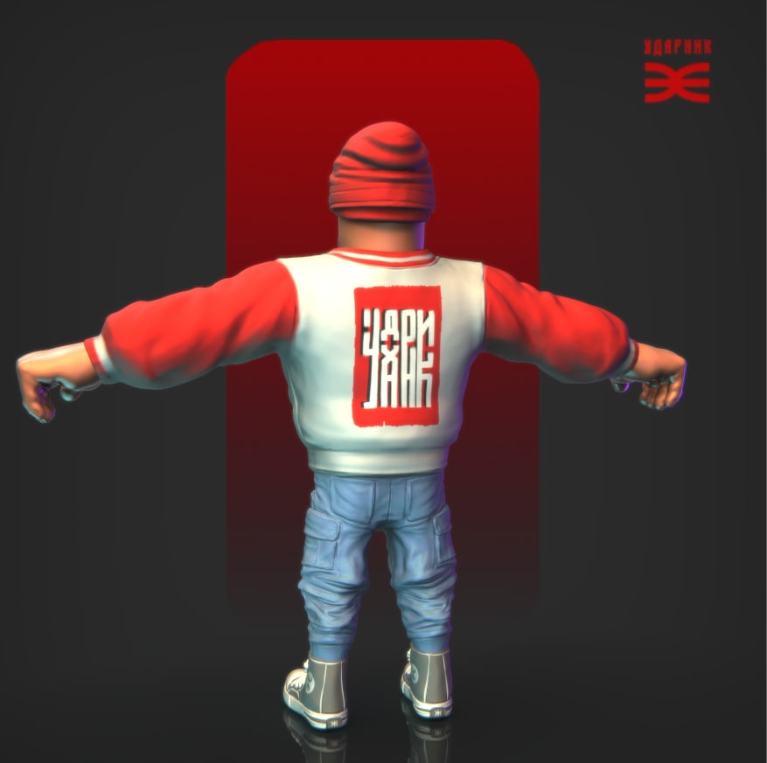
ASSET CREATION AND PIPELINE:

Slide 33
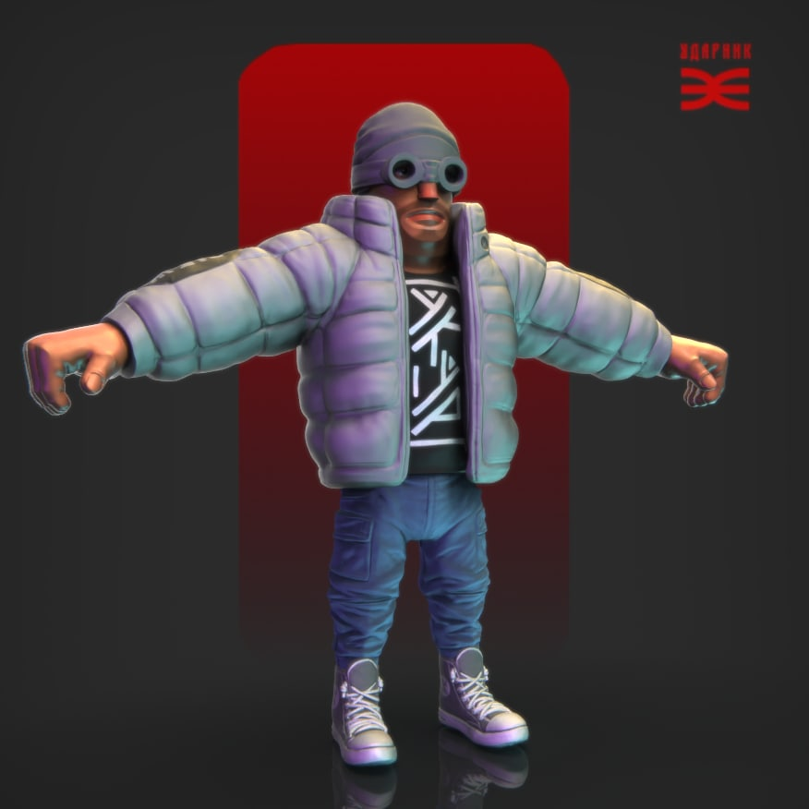
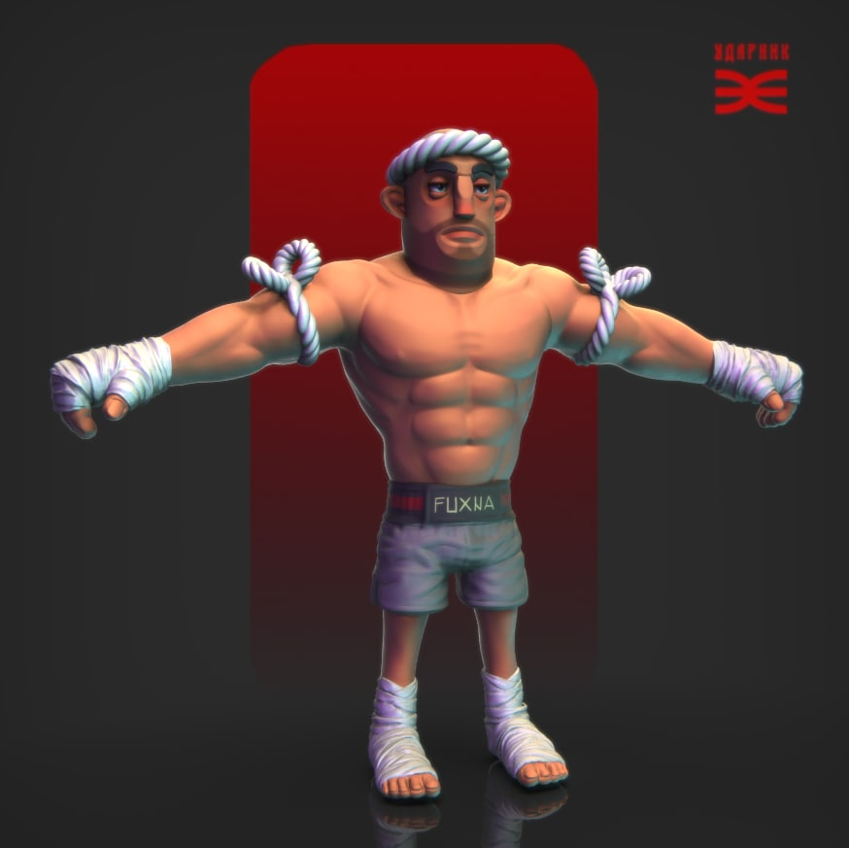
ASSET CREATION AND PIPELINE:

Slide 34
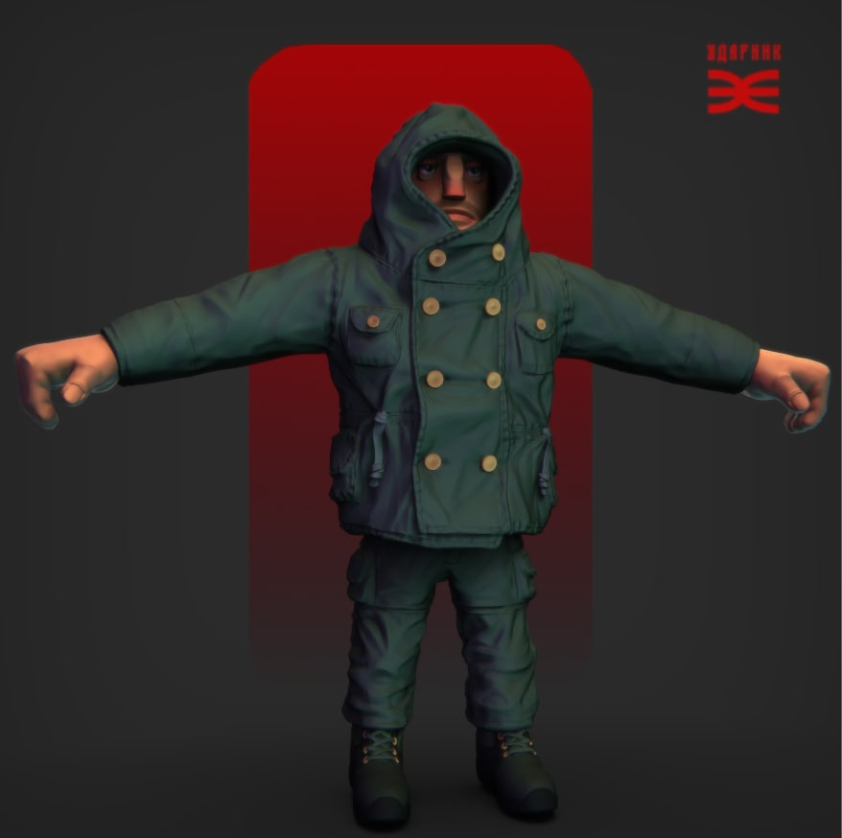
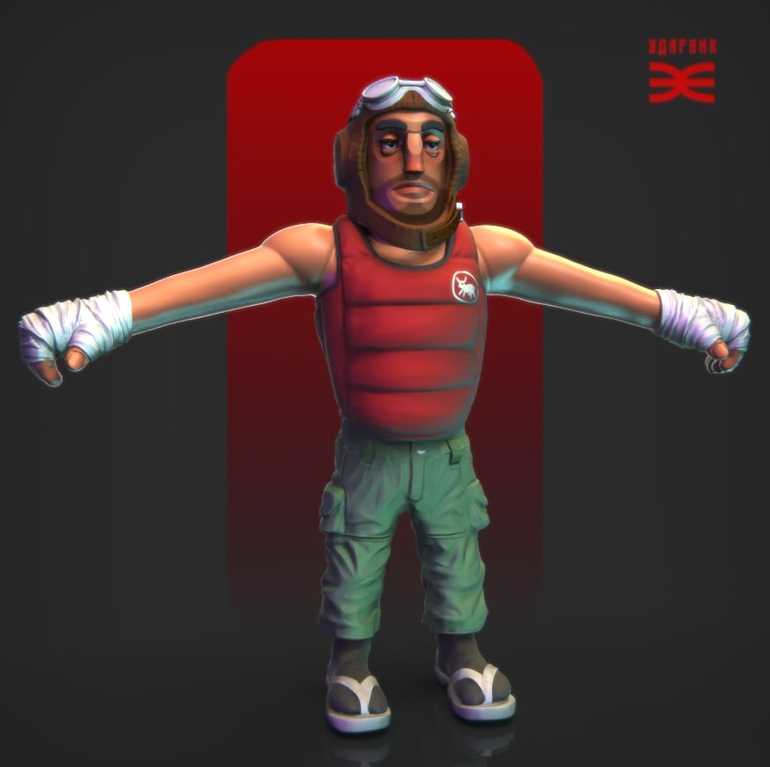
ASSET CREATION AND PIPELINE:

Slide 35
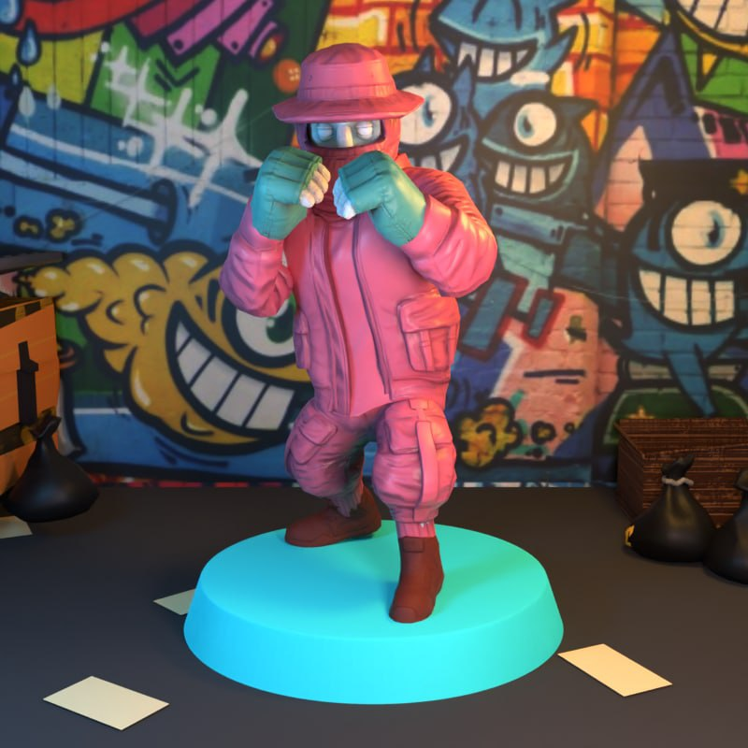
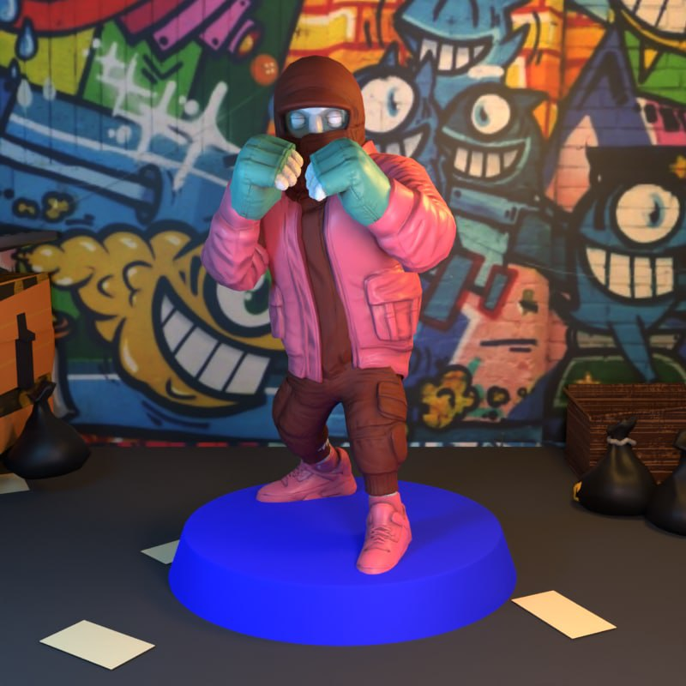
PROBLEMS AND SOLUTIONS:

Slide 36
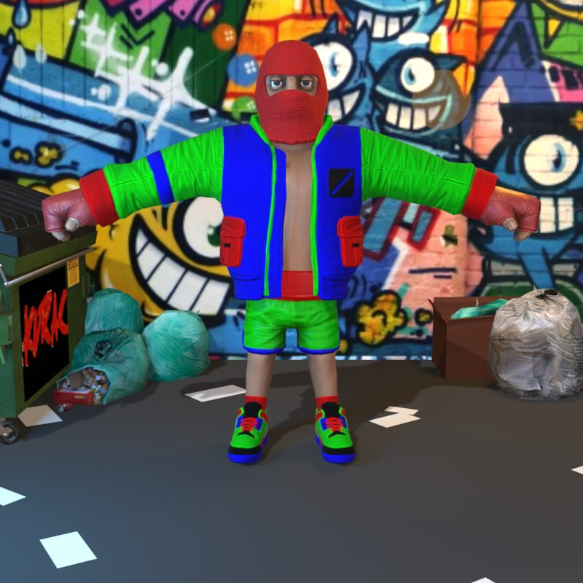
PROBLEMS AND SOLUTIONS:

Slide 37
PROBLEMS AND SOLUTIONS:

Slide 38
RESULT:

Slide 39
UTILITY AND NFTs
POTENTIAL VALUE

Slide 40
DIGITAL ASSETS WITH VALUE:
UTILITY FIRST
USING NFTs AS ALTERNATIVE FUNDING
PLAY TO EARN AND IDEAS

Slide 41
Thank you for attending.
Vukašin Despotović - despotovic@ooxcit.com
Konstantin Đuričković - konstantin@ooxcit.com

