Slide 1
BLOCKCHAIN IN E-BUSINESS ECOSYSTEMS
Aleksandra Labus, aleksandra@elab.rs

Slide 2
Introduction
Blockchain
Consensus algorithms
Blockchain platforms
Blockchain in e-business ecosystems
Conclusion

Slide 3
Introduction

Slide 4










Department for e-business
Research areas:
  E-business
  Blockchain
  Internet of Things
  Cloud Computing
  Enterprise networking
  Big Data
  Internet technologies
  Mobile business
  Digital marketing and social media
  Computer simulation and virtual reality
  E-education
  E-health
  E-government
  E-banking
Prof.dr Božidar Radenković
Prof.dr Marijana Despotović-Zrakić
Prof.dr Zorica Bogdanović
Prof.dr Dušan Barać
Prof.dr
Aleksandra Labus
Tamara
Naumović
Petar Lukovac
Aleksa Miletić
Milica Simić

Slide 5
Blockchain laboratory
Organization of micro and macro courses, Hands-on, workshops
Elab Summer School “Technology of Electronic Business”
Organization of students’ Hackathons
Establishment of the Student Blockchain Club at FOS in cooperation with the FONIS student community
Popularization of blockchain technologies, with a focus on Algorand
Development of new teaching materials for students at all study levels
Realization of students’ graduation, master, specialist and doctoral theses
Research and publication of scientific papers in the field of blockchain
Connecting with scientific research institutions, organizations and companies

Slide 6
Blockchain

Slide 7
Introduction to blockchain
The development of the digital economy is changing the ways of modern business and the exchange of digital information between people.
In the digitalization world, data and information are traded intensively and the need for securing the transfer of transactions across the network arises.
Blockchain technologies can solve problems related to:
  data management,
  transparency of business transactions,
  trust in data handling,
  security and privacy,
  scalability and interoperability issues,
  stakeholder relationship management.

Slide 8
Blockchain
Complex mathematical algorithm aimed at maximizing the security of financial transactions using cryptographic methods.
Based on a distributed database, which consists of encrypted data that cannot be changed or copied.
The transactions are exchanged between different nodes in a decentralized peer-to-peer (P2P) network, where they are validated and "chained" into a blockchain.
Blockchain provides a distributed, unchangeable, transparent and secure ledger in which all transactions of money are reliably recorded.

Slide 9
Blockchain work flow

Slide 10
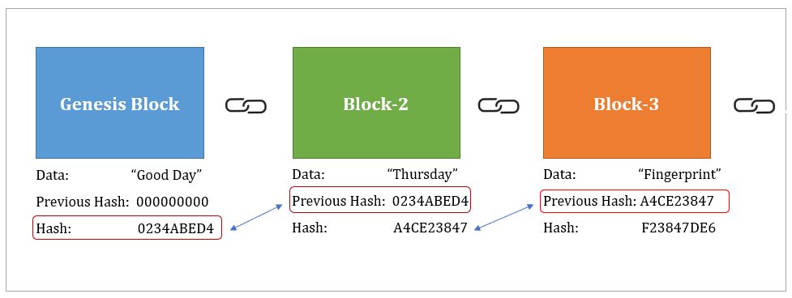
Blockchain components
Blocks contain:
  block header - contains metadata: block number, hash value of previous block header, timestamp, nonce value, and size of block. The hash value of the previous block header is stored in the block header of the current block (chaining of blocks). The first block with no parent block is called Genesis Block.
  block data - contains list of transactions which have been included in the block after validation and authentication.

Slide 11
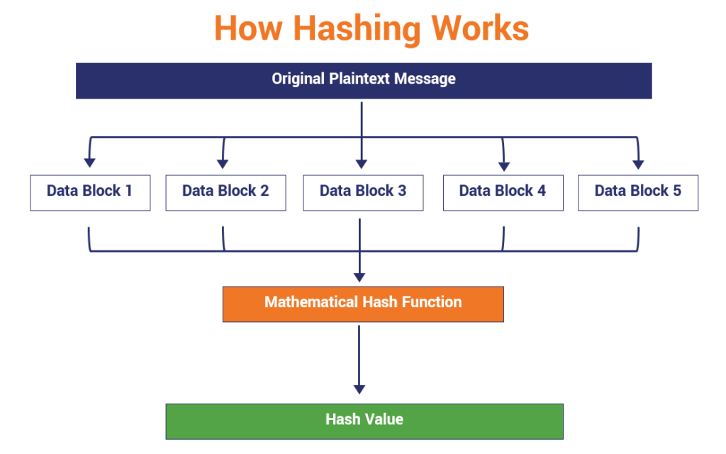
Blockchain components
Cryptographic Hash Functions. On passing the input data (file, text, etc.), it generates a unique output of fixed size called as hash. Hash functions enable to create a chain of blocks. Any modification in the block or chain also changes the hash value.

Slide 12
Blockchain components
Consensus Algorithm. In blockchain network must be a consensus among different members. Each member of the network have right to validate and verify the integrity of system without a third party. This consensus is essential for adding a block to the blockchain.
Incentives. Incentives are given to the validators or miners who perform the required tasks in the blockchain network.
Peer-to-Peer Network. It is a group of interconnected computers or devices (nodes) connected through wired or wireless connection. These nodes take part in transfer of data without the role of central server.
Memory pools (mempools). It is a collection of pending transactions. A node chooses a transaction from this pool to add to the block and once a transaction is added to the block then it is removed from the mempool.

Slide 13
Characteristics of blockchain technology
Decentralization. Blockchain utilizes distributed system that does not require a central authority.
Anonymity. The members of blockchain network can interact with one another without revealing their real identity. Instead they use a generated public key to communicate.
Auditability. Current transaction must refer to the previous transaction and this leads to a chaining.
Security. The blockchain technology is secured using cryptographical techniques.
Increased capacity. Blockchain has increased the capacity by better involvement of the computers or devices in that network to perform a function.
Transparency. All transactions in the blockchain network are transparent to all network members.
Reliability. A copy of transactions is stored in the distributed ledger of each node in the network.
Immutability. Once the transaction is added and recorded it cannot be changed.

Slide 14
Blockchain transactions
To manage blockchain transactions it is important to provide:
  the scalability
  performance
  interoperability
  security
  privacy
  trust.

Slide 15
Blockchain transactions
The scalability and performance of the blockchain system are determined by:
  Data size. Depending on the cryptocurrency, the size of the blocks that generate transactions varies. Transactions continue, records grow, and all this leads to a constant increase of blocks.
  Response time. Due to the daily increase in the number of users and the number of transactions they perform, it is necessary to reduce the waiting time and adjust the response time.
  Price. Increasing the number of users, transactions, and traffic in general leads to increased costs.

Slide 16
Blockchain data models
Blockchain data models are an essential part of a solution resolving the privacy issues.
The four parties involved in the blockchain data models are:
  Miner. The ones in charge of validating new transactions and storing them in the global ledger.
  Agent. The agent works in a public blockchain, collects assignments and publishes them in the private agent network.
  Requester. An assignment is released to the blockchain by the requester for the purpose of gathering information from certain locations.
  Worker. When an assignment is released, workers can download them and solve them. When the assignment is completed, workers are rewarded. All workers are anonymous.

Slide 17
Blockchain types
According to different applications three types of blockchain have been identified:
  Public (permissionless). It is organized as an open-source decentralized system ruled by democracy, and there is no authority that controls it. It can be used by anyone who wants to participate in basic activities within the blockchain network. Disadvantages are higher energy consumption for maintaining and distributing the ledger and the existence of malicious programs that aim to steal tokens or clog the network.
  Private. The implementation of the private blockchain allows network access only to verified users. Unlike public blockchains, private ones are centralized and controlled by its users, who have permission to access the network and maintain the main ledger.
  Consortium. The consortium blockchain regulates the consensus process in advance with a selected set of nodes.

Slide 18
Consensus algorithms

Slide 19
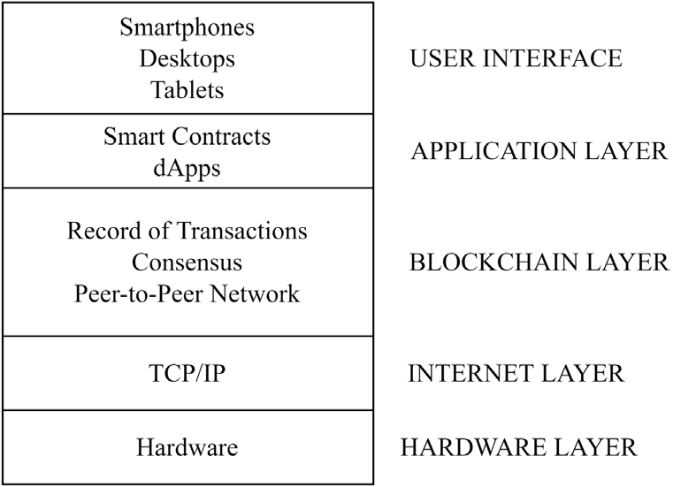
Blockchain stack
Main layers of blockchain stack:
  Internet Layer - different devices are interconnected with one another and communicate using the TCP/IP protocol.
  Blockchain Layer - there is involvement of blockchain fundamentals such as consensus rules, peer-to-peer network, and distributed ledger of transactions.
  Application Layer - Decentralized applications (dApps) along with smart contracts are built on top of blockchain layer.

Slide 20
Consensus algorithms
Consensus as a notion constitutes unanimous decision-making.
In a blockchain context, this term is based on the principle of verification and validation.
The consensus is a synchronized process that encompasses transactions and keeps track of them at the network level.
When the transactions are verified, the ledger is updated.
There is a large number of consensus algorithms which are based on different principles but have the same goal.

Slide 21
Commonly used consensus algorithms
Proof of Work (PoW):
  The most frequently used algorithm in cryptocurrency systems.
  The user receives a task to solve and can receive prize in cryptocurrencies.
  It allows anyone to mine, but it requires huge energy consumption.
  It is proposed to be used in a peer-to-peer version of the electronic cash system (Bitcoin), where the online payments occur between two parties directly without intermediary.
Proof of Stake (PoS):
  Some users process transactions, while others confirm them by mining and no professional equipment is required.
  The miner must hold a certain number of bitcoins and this amount determines the probability of a node getting selected as a validator for the next block.
  Uses digital signature to prove the ownership of coins.

Slide 22
Commonly used consensus algorithms
  Pure proof of stake (Pure POS):
  This means that it can tolerate malicious users, achieving consensus without a central authority, as long as a supermajority of the stake is in non-malicious hands.
  This protocol is very fast and requires minimal computational power per node, giving it the ability to finalize transactions efficiently.
  Delegate Proof of Stake (dPoS):
  System is maintained by the coin holder that votes for delegates.
  Delegates are responsible for validating new blocks and get reward.
  A fixed number of delegates are voted by stakeholders.
  Each stakeholder gets votes proportional to the number of coins they own.
  Each delegate is scheduled for a certain interval of time.
  In case of failure in validating blocks or any malicious activity, the delegate is replaced by another delegate.

Slide 23
Blockchain platforms

Slide 24
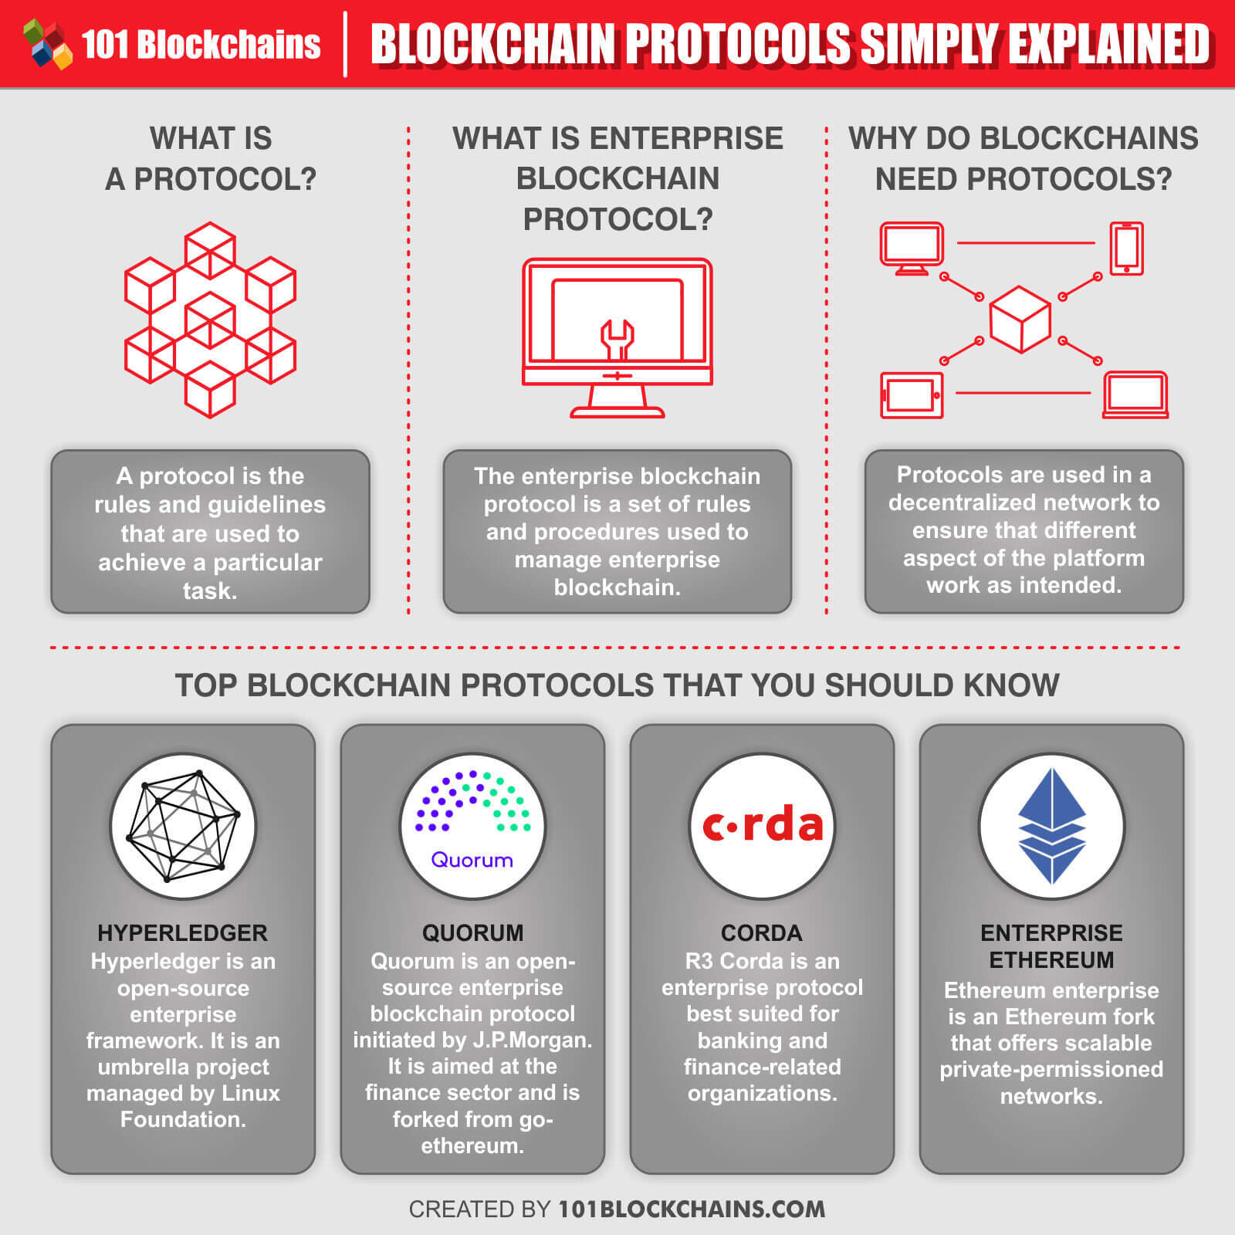
Blockchain platforms
  Various blockchain platforms have been introduced to deploy smart contracts and provide enterprise solutions to issues in numerous industries.
  Depending on the system requirements, the suitable blockchain platform should be selected.

Slide 25
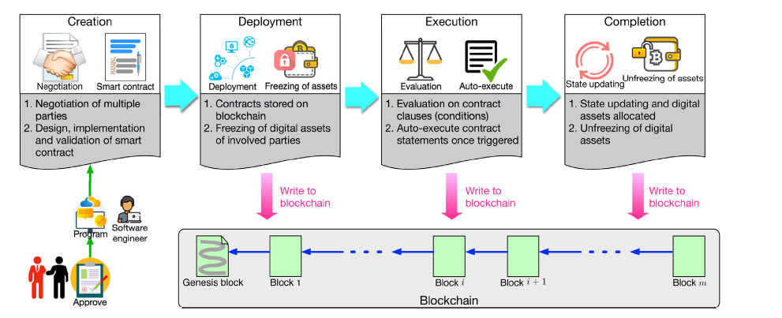
Smart contracts
  Every blockchain transaction depends on a specific smart contract.
  Smart contracts:
  contain contract clauses written in computer programs
  are computational transaction protocols that implement the rules defined in the contract
  are automatically executed when predefined conditions are met
  A life cycle of a smart contract consists of:
    Creation
    Deployment
    Execution
    Completion

Slide 26
Algorand
  Algorand solution is related to the way in which the new block is added to the existing chain.
  A new block is created in two stages:
  One token is chosen at random. Its owner is the user who proposes to add a new block.
  The second stage involves the selection of 1000 tokens from the system. Their owners become part of the committee that accepts the proposed token.
  Considering that the system contains 10 billion tokens, the chances of fraud in the system are very low.
  Each owner of the selected token runs a cryptographic lottery for each token they own.
  If no token is selected, the vote of that user is ignored.
  Otherwise, the number of votes won and the opinion about the new block is sent to the network.

Slide 27
Algorand
  Each blockchain has its own native currency that plays a key role in encouraging the good behavior of the network called Algo.
  Users who have Algo tokens can register to participate in the consensus, i.e. the process of proposing and voting on new blocks.
  Algo is also used as a utility token.
  During application development, Algos are needed to pay transaction fees and serve as minimum deposits to store data on the blockchain.
  On the Algorand platform applications can be developed using:
  Reach - in order to learn Reach, a basic knowledge of JS is required. It is abstract enough to allow writing applications with fewer lines of code.
  Pyteal - learning Pyteal requires a basic knowledge of Python. It is at a lower level of abstraction than Reach.
  The Algorand blockchain uses a decentralized Byzantine Agreement protocol that leverages pure proof of stake (Pure POS).

Slide 28
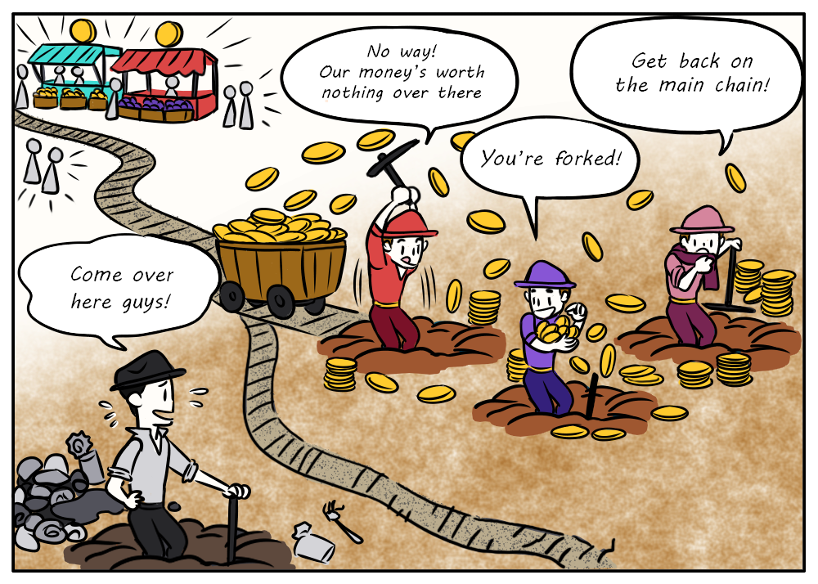
Algorand
  A problem that has often occurred in the blockchain network is forking.
  Within the blockchain network such as Bitcoin, there is a possibility of the disappearance of blocks in a situation where the blockchain splits into two separate branches.
  Algorand reduces this possibility to a minimum.

Slide 29
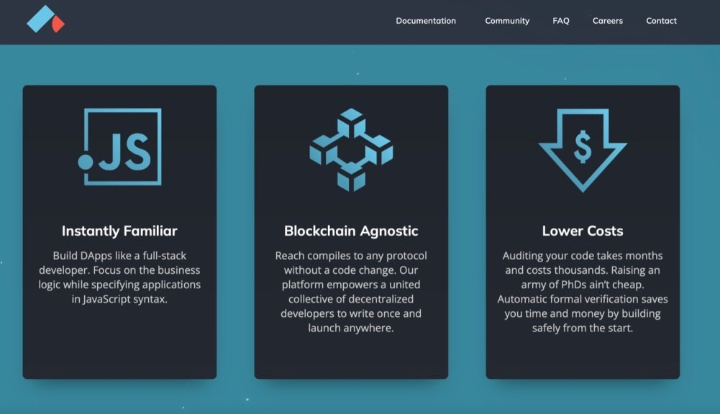
Reach
  Reach is used for the development of decentralized apps.
  It has a similar syntax as JavaScript and the code is written on a more abstract level than other languages used for dApp development.
  Enables participants to interact and complete transactions on a consensus network.
  Reach is blockchain agnostic and can launch blockchain projects on different consensus networks like Ethereum, Algorand, and Conflux.

Slide 30
Blockchain in e-business ecosystems

Slide 31
Generations of blockchain
  Four generations of blockchain have been recognised:
    Blockchain 1.0 - cryptocurrency transactions
    Blockchain 2.0 - financial applications
    Blockchain 3.0 - diversified decentralized applications
    Blockchain 4.0 - integration of blockchain and various domains:
    E-business,
    Finances,
    Industry,
    Healthcare,
    Education,
    Government,
    Smart Cities, etc.

Slide 32
Blockchain application domains
E-business
  For companies that operating online, it is important to monitor user behavior and determine their preferences for certain products and services.
  Analyzing consumers who shop online is essential to determine the recency, frequency, and monetary value realized for each transaction.
  The application of blockchain allows consumers to customize the content and ads they want to see and consume.
  The Basic Attention Token (BAT) was created by the co-founder of Mozilla and Firefox, Brendan Eich, to improve the security, fairness, and efficiency of digital advertising through blockchain technology.
  Built on Ethereum, its goal is to efficiently distribute advertising money between advertisers, publishers, and readers of online marketing content and ads.

Slide 33
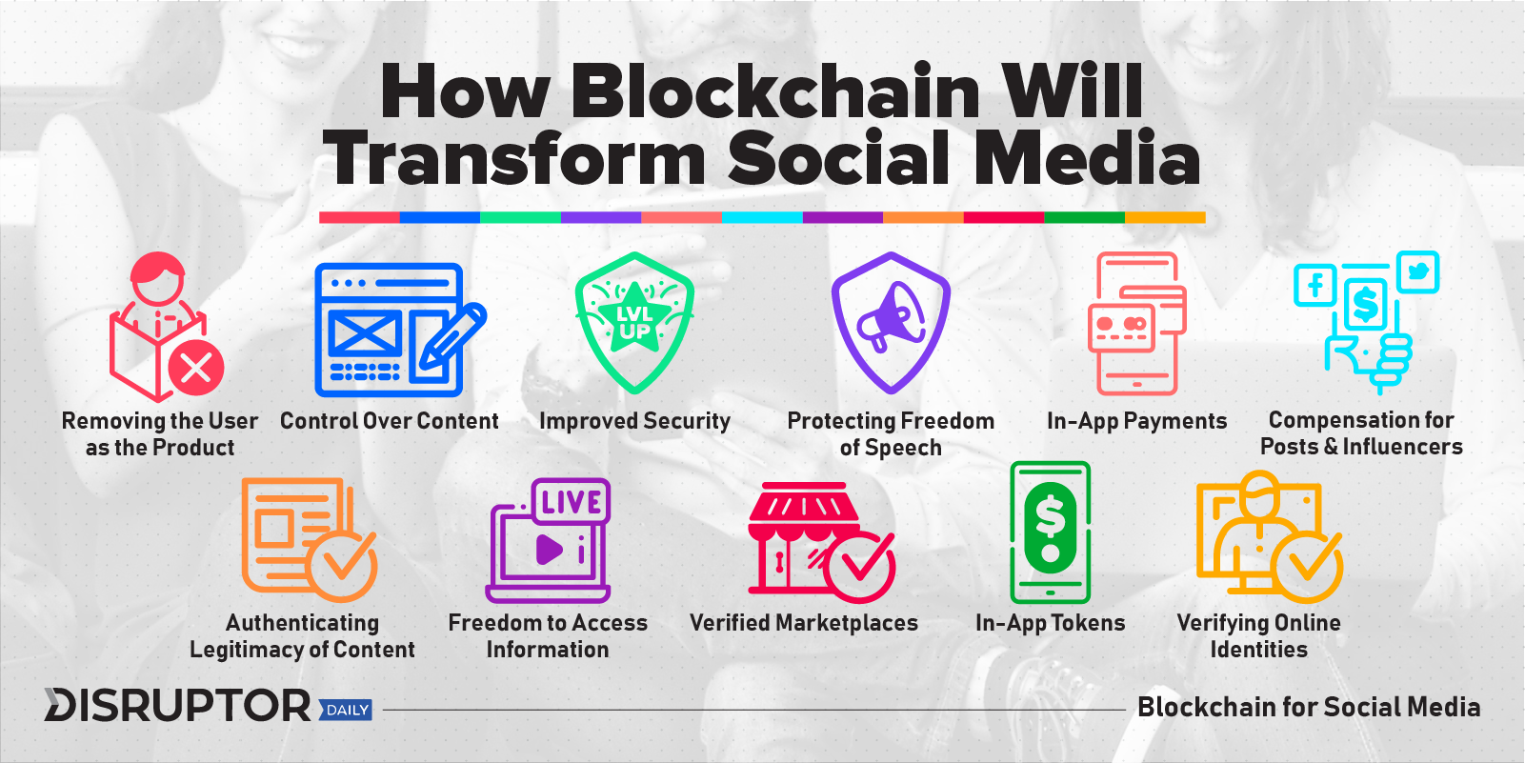
Blockchain application domains
E-business
  Digital marketing and social media become an inevitable part of e-business.
  Social media has transformed the mode of communication globally by providing an extensive system for exchanging ideas, initiating business contracts, and proposing new professional ideas.
  The application of Blockchain in social media brings benefits

Slide 34
Blockchain application domains
Loyalty programs
  Loyalty programs are marketing methods used by companies in order to improve user collaboration and gather additional user data.
  Blockchain makes collaboration between partner companies easier and it contributes to solving problems such as high maintenance costs, low retention rate, low point utilization, data privacy and security.
  By using a single blockchain wallet the consumers can utilize their loyalty points in different companies through a single platform.

Slide 35
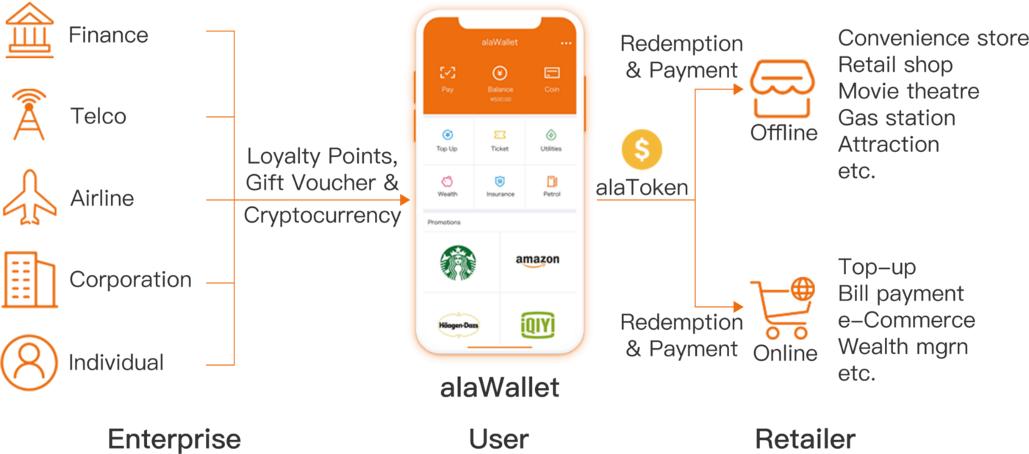
Blockchain application domains
Loyalty programs

Slide 36
Blockchain application domains
Healthcare
  Digital transformation and Healthcare 4.0 enabled the application of innovative digital technologies in the healthcare sector that positively affected:
  real-time communication and collaboration among stakeholders,
  healthcare organizational processes, better productivity, lower business costs,
  better insight into business transactions,
  managing large data sets in real-time,
  health insurance problems,
  improved medical care services,
  faster detection and identification of diseases,
  patients enabling them to approach their medical data and to share them on request with healthcare providers and other participants in the healthcare ecosystem.

Slide 37
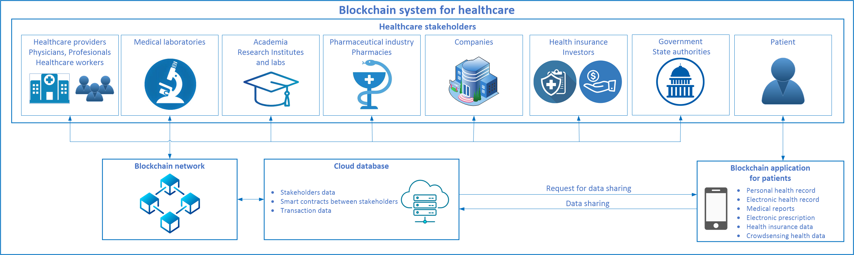
Blockchain application domains
Healthcare

Slide 38
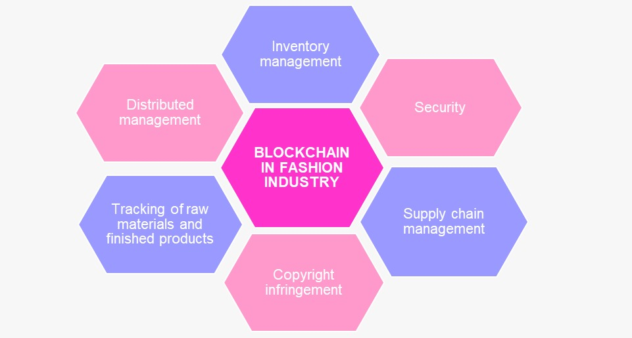
Blockchain application domains
Industry
  In supply chain blockchain:
  facilitates a comprehensive check of the financial flow within the whole supply chain process
  increases process speed by minimizing physical interactions and communication
  provides insight to each participant into all processes within the supply chain
  enables performance measurement indicators for environmental, economic, and social sustainability
  complete insight into the process of creation of the product

Slide 39
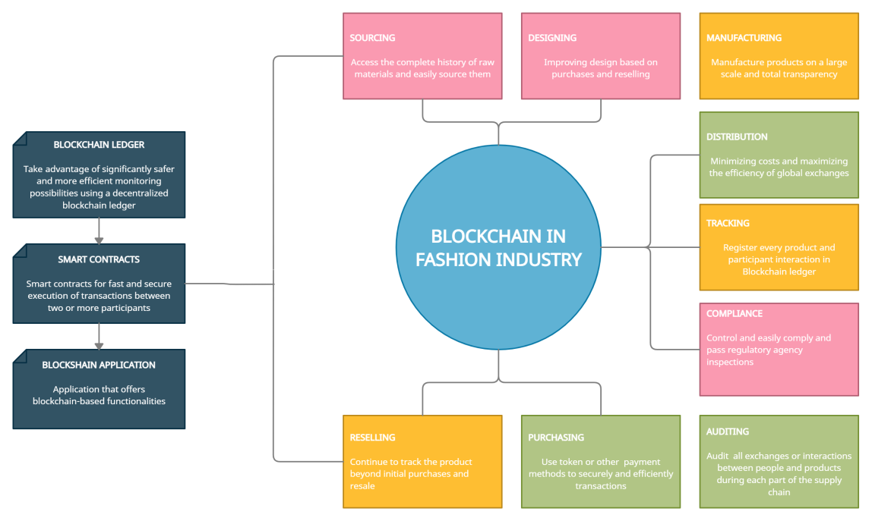
Blockchain application domains
Fashion industry
  Stakeholders involved in the fashion industry:
  Supplier of raw materials
  Designer
  Manufacturer
  Distributor
  Seller
  Customer
  Each stakeholder in supply chain presents
  their requirements and conditions in the smart contracts.
  Customers have insight into the product's origin and value.

Slide 40
Conclusion

Slide 41
Conclusion
  The development of the digital economy is changing the ways of modern business and the exchange of digital information.
  Consistent integrity of data and records in modern distributed information systems can be achieved by applying blockchain technologies.
  Blockchain is based on a distributed database, which consists of encrypted data that cannot be changed or copied, and which enables reliable verification and automation.
  Blockchain can be applied in the domains of e-business, health, industry, and others.
  The goal of applying blockchain technologies in certain domains is to improve the way of doing business with:
  lower costs,
  greater security of business transactions,
  reduced risk of fraud.

Slide 42

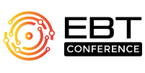
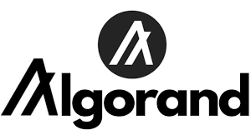




Slide 43




BLOCKCHAIN IN E-BUSINESS ECOSYSTEMS
https://bc.elab.fon.bg.ac.rs/
bclab@elab.rs
Stay tuned

